Slide 1


INVERTER UNITARY TRAINING
Brand Introduction and Product Installation
Please download the Ecoer smart Service App from the app store

Slide 2
TABLE OF CONTENTS
Brand Introduction
Products
Installation
Key Product Components
Heat Pump Installation Notes
Heat Pump Function
Gateway Installation Notes
Gateway Function
Field Setting

Slide 3





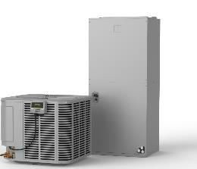
About Ecoer company
R&D
3 Locations: China, Japan and USA 6 USA Patent filed in 2016
100% of the technology owned by Ecoer
Brand
Ecoer Inc.
Headquarters is located in Fairfax, Virginia. A US based company focusing on offering the best Residential Central Air Conditioner systems and Heat Pump systems using Inverter Technology.
Ecoer makes Unitary Inverter Easy, Smart and Affordable.
Warehouse and Logistic
Houston, TX
East Haven, CT
Certification
AHRI, UL, ETL, NEEP, Mass Save
No copies allowed, all rights reserved by ECOER

Slide 4
Certified Dealer Program
The Ecoer Certified Dealer Program is a chance for contractors to tap directly into Ecoer’s extensive marketing, training and service resources. When a contractor meets the requirements of the Certified Dealer Program, they will have access to the many services and resources offered by Ecoer. We understand that authorization is a process and will take a concerted effort on your part as well as ours to achieve the highest level of Ecoer Dealership.
No copies allowed, all rights reserved by ECOER

Slide 5
Certified Dealer Program
A fully Certified Ecoer Dealer will have installed four (4) systems with the IoT Gateway.
A single 3rd party matchup system will count towards .5 system
Receive factory or factory‐approved distributor training (factory provided online training available soon)
Offers the Ecoer products on all applicable residential replacement proposals
Offer IoT Gateway on all Ecoer proposals
Certified Ecoer Dealer status will be reviewed annually.
No copies allowed, all rights reserved by ECOER

Slide 6
Certified Dealer Program
A fully Certified Ecoer Dealer will have installed four (4) systems with the IoT Gateway.
A single 3rd party matchup system will count towards .5 system
Receive factory or factory‐approved distributor training (factory provided online training available soon)
Offers the Ecoer products on all applicable residential replacement proposals
Offer IoT Gateway on all Ecoer proposals
Certified Ecoer Dealer status will be reviewed annually.
No copies allowed, all rights reserved by ECOER

Slide 7
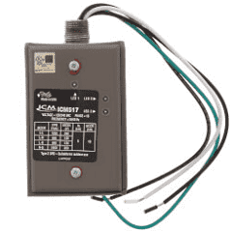
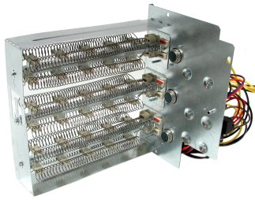
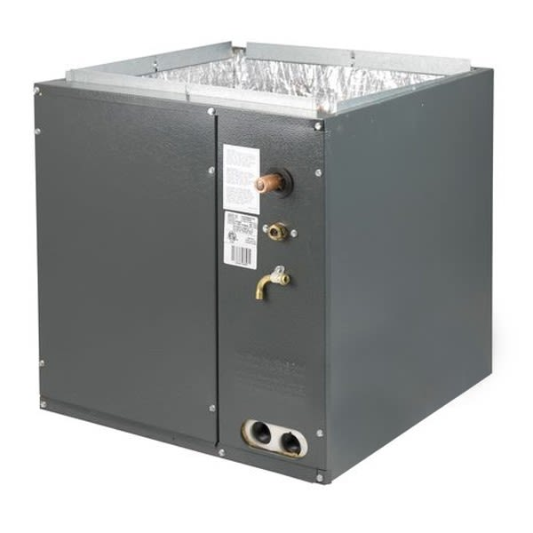
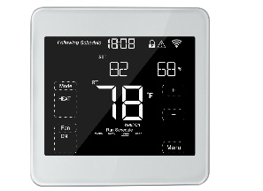

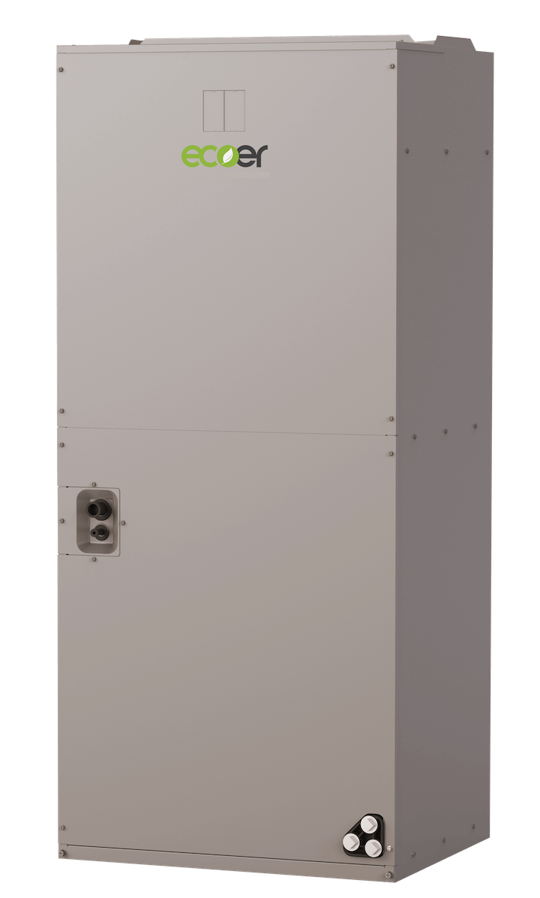
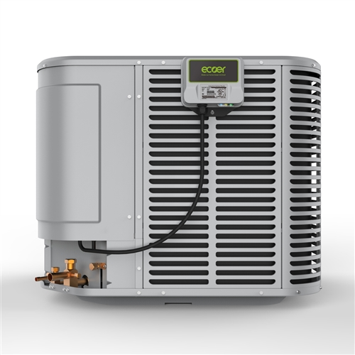
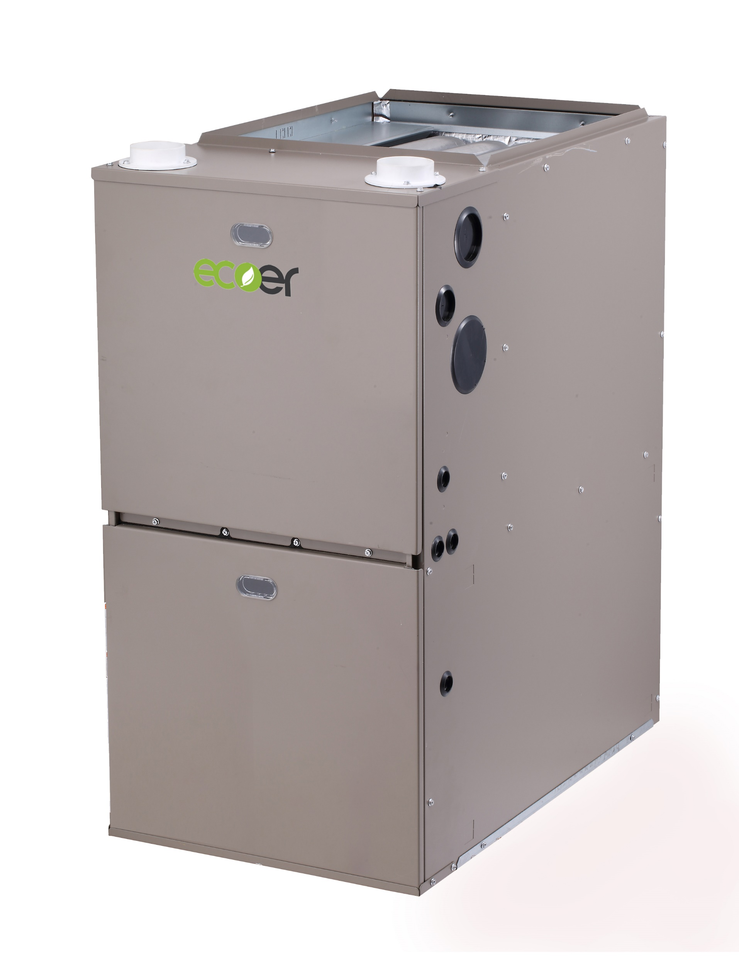


PRODUCTS
Inverter & IoT Technology
ESI Products

Slide 8
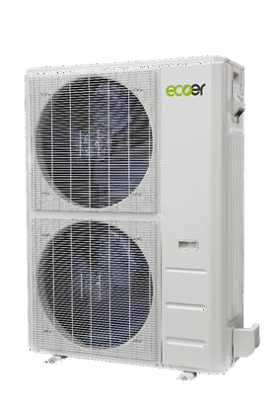
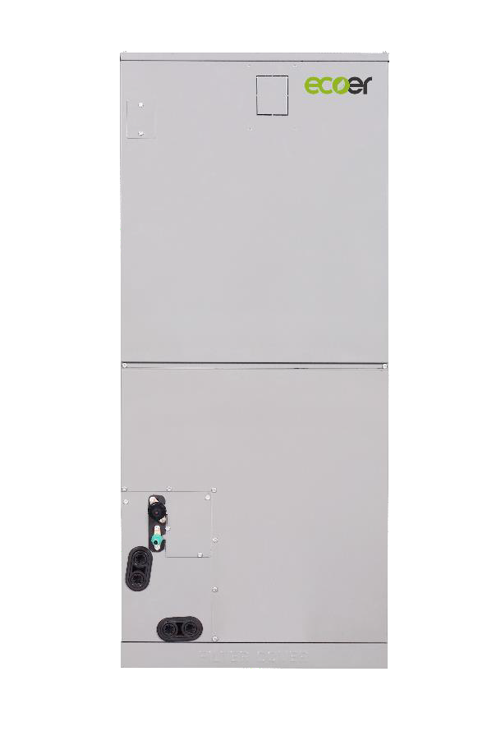

PRODUCTS
Inverter & IoT Technology
SDI Products

Slide 9
PRODUCTS
Inverter & IoT Technology
Heat Pumps
EODAH18-2436
EODAH18-4860

Slide 10
PRODUCTS
Inverter & IoT Technology
Air Handlers
EAHATN-24
EAHATN-36
EAHATN-48
EAHATN-60

Slide 11
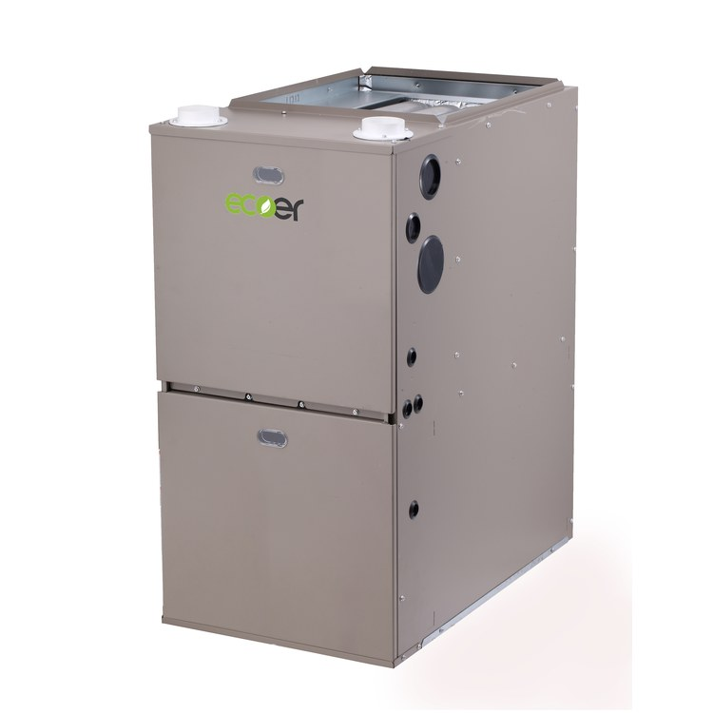
PRODUCTS
Inverter & IoT Technology
Furnace
MGH96M060B3A
MGH96M080C4A
MGH96M080B3A
MGH96M100C5A

Slide 12
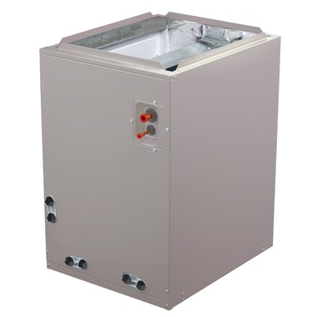
PRODUCTS
Inverter & IoT Technology
Cased Coil
GNC2430APT
GNC2430BPT
GNC3036BPT

Slide 13
PRODUCTS
Inverter & IoT Technology
Cased Coil
GNC4248CPT
GNC4860CPT
GNC4860DPT

Slide 14
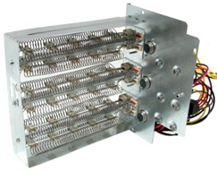
PRODUCTS
Inverter & IoT Technology
Heaters
EHK10
EHK05
EHK08
EHK15
EHK20

Slide 15
PRODUCTS
Inverter & IoT Technology
Accessories
DTK-120/240
EST01
EG910L

Slide 16
PRODUCTS
Inverter & IoT Technology
SDI Heat Pumps

Slide 17
PRODUCTS
Inverter & IoT Technology
SDI Heat Pumps
ESCA16H-36
ESCA16H-60

Slide 18
PRODUCTS
Inverter & IoT Technology
SDI Accessories
EAHAEC-36BAA
EAHAEC-60BAA

Slide 19
PRODUCTS
Inverter & IoT Technology
SDI Heaters
E-EAH05B (UL)
E-EAH08B (UL)
E-EAH10B (UL)
E-EAH15B (UL)
E-EAH20B (UL)

Slide 20
PRODUCTS
Inverter & IoT Technology
SDI Accessories
DTK-120 / 240
ECT01

Slide 21

Ecoer Inverter Heat Pumps
WWW.ECOERMASSAVE.COM
Utility Rebate Program

Slide 22
Ecoer Inverter Heat Pumps
Side Discharge series (SDi) Performance Heat 3 ton
Conditions 70F Indoor 5F Outdoor
ESI 24,000 BTUH
SDI 39,000 BTUH

Slide 23
Ecoer Inverter Heat Pumps
Side Discharge series (SDi) Performance Heat 5 ton
Conditions 70F Indoor 5F Outdoor
ESI 38,000 BTUH
SDI 52,000 BTUH

Slide 24
Ecoer Inverter Heat Pumps
Side Discharge series (SDi) Performance Heat 5 ton
Conditions 70F Indoor 5F Outdoor
ESI 38,000 BTUH
SDI 52,000 BTUH

Slide 25
Ecoer Inverter Heat Pumps
Side Discharge series (SDi) Performance Cool 3 ton
Conditions 75/63F Indoor 95F Outdoor
ESI 30,900 BTUH
SDI 45,000 BTUH

Slide 26
Ecoer Inverter Heat Pumps
Side Discharge series (SDi) Performance Cool 5 ton
Conditions 75/63F Indoor 95F Outdoor
ESI 47,400 BTUH
SDI 53,600 BTUH

Slide 27
PRODUCTS
Inverter & IoT Technology
Ecoer AHRI Performance Data Air Handler
AHRI | Energy Star | Outdoor Unit | Air Handler | Cooling |  |  | Heating |  |  | CFM
 |  |  |  | Total | SEER | EER | High | HSPF | Low
202337969 | Yes | EODA18H-2436 | EAHATN-24 | 23400 | 20.00 | 13.00 | 24000 | 10.00 | 15200 | 800
202110525 | No | EODA18H-2436 | EAHATN-36 | 34200 | 18.00 | 11.20 | 36000 | 10.00 | 24000 | 1130
202110529 | Yes | EODA18H-4860 | EAHATN-36 | 36000 | 20.00 | 13.00 | 36000 | 10.00 | 24000 | 1130
202337970 | No | EODA18H-4860 | EAHATN-48 | 45000 | 17.00 | 12.00 | 47000 | 9.50 | 32000 | 1500
202110527 | No | EODA18H-4860 | EAHATN-60 | 54000 | 17.00 | 10.00 | 54000 | 9.50 | 35600 | 1590

Slide 28
PRODUCTS
Inverter & IoT Technology
Ecoer AHRI Performance Data Cased Coil (Only)
AHRI | Energy Star | Outdoor Unit | Cased Coil | Cooling |  |  | Heating |  |  | CFM
 |  |  |  | Total | SEER | EER | High | HSPF | Low
203376741 | No | EODA18H-2436 | GNC2430APT | 22800 | 16.00 | 11.00 | 22800 | 9.50 | 15000 | 750
206395296 | No | EODA18H-2436 | GNC2430BPT | 22800 | 16.00 | 11.00 | 22800 | 9.50 | 15000 | 780
203376742 | No | EODA18H-2436 | GNC3036BPT | 31000 | 16.00 | 10.00 | 33000 | 9.50 | 21000 | 1000
203376743 | No | EODA18H-4860 | GNC4248CPT | 41000 | 16.00 | 10.50 | 43000 | 9.50 | 30000 | 1280
203376744 | No | EODA18H-4860 | GNC4860CPT | 51000 | 16.00 | 10.00 | 51000 | 9.50 | 30600 | 1280
203376745 | No | EODA18H-4860 | GNC4860DPT | 51000 | 16.00 | 10.00 | 51000 | 9.50 | 30600 | 1500

Slide 29
PRODUCTS
Inverter & IoT Technology
Ecoer AHRI Performance Data Furnace and Cased Coil
AHRI | Energy Star | Outdoor Unit | Cased Coil | Furnace | Cooling |  |  | Heating |  |  | CFM
 |  |  |  |  | Total | SEER | EER | High | HSPF | Low
206340202 | Yes | EODA18H-2436 | GNC2430BPT | GNVF96M060B | 23200 | 17.00 | 12.50 | 23200 | 9.50 | 15600 | 860
206340203 | No | EODA18H-2436 | GNC3036BPT | GNVF96M060B | 31000 | 16.50 | 10.50 | 33000 | 9.50 | 22000 | 1100
206340204 | Yes | EODA18H-4860 | GNC3036BPT | GNVF96M060B | 33200 | 18.00 | 12.50 | 34000 | 9.50 | 23000 | 1100
206199282 | Yes | EODA18H-2436 | GNC2430APT | GNVF96M080B | 23200 | 17.00 | 12.50 | 23200 | 9.50 | 15600 | 800
206199284 | Yes | EODA18H-2436 | GNC2430BPT | GNVF96M080B | 23200 | 17.00 | 12.50 | 23200 | 9.50 | 15600 | 840
206199283 | No | EODA18H-2436 | GNC3036BPT | GNVF96M080B | 31000 | 16.50 | 10.50 | 33000 | 9.50 | 22000 | 1070
206199285 | Yes | EODA18H-4860 | GNC3036BPT | GNVF96M080B | 33200 | 18.00 | 12.50 | 34000 | 9.50 | 23000 | 1070
206199286 | No | EODA18H-4860 | GNC4248CPT | GNVF96M100C | 44000 | 17.00 | 11.00 | 45000 | 9.50 | 30000 | 1450
206199287 | No | EODA18H-4860 | GNC4860CPT | GNVF96M100C | 51000 | 16.50 | 10.00 | 52000 | 9.50 | 35000 | 1450
206199288 | No | EODA18H-4860 | GNC4860DPT | GNVF96M120D | 51000 | 16.50 | 10.00 | 52000 | 9.50 | 35000 | 1500

Slide 30
4
1
4
Key Heat Pump Components

Slide 31
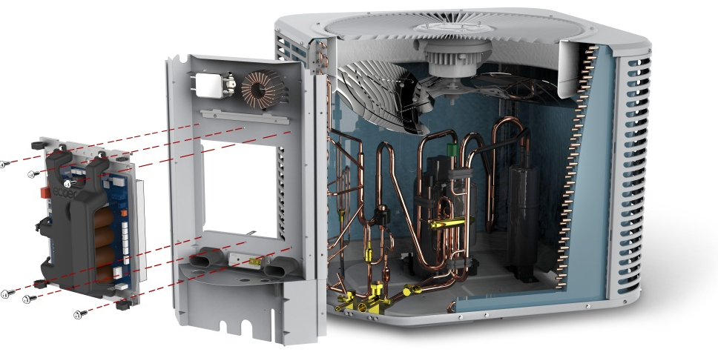
Key Product Components
ODU Functional Parts Layout
DC Motor (FAN)
High Pressure Sensor (HP) Black
Low Pressure Sensor (LP) Green
Inductance
Fan Blades
Noise Filter
Function and Control
Heat Exchanger
Accumulator (ACC)
Inverter Compressor (INV)
Main Control Board (PCB)
Strainers
Gauge Port
Reversing Valve (ST1)
Electronic Expansion Valve (EEV)
Lower Side Plate
Liquid/Gas Service Valve

Slide 32
4
1
4
Heat Pump Refrigerant Flow Chart

Slide 33
Function and Control
ODU Refrigerant circuit diagrams
EEV
TA
Liquid Service Valve
TL
FAN
TA= Ambient Temp
TH= Defrost Sensor
TD= Compressor Discharge Temp
TL= Liquid Line Temp
TS= Compressor Suction Line Temp
HP= High Pressure Sensor
LP= Low Pressure Sensor
ST1=Reversing Valve
TH
Heat Exchanger
Gas Service Valve
ST1
True Suction Port
TD
Gauge Port
HP
LP
INV
TS
NOTE: Reversing Valve is energized (208/230Vac) in Cooling Mode
ACC

Slide 34
Function and Control
Cooling Operation (including cooling oil return and defrost operation)
EEV
TA
TXV
Liquid Service Valve
TL
FAN
Heat Exchanger
TH
Heat Exchanger
Gas Service Valve
O signal 24V=ON,
Reversing valve is energized .
Cooling Metering: Indoor TXV
True Suction Port
ST1
Gauge Port
TD
HP
High pressure Gas
LP
INV
High pressure Liquid
Low pressure Gas
Low pressure Mix.
TS
ACC
Notes:
Q&A: Does the 4-way valve energize in cooling or in heating?
Ecoer uses O signal for cooling (Low voltage), but de-energizes the 4-way valve (high voltage supply for the 4-way valve coil).

Slide 35
Function and Control
Heating Operation (including heating oil return)
EEV
TA
TXV
Liquid Service Valve
TL
FAN
Heat Exchanger
TH
Heat Exchanger
Gas Service Valve
O signal 24V=OFF,
Reversing valve is deenergized (208/230V).
Heating Metering: outdoor EEV
True Suction Port
ST1
Gauge Port
TD
HP
High pressure Gas
LP
INV
High pressure Liquid
Low pressure Gas
Low pressure Mix.
TS
ACC

Slide 36
4
1
4
Heat Pump Function and Control

Slide 37
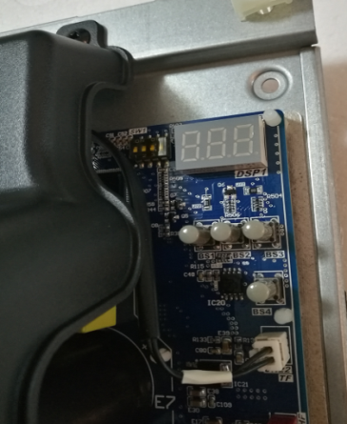
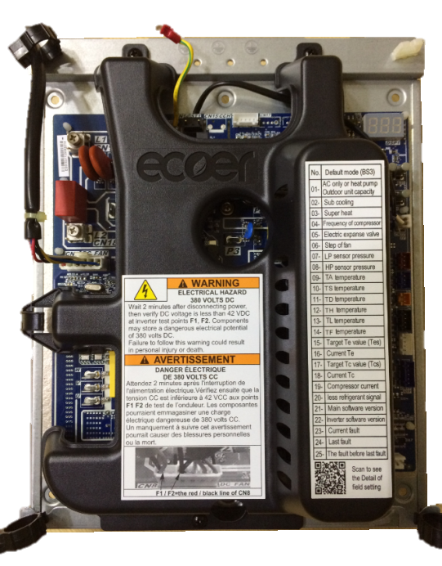
4
1
4

Slide 38
FUNCTION

Slide 39
FUNCTION
SEG1
SEG2
SEG3

Slide 40
FUNCTION

Slide 41
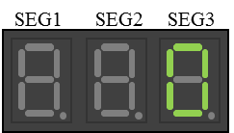
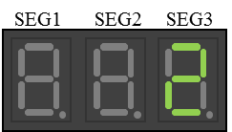
FUNCTION
Six Operation Modes
Operation in stop mode
after 1 minutes
Stand by without running signal
Thermostat OFF
→Status Code (SEG3): 0
or
Y=OFF
O be changed
Thermostat ON
(Y=ON)
Pressure equalizing prior to start up
SEG1
SEG2
SEG3
Wait to start after receiving Y signal
(about 6min for pressure equalizing)
Longest 6 minutes
→Status Code (SEG3): 1
Startup control*1
・Cooling startup
(O=ON)
・Heating startup
(O=OFF)
Cooling running
→Status Code (SEG3): 2
Outdoor unit rotation
Heating running
SEG1
SEG2
SEG3
→Status Code (SEG3): 3
Normal operation:
Cooling operation
Heating operation
Oil return operation
Defrost operation
Normal operation
Oil return
SEG1
SEG2
SEG3
→Status Code (SEG3): 4
Defrost operation
SEG1
SEG2
SEG3
→Status Code (SEG3): 5

Slide 42
FUNCTION
Oil Return 4
Oil return
SEG1
SEG2
SEG3
→Status Code (SEG3): 4
Heating or cooling mode: system will enter oil return mode following a runtime of 45 minutes cumulative.
Heating or cooling mode: system will exit oil return mode after 90 seconds

Slide 43
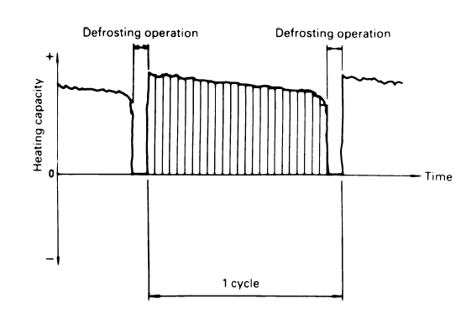
FUNCTION
Defrost operation(smart)
Defrost operation
SEG1
SEG2
SEG3
→Status Code (SEG3): 5
Defrost will initiate if one of the following conditions is met.
Outdoor temperature is lower than 28F and the high-pressure sensor is lower than 245 PSI for 20 minutes.
Outdoor temperature is lower than 30F and the outdoor coil sensor (TH) is 18F or lower than the ambient
Outdoor temperature is 18F and the systems has been running for 80 minutes
Outdoor temperature is lower than 23F and the system has run for 210 minutes
Outdoor temperature is lower than 43F and higher than 23F and the system has been running for 120 minutes

Slide 44
FUNCTION
3 Technician Input Modes
Force defrost
SEG1
SEG2
SEG3
Status Code (SEG3): 6
Test Mode / Charge Mode
SEG1
SEG2
SEG3
Status Code (SEG3): 7
Pump Down
SEG1
SEG2
SEG3
Status Code (SEG3): 8

Slide 45
FUNCTION
Operator Mode: Forced Defrost
Force defrost
SEG1
SEG2
SEG3
Status Code n08
Forced Defrost
Press and hold BS 1 for 5 seconds Display n 0 0
Press BS2 until n 0 8 Display n 0 8
Press BS3 to enter sub-menu Display - 0
Press BS2 to display -1 Display - 1
Press BS3 two (2) times to save Display n 0 8
Press BS1 to exit manual defrost Display Current operating Mode
  When forced defrost is initiated, W1 on the heat pump (if enabled) will output 24 volts to energize secondary heat at the air handler.
BS 1
BS 2
BS 3
BS 4

Slide 46
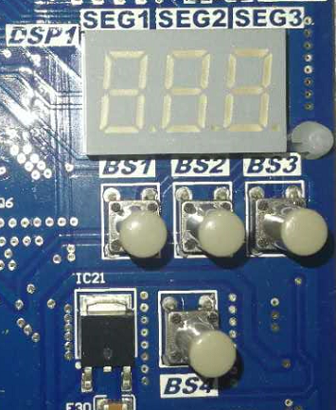
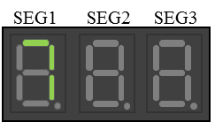
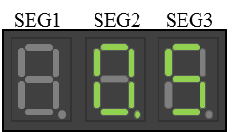
FUNCTION
Operator Mode: Test Mode / Auto Charge Mode
Test Mode / Charge Mode
SEG1
SEG2
SEG3
→Status Code (SEG3): 7
Test Mode / Auto Charge Mode
Press and hold BS 4 for 5 seconds Display Flashing 7 / - -
Wait until unit display an alternating number Display Flashing 7 / . 1 - . 9
Charge unit to proper value Display Flashing 7 / .6
Press BS4 to exit test / auto charge mode Display 0 0 2
  The Test / auto charge mode is avaible only when the system is in cooling mode and the ambient is above 55F.
BS 1
BS 2
BS 3
BS 4

Slide 47
FUNCTION
Operator Mode: Pump Down
Pump Down
SEG1
SEG2
SEG3
→Status Code (SEG3): 8
Pump Down Mode
Press and hold BS 4 for 5 seconds Display 0 0 7
Press BS2 until 0 0 8 Display 0 0 8
Close liquid line base valve Display ? ? ?
Close suction line base valve after system shuts down Display 0 0 8
Press BS4 to exit pump down Display 0 0 2
  The system will display the low pressure after pump down is initiated. Pump down will terminate when system reaches 24.5 PSIG.
BS 1
BS 2
BS 3
BS 4

Slide 48
FUNCTION
Operational Set points

Slide 49
FUNCTION
Filed setting- Setting mode

Slide 50
FUNCTION
Operator Mode: Pump Down
Selecting Operation Mode n00 – n08
SEG1
SEG2
SEG3
Press and hold BS1 (About 5 Seconds) Display n00
Tap BS2 to select mode n00 – n08 Display n01 – n08
Tap BS3 to enter mode sub menu Display 0 – 4 (Current Setting)
Tap BS2 to select Sub menu Item Display 0 – 4 (Desired Setting)
Double tap BS3 to lock new setting Display n01 – n08
Tap BS1 to return to operation Display 0 – 5 ( in Seg 3_
BS 1
BS 2
BS 3
BS 4

Slide 51
FUNCTION
Operator Mode: Heat Pump Stop
Heat Pump Stop
SEG1
SEG2
SEG3
Heat Pump Stop is the outdoor temperature stop temperature as measured by the Ecoer Heat Pump outdoor sensor. The temperature choices are as follows
0 = Stop at temperature below -22F
1 = Stop at temperature below -3F
2 = Stop at temperature below +15F
3 = Stop at temperature below +30F
4 = Stop at temperature below +40F
Status Code n01
BS 1
BS 2
BS 3
Press and hold BS 1 for 5 seconds Display n 0 0
Tap BS2 until N 0 1 Display n 0 1
Tap BS3 to enter sub-menu Display -01
Tap BS2 to desired temperature Display - 0 (See Above)
Double Tap BS3 to save settings Display n 0 1
Tap BS1 to exit or BS2 to advance* Display Current operating Mode
* Typically press BS2 to advance to W1 output n03
BS 4

Slide 52
FUNCTION
Operator Mode: W1 Output Temperature
W1 Output Temperature
SEG1
SEG2
SEG3
W1 output temperature is the temperature the W1 (white 24-volt wire) will energize. The choices are below
0 = Stop at temperature below +15F
1 = Stop at temperature below +30F
2 = Stop at temperature below +40F
3 = Stop at temperature below -3F
4 = Stop at temperature below +OFF
Status Code n03
BS 1
BS 2
BS 3
Press and hold BS 1 for 5 seconds Display n 0 0
Tap BS2 until N 0 3 Display n 0 3
Tap BS3 to enter sub-menu Display - 0
Tap BS2 to desired temperature Display - 3 (See Above)
Double Tap BS3 to save settings Display n 0 3
Tap BS1 to exit or BS2 to advance* Display Current operating Mode
* Typically press BS2 to advance to mode Choice N00
BS 4

Slide 53
FUNCTION
Operator Mode: Mode Choice
Mode Choice
SEG1
SEG2
SEG3
Mode choice determines the operation curve of the heat pump
0 = Normal
1 = Dry Mode (allows the heat pump suction temperature to fall to +28F
2 = High Capacity (allows the heat pump to ramp up faster than normal mode)
Status Code n00
BS 1
BS 2
BS 3
Press and hold BS 1 for 5 seconds Display n 0 0
Tap BS2 until N 0 0 Display n 0 0
Tap BS3 to enter sub-menu Display - 0
Tap BS2 to desired temperature Display - 2 (See Above)
Double Tap BS3 to save settings Display n 0 0
Tap BS1 to exit Display Current operating Mode
BS 4

Slide 54
FUNCTION
Operator Mode: Defrost Mode
Defrost Mode
SEG1
SEG2
SEG3
Changing this setting will extend or shorten defrost duration
0 = Heavy Frost
1 = Normal Frost
2 = Light Frost
Status Code n04
BS 1
BS 2
BS 3
Press and hold BS 1 for 5 seconds Display n 0 0
Tap BS2 until N 0 4 Display n 0 4
Tap BS3 to enter sub-menu Display - 1
Tap BS2 to desired setting Display - 0 (See Above)
Double Tap BS3 to save settings Display n 0 4
Tap BS1 to exit or BS2 to advance* Display Current operating Mode
* Typically press BS2 to advance to other mode choices
BS 4

Slide 55
FUNCTION
Operator Mode: Silent Mode
Silent Mode
SEG1
SEG2
SEG3
Changing this setting will change the output decibel of the heat pump and the duration of the silent mode. Choosing 1 or 2 will keep the heat pump in silent mode indefinitely.
0 = Off
1 = Silent 1
2 = Silent 2
3 = Night Silent 1 (see n06, n07)
4 = Night Silent 2 (see n06, n07)
Status Code n05
BS 1
BS 2
BS 3
Press and hold BS 1 for 5 seconds Display n 0 0
Tap BS2 until N 0 5 Display n 0 5
Tap BS3 to enter sub-menu Display - 0
Tap BS2 to desired setting Display - 2 (See Above)
Double Tap BS3 to save settings Display n 0 5
Tap BS1 to exit or BS2 to advance* Display Current operating Mode
* Typically press BS2 to advance to other mode choices
BS 4

Slide 56
FUNCTION
Operator Mode: Night Silent Mode Start Time
Night Silent Mode Start Time
SEG1
SEG2
SEG3
Changing this setting will enable the chosen silent level (3 or 4 see below) start time
0 = Silent On 5:00 PM
1 = Silent On 6:00 PM
2 = Silent On 7:00 PM
3 = Silent On 8:00 PM
4 = Silent On 9:00 PM
Status Code n06
BS 1
BS 2
BS 3
Press and hold BS 1 for 5 seconds Display n 0 0
Tap BS2 until N 0 6 Display n 0 6
Tap BS3 to enter sub-menu Display - 0
Tap BS2 to desired setting Display - 1 (See Above)
Double Tap BS3 to save settings Display n 0 6
Tap BS1 to exit or BS2 to advance* Display Current operating Mode
* Typically press BS2 to advance to other mode choices
BS 4

Slide 57
FUNCTION
Operator Mode: Night Silent Mode Stop Time
Night Silent Mode Stop Time
SEG1
SEG2
SEG3
Changing this setting will enable the chosen silent level (3 or 4 see below) start time
0 = Silent Off 5:00 AM
1 = Silent Off 6:00 AM
2 = Silent Off 7:00 AM
3 = Silent Off 8:00 AM
4 = Silent Off 9:00 AM
Status Code n07
BS 1
BS 2
BS 3
Press and hold BS 1 for 5 seconds Display n 0 0
Tap BS2 until N 0 7 Display n 0 7
Tap BS3 to enter sub-menu Display - 0
Tap BS2 to desired setting Display - 2 (See Above)
Double Tap BS3 to save settings Display n 0 7
Tap BS1 to exit or BS2 to advance* Display Current operating Mode
* Typically press BS2 to advance to other mode choices
BS 4

Slide 58
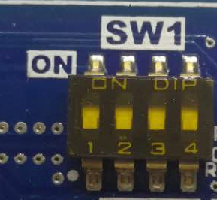
FUNCTION
Filed setting- Dip switch
Outdoor unit’s functions can be applied by pushing buttons and dialing switch on the job site. The following table shows the setting contents for “SW1” switch.
Dip switch |  | Description
NO． | Setting item | State | Content
1 | Winter Fan Mode | ON | No Exercise
 |  | OFF ( factory) | Winter Fan Exercise
2 | Capacity selection ^{*1} | ON | 2 Ton | 4 Ton
 |  | OFF(factory) | 3 Ton | 5 Ton
3 | AC only/heat pump selection | ON | AC only
 |  | OFF(factory) | Heat pump
4 | Response for IoT | ON | IoT output from board off
 |  | OFF(factory) | IoT output from board on
*1 Keep the ODU’s dip switch when 5Ton matches with 2 or 3 Ton indoor unit for hyper heating.

Slide 59
SEG1
SEG2
SEG3
Error Code
Code | Description | Legend
P1 | High pressure protection
E1 | System locks up when P1 has occurred six times in 3 hours. | Cannot restart *1
P2 | Low pressure protection in cooling mode
E2 | System locks up when P2 has occurred six times within 3 hours. | Cannot restart *1
P3 | Compressor discharge temperature (TD) protection
E3 | System locks up when P3 has occurred six times within 3 hours. | Cannot restart *1
P4 | Compressor discharge temperature (TD) sensor is disconnected or damaged
P5 | Inverter module temperature (TF) protection
E5 | System locks up when P5 has occurred six times within 3 hours. | Cannot restart *1

Slide 60
SEG1
SEG2
SEG3
Error Code
Code | Description | Legend
P6 | Compressor over-current protection
E6 | System locks up when P6 has occurred six times within 3 hours. | Cannot restart *1
P7 | Liquid slugging protection
E7 | System locks up when P7 has occurred three times within 5 hours. | Cannot restart *1
P8 | Low compressor voltage protection | Cannot restart *1
E8 | System locks up when P8 has occurred three times within 60 minutes. | Cannot restart *1
P9 | Incorrect compressor line sequence | Cannot restart *1
PA | DC fan motor over-load protection

Slide 61
SEG1
SEG2
SEG3
SEG1
SEG2
SEG3
Error Code
Code | Description | Legend
F1 | Ambient temperature(TA) sensor fault | Backup running*2
F2 | Compressor suction temperature(TS) sensor fault | Backup running*2
F3 | Liquid line temperature(TL) sensor fault | Backup running*2
F4 | Defrost temperature(TH) sensor fault | Backup running*2
F5 | Compressor discharge temperature(TD) sensor fault | Backup running*2
F6 | Inverter module temperature(TF) sensor fault | Backup running*2
F7 | High pressure(HP) sensor fault | Backup running*2
F8 | Low pressure(LP) sensor fault | Backup running*2
E4 | Communication fault between main chip and INV drive chip | Cannot restart *1

Slide 62
SEG1
SEG2
SEG3
SEG1
SEG2
SEG3
Error Code
Code | Description | Legend
H1 | Ambient temperature limit operation in cooling mode
H2 | Ambient temperature limit operation in heating mode
H3 | Abnormal switch alarm for 4-way valve | Just show alarm
H4 | Defrost temperature(TH) sensor is disconnected or damaged
H5 | EEPROM fault
H6 | Low voltage alarm
HF | Abnormal function control
C0-CC | Compressor INV module protection
E0 | System locks up when C0~CA has occurred three times within 60 minutes. | Cannot restart *1

Slide 63
SEG1
SEG2
SEG3
SEG1
SEG2
SEG3
Error Code
Code | Description | Legend
C0 | Critical over-voltage fault
C1 | DC bus over-voltage protection
C2 | DC bus under-voltage protection
C3 | Over-current protection
C4 | Zero speed fault
C5 | Synchronization - PwmsyncErr
C6 | Phase loss protection for 3-phase lines U, V, W in compressor-PhslossFlt
C7 | Compressor speed inconsistent fault
C8 | Compressor speed instability
C9 | Compressor speed difference between given transient variation and actual operation
CA | AC over-voltage protection
CB | AC under-voltage protection
CC | PFC Error

Slide 64
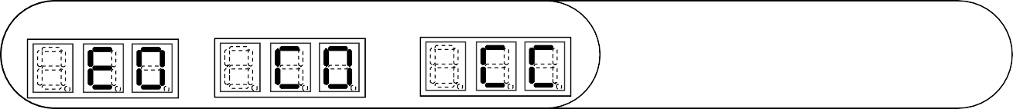
ESI (Ultra) Service Manual
59/68
www.ecoer.com
Display
Compressor INV module protection
or
Remarks:
Priority E→P→C→F→H, the lower number has the priority if the first code letter is the same.
When an “E” code is displayed, turning off the power supply for 5 minutes to reset the system.
The system is designed to run in a backup mode between 7 and 180 days (depending on failed sensor)
E0: System locks up when C0~CA has occurred three times in 60 minutes.
Abnormal power supply voltage
Power supply disconnected (C2/C7/C9 or C2/C3/C7 report at the same time)
Dirty compressor terminal or damaged compressor
Damaged main control board
Micro channel coil has been used for heat pump
1. Error definition:

Slide 65
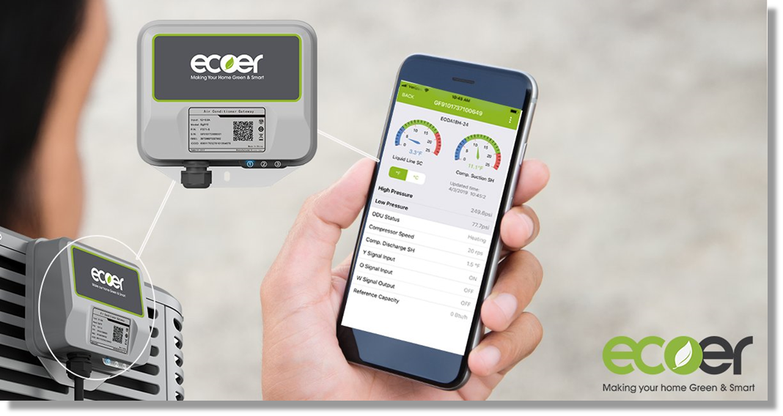
Ecoer Gateway and ESS Pro App
What does the Gateway do?
Provides 24 / 7 monitoring of each system
Automatically alerts technician of heat pump component fault
Provides monitors system over charge, under charge, capacity
Suggestions on solution
10-year labor warranty
True IoT

Slide 66
Ecoer Gateway and ESS Pro App
How does the gateway work??
Connects to heat pump board and 4G cellular network or internet
Does not use Customers WiFi
Provides data to technician, wholesaler, and factory

Slide 67
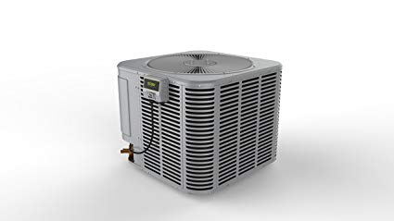
What does the Gateway Report
Controller Temperature
Compressor Speed
Ambient Temperature
Super Heat
Suction Temperature
Sub Cooling
High Side Pressure
Discharge Temperature
Low Side Pressure
Electrical Characteristics
Discharge Temperature
BTUH
Fan Speed

Slide 68

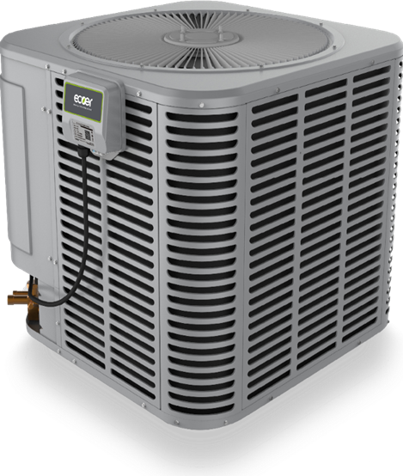


How does it Work

Slide 69
What does it Mean
BTUH Capacity
Control Board Health
Do you have proper airflow
Is the condenser clean
Is the voltage in an acceptable range
Is the refrigerant charge correct
Is the load decreasing

Slide 70
Why Does it Matter
Optimum Operation: Adjusts system to obtain maximum efficiency
Load Matching: Adjusts system to meet the heating and cooling demand
Interoperability: Allowing unrelated components to work together
Predictive Fault Analysis: Allows the system to determine when a fault is imminent
Warranty: Together with Ecoer 10- year parts warranty, provides a 10-year labor warranty

Slide 71

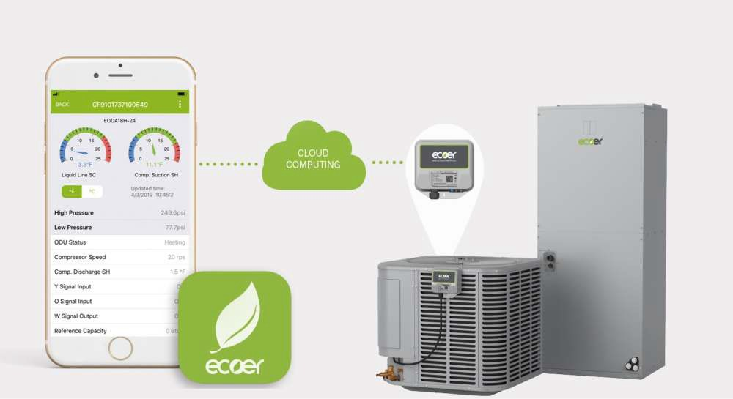
ESS Pro App UM
1/22
www.ecoer.com
Ecoer Smart Service Pro App User Manual
How to make it Work
Log in www.ecoer.com or App >Files >Installation to get the latest user manual for Ecoer Smart Service (ESS) Pro App.

Slide 72

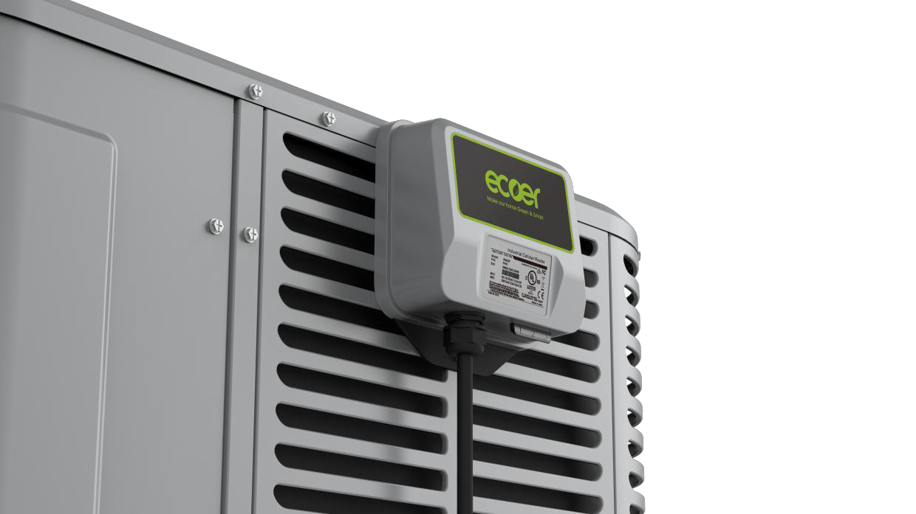
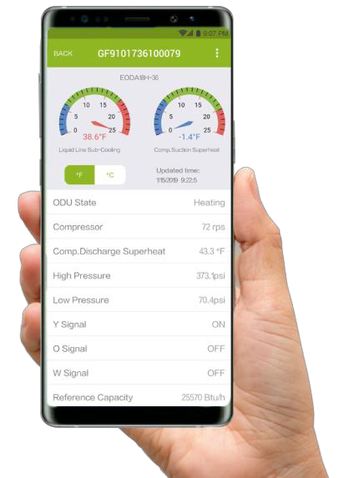
ESS Pro App User Manual
1/15
www.ecoer.com
Ecoer Smart Service(ESS) Pro App User Manual
Contents
Create an ecoer account---------------- 2
App Layout-------------------------------- 4
6
11
-
--
--
---
--
--
Register a new AC----------------------
AC Details---------------------------------
Trouble shooting ----------------------- 14
Technical Manuals---------------------- 15
Visit https://www.ecoer.com/library/ or
Log in App->Files->Installation to get the latest user manual for Ecoer Smart Service(ESS) Pro Mobile App.
Manufacturer reserves the right to change specifications or designs without notice.
02.2019
Making your home Green & Smart

Slide 73

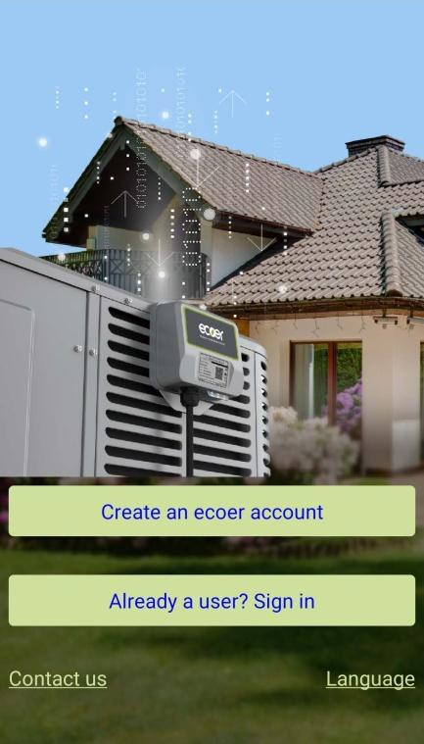
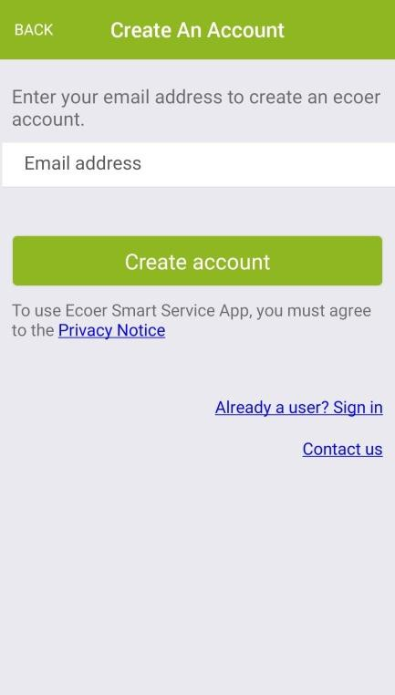


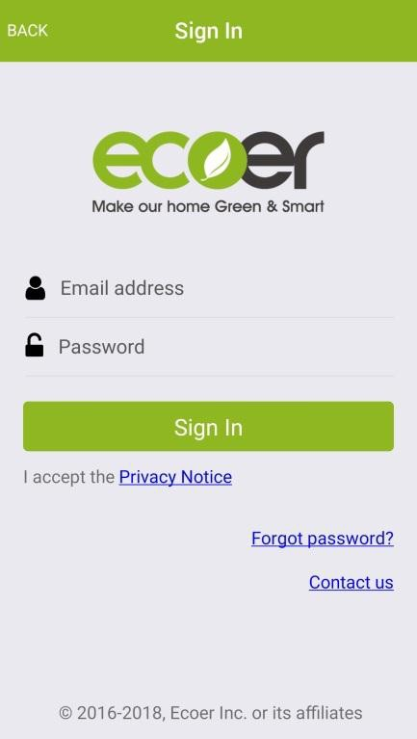
ESS Pro App User Manual 2/15 www.ecoer.com
I. Create An ecoer Account
Step1. Touch “Create an ecoer account” to sign up with your email address. Initial password will be sent to your mailbox by Ecoer Inc.
Step2. Touch “Go to the sign in page”. Enter your email address and the initial password (Check Inbox and Junk depending on your email setting) to sign in.

Slide 74
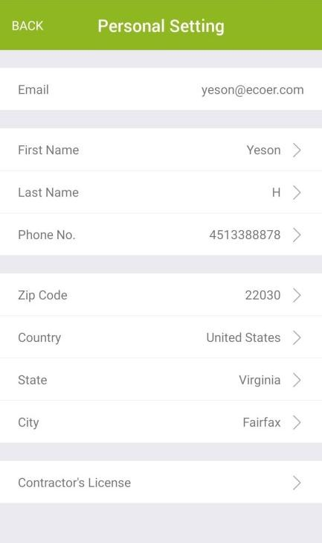

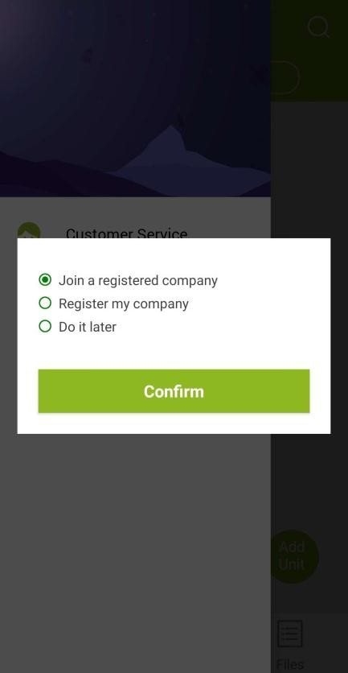

ESS Pro App User Manual 3/15 www.ecoer.com
Step3. Enter required personal information. Touch “DONE” (located on the right upper corner) after each input and fill all the information required.
Remarks:
For the Contractor’s License item, touch “ + ” to
upload a photo of your license (contractor license, EPA license, insurance liability coverage). After the uploading is finished, touch “BACK” button.
If you don’t have the license with you, touch “BACK”
button on the left upper corner, click “do it later”.
Step 4. Choose group.
“register my company” if you are the owner or administrator of the company, then complete all required information. The 'Contractor NO.' is the unique ID of your company which may be required for parts warranty claim. Show the QR Code to your employees to allow them join to the group. Information of all units installed by your company is shared to every employees.
Choose “Join a registered company” if you are an employee. Scan the owner’s or administrator’s QR Code shown in his/her App to complete.
NOTE:
If the above step has been skipped, touch located on the left upper corner, then choose “Dealer Info.” to finish it later.

Slide 75

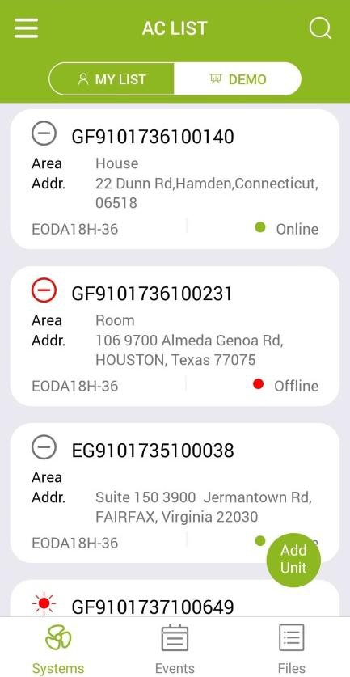
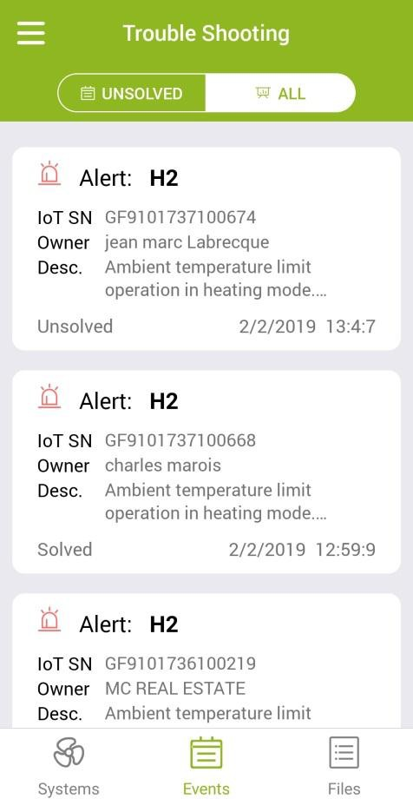
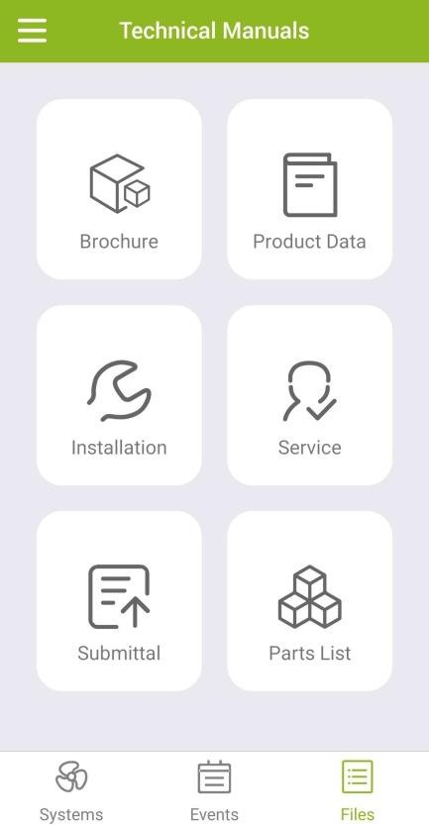
ESS Pro App User Manual 4/15 www.ecoer.com
II. App Layout
Ecoer Smart Service (ESS) Pro App is a tool that contractors can use to maintain and monitor an Ecoer AC or Heat Pump system that was installed.
This App will display operational data of each system installed and allow continuous monitoring. Contractors will receive system alerts and service messages in real time, allowing for remote diagnostics and faster, more accurate responses.
ESS Pro App has three pages:
“Systems” includes MY LIST and DEMO. See more details about the interface in the following page.
“Events” provides alerts of systems that were installed.
“Files” presents public technical manuals including Brochure, Product Data, Installation, Service, Submittal and Parts List.

Slide 76
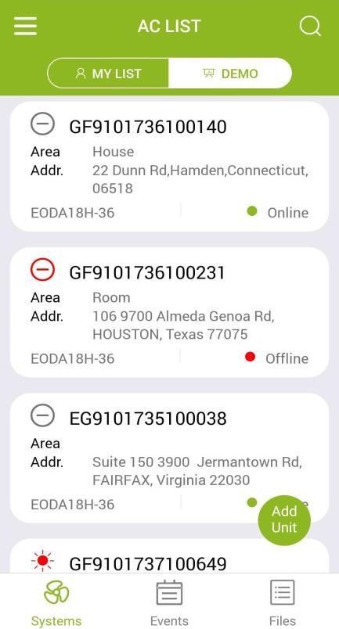





ESS Pro App User Manual
5/15
www.ecoer.com
Interface of “Systems”
Pull up to show more units that were installed (Default amounts are 30 in AC LIST). Pull down to refresh the outdoor unit status and IoT status.
“Me” page
Search button
Customer Service
Dealer Info.
My Account
About
IoT SN
ODU SN
Owner name
Zip code
Outdoor unit status
AC or HP Area
Fault stop
Stop
Cooling
IoT serial number
Heating
IoT status
Online/Offline
Others (Start-up, oil return, defrost, etc.)
Unit location
Installation address
Registration button
Outdoor unit model
Heat Pump
Cooling only
Page switch
EODA18H-24
EODA18H-36
EODA18H-48
EODA18H-60
EODA18C-24
EODA18C-36
EODA18C-48
EODA18C-60

Slide 77
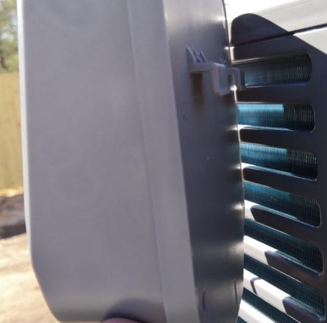
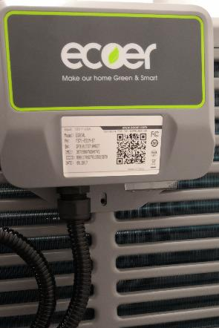
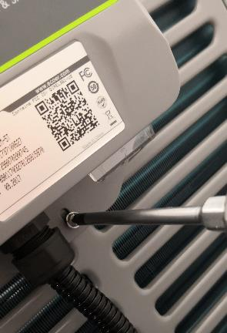
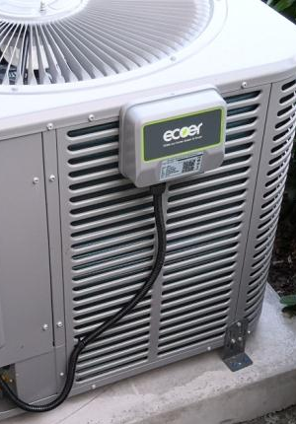
IoT Device INSTALLATION
To keep the best LTE signal, choose one side that is further away from the wall to hook up the IoT device to the condensing unit. Use screw to tighten the device and tie wrap to secure the cable.
The 1st row of the grille
1-a
1-b
1-c
1-d

Slide 78
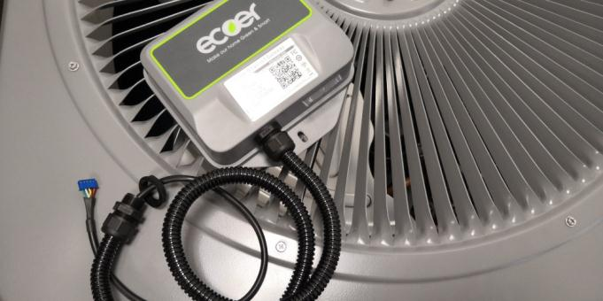
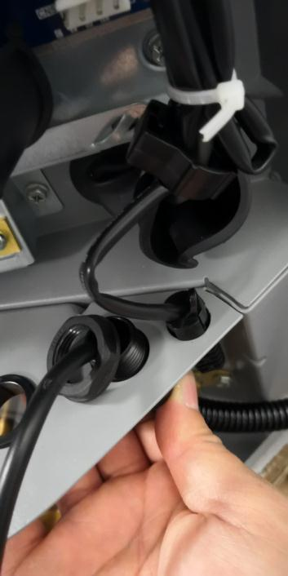
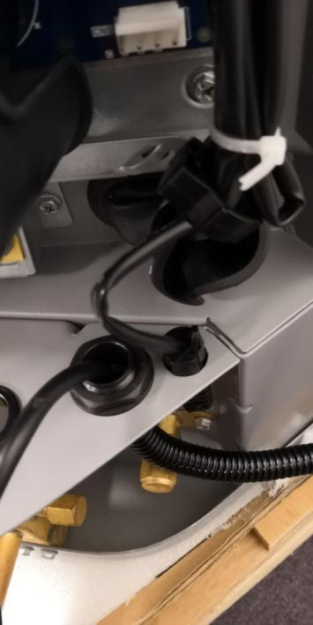
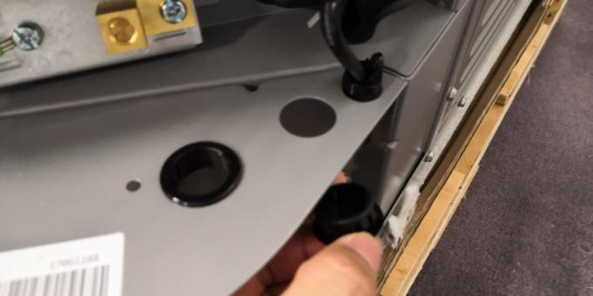
IoT Device INSTALLATION
Wiring
Unscrew the cable locker cap and securely fasten the waterproof joint to the reserved hole (plug has to be removed).
2-a
2-c
2-d
Unscrew the locker cap
2-b
Remove the reserved plug

Slide 79
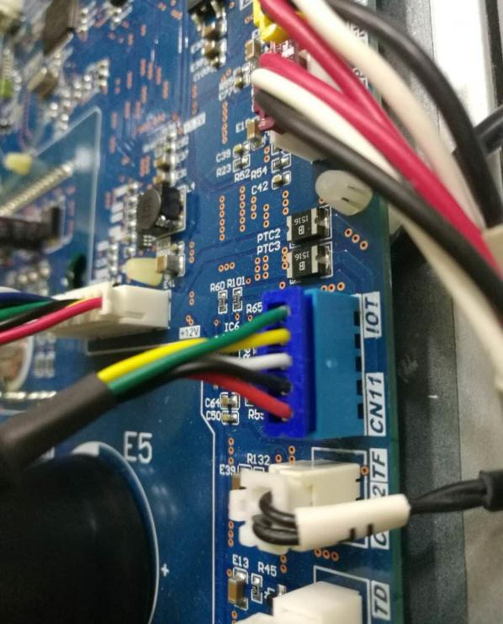
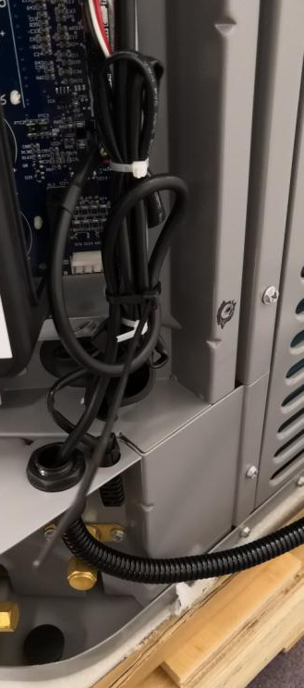
IoT Device INSTALLATION
Wiring
Plug the male blue terminal into CN11 (IoT) connector on main control board of outdoor unit.

Slide 80

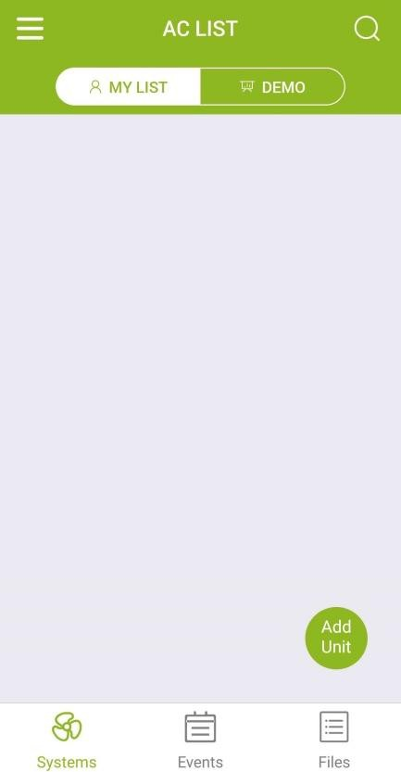

ESS Pro App User Manual 6/15 www.ecoer.com
III. Register A New AC
With the IoT gateway, Ecoer Inc. provides an easy way for the dealers to help their customers finishing warranty registration by Ecoer Smart Service (ESS) Pro Mobile App in few minutes. Then dealers can monitor units’ live/history data and receive system alerts in time.
Ecoer Service Team will diagnose the installing and servicing quality, and notice the dealer to service if there is an issue.
Step 1. Enter registration page
Touch floating button
Add Unit
in AC LIST to enter the “Register A New AC” page.

Slide 81


ESS Pro App User Manual
7/15
www.ecoer.com
Step 2. Sign/Select agreement
Sign a new agreement with homeowner to start the registration.
Choose the existing agreement if units are going to be installed in the same location.
Touch the privacy content in “blue color” if you want to learn more about the Privacy Terms. Show this statement to the homeowner. (Ecoer uses independent cellular data to monitoring the condensing unit only.)
Type in homeowner’s name, unit location and other required information. Ask the homeowner to agree on ecoer system monitoring by sign his/her name on the App.
Note: The agreements MUST be signed by the homeowner.

Slide 82



ESS Pro App User Manual
8/15
www.ecoer.com
Step 3. Scan/Input SN
Respectively use button to scan the corresponding serial numbers.
Tips: Make sure the code is steady and well-lit. Hold your phone 12 inches away and
then bring it closer to cover all code.
IoT Gateway SN and Outdoor Unit SN are required for registration by ESS Pro App.
Enter serial number manually
Available Area Selections
House/ Floor1/ Floor2/ Floor3 Living Room/ Bedroom
Manually enter for other options.
Find where the QR/Bar Codes are located in the following page

Slide 83






ESS Pro App User Manual 9/15 www.ecoer.com
IoT Gateway QR Code
Serial Number
Outdoor Unit Bar Code
Four sides
Indoor Unit Bar Code

Slide 84


ESS Pro App User Manual
10/15
www.ecoer.com
Step 4. Confirm SN
Check the serial numbers you submitted. Press “BACK” in the left upper corner to
revise the serial number if one of the SN is incorrect.
Registration is done once you can see the unit in MY LIST.

Slide 85





ESS Pro App User Manual 11/15 www.ecoer.com
IV. AC Details
Touch the unit in AC LIST to enter “AC Details” interface when you want to get the live/history data of the AC or HP. Check other subpages by touching the upper right button to review more info.
Dash Board
The default interface of AC Detail is Dash Board. You will be able to see Liquid Line Sub-Cooling, Compressor Suction Superheat, Outdoor Unit (ODU) Status, Compressor speed, Compressor discharge superheat, High/Low Pressure, Y/O/W Signals, Reference Capacity, Compressor Speed Limitations.
Sticky Button (up to 10 units)

Slide 86



ESS Pro App User Manual
Alert
12/15
www.ecoer.com
This subpage shows the last alert of each code reported.
History Data
Touch “ ” to see the symbols as showing below.
ODU Stat.: Outdoor unit mode
(0-Stop, 1-Ready to start, 2-Cooling, 3-Heating, 4-Oil Return, 5-Defrost, 6-Manually defrost, 10-Test)
… Touch Help to get meanings of other symbols.
Slide down the screen to review the history curve of the selected symbols. Ecoer provides up to two months data for check from ESS Pro App.

Slide 87


ESS Pro App User Manual
Field Setting
13/15
www.ecoer.com
Check Field Setting of the Ecoer unit, especially for duel-fuel applications.
Units Info.
Units Info. page shows all scanned/input serial numbers of the system. Replacement function is provided by scanning the SN of the new equipment.
Property Owner
It shows the owner contact info. of the system.

Slide 88








ESS Pro App User Manual 14/15 www.ecoer.com
V. Trouble Shooting
Trouble shooting the issue before go to the job site.
1
2
3
4
5

Slide 89




ESS Pro App User Manual 15/15 www.ecoer.com
VI. Technical Manuals
Technical documents can be loaded and browsed from ESS Pro App. Download files at https://www.ecoer.com/library/ if you need the PDF files.

Slide 90
4
1
4
IoT INSTALLATION

Slide 91

IoT Device INSTALLATION
IoT device
Activate automatically when you energized the outdoor condensing unit.
It needs several minutes (Max. 12min) to initialize for the first time.
The normal working state of device should be blue LED (No.1) is blinking with other LEDs are off.
No. | Color | Indication content | Description
1 | Blue | IoT device state | Always OFF： Power off Always ON： Booting Blinking: Running
2 | Red | LTE connection | Always OFF： LTE connected Always ON： Booting Blinking: LTE disconnected
3 | Green | Local connection | Always OFF： Local link connected Always ON： Booting Blinking: Local link disconnected
LEDs

Slide 92
ESS Pro App INSTALLATION
Install Ecoer Smart Service Pro App
Create an ecoer account
Register a new AC/HP unit
Sign agreement with homeowner
Scan/Input SNs to submit

Slide 93





ESS Pro App INSTALLATION
Install Ecoer Smart Service Pro App
I. Search “Ecoer” to download ESS Pro APP
Get the Ecoer Smart Service Pro App
Download or update the Ecoer Smart Service Pro App free on App Store or Google Play.

Slide 94






ESS Pro App INSTALLATION
Create an ecoer account
II. Create an account
Step1. Touch “Create an ecoer account” to sign up with your email address. Initial password will be sent to your mailbox by noreply@ecoer.com. Pls check Inbox and Junk/Trash depending on your email settings.
Step2. Touch “Go to the sign in page”. Enter your email address and the initial password to sign in.

Slide 95




ESS Pro App INSTALLATION
Register A New AC
Step 3. Scan/Input SNs
Respectively use button to scan the corresponding serial numbers.
TIPS:
Make sure the code is steady and well-lit. Hold your phone 12 inches away and then bring it closer to cover all code.
IoT device SN and Outdoor Unit SN are required for registration by ESS Pro App. See the locations of QR/Bar Codes in the following pages.
Enter serial number manually

Slide 96

ESS Pro App INSTALLATION
Register a new AC
Touch button to scan IoT SN.
Serial Number

Slide 97



ESS Pro App INSTALLATION
Register a new AC
Touch button to scan ODU SN.
Four sides

Slide 98


ESS Pro App INSTALLATION
Register a new AC
Touch button to scan IDU SN.
E Series Air Handler
Remarks:
Indoor unit SN may not needed if Ecoer condensing units match with other brands IDU.

Slide 99


ESS Pro App INSTALLATION
Register a new AC
Touch button to scan IDU SN.
G Series
Cased Coil
Two sides
Remarks:
Indoor unit SN may not needed if Ecoer condensing units match with other brands IDU.

Slide 100



ESS Pro App INSTALLATION
Register A New AC
Step 4. Confirm SNs
Check the serial numbers you submitted. Press “BACK” on the upper-left corner to revise if it’s incorrect.
Homeowner will get his/her Ecoer Warranty Registration Number by ***@ecoer.com.
Choose or type in the AC Area for further inquiry.
Area Selections
House / Floor1-3 /Living Room / Bedroom
Manually enter for other options.
The device shall be powered ON first so that ecoer server can respond to the device’s registration requirement.

Slide 101


Key Features
1
Secure 4G communication platform including factory system support and monitoring

Slide 102


ESS Pro App INSTALLATION
Technical Manuals
Technical documents can be browsed on ESS Pro App.
Ecoer certified Distributors / Dealers are able to download original files at www.ecoer.com after your login.

Slide 103
4
1
4
HEAT PUMP INSTALLATION

Slide 104

4
1
4

Slide 105

4
1
HEAT PUMP INSTALLATION
4
Installation Clearance Requirement
Avoid to install near bedrooms
Ensure the top discharge area is unrestricted for at least 60 inches above the unit.
Do not locate condensing unit near bedrooms because normal operational sounds may be annoying. Position unit to allow adequate space for unobstructed airflow, wiring, refrigerant lines, and serviceability.
Min. 60”unrestricted
Min. 24”
unrestricted
Min. 12” to
shrubbery
Allow a minimum of 12 in. clearance on one side of access panel to a wall and a minimum of 24 in. on the adjacent side of access panel. Maintain a distance of 24 in. between units.
Access panel
Fig 2-3 Clearance requirement

Slide 106

4
1
HEAT PUMP INSTALLATION
4
Position unit so water, snow, or ice from roof or overhang cannot fall directly on unit.
Min. 12” to
shrubbery
Min. 24”
to wall
Access panel
Fig 2-4 Unit location

Slide 107

4
1
HEAT PUMP INSTALLATION
4
Cold Climate Considerations
Minimum Distance from Wall 12”
Precautions must be taken for units being installed in areas where snow accumulation and prolonged below-freezing temperatures occur.
Elevate unit per local climate and code requirements. This additional height will allow drainage of snow and ice melted during defrost cycle to flow out smoothly prior to its refreezing.
Elevate Heat Pump minimum 8”

Slide 108

4
1
HEAT PUMP INSTALLATION
4
Position the Unit
When mounting the unit on a roof, be sure the roof will support the unit’s weight obtained from nameplate. Properly selected isolation is recommended to prevent sound or vibration transmission to the building structure.
When installing the unit on a support pad, such as a concrete slab, consider the following:
The pad must be 1~2” larger than the unit on all sides.
The pad must be separated from any structure.
The pad must be level.
The pad must be high enough above grade to allow for drainage.
The pad location must comply with National, State and Local codes.

Slide 109
4
1
HEAT PUMP INSTALLATION
4
Refrigerant Line Considerations
  Refrigerant Line Limits
Use only the line sizes indicated in below table and determine required line length. If the suction line sets are greater than 50 feet, do not use a larger suction line than recommended.
Table 4-1 Line sizes and maximum lenghth
Capacity Model | Liquid Line | Suction Line | Total Equivalent Length (FT)
 |  |  | 25 | 50 | 75 | 100
 | Dimensions in inches |  | Maximum Elevation Difference (FT)
2Ton | 3/8 Std. | 3/4 Std. | 25 | 50 | 45 | 40
 | 1/4 Opt. | 5/8 Opt. | 25 | 50 | 40 | 30
3Ton | 3/8 Std. | 3/4 Std. | 25 | 50 | 50 | 50
 | 1/4 Opt. | 5/8 Opt. | 25 | 50 | 45 | 40
4Ton | 3/8 | 7/8 Std. | 25 | 50 | 50 | 40
 |  | 3/4 Opt. | 25 | 50 | 50 | 40
5Ton | 3/8 | 7/8 Std. | 25 | 50 | 50 | 40
 |  | 3/4 Opt. | 25 | 50 | 50 | 40
 |  | 1-1/8 Opt. | 25 | 40 | N/A | N/A
Std.: Standard line size; Opt.: Optional line size; N/A: Application not recommended

Slide 110



4
1
HEAT PUMP INSTALLATION
4
Maximum line length = 100 feet. | Maximum elevation difference = 50 feet.
Max.100ft Fig 4-1 Line length limit | Max.50ft Max.50ft Fig 4-2 Elevation difference limit

Slide 111
INSTALLATION
Piping installation- Pipe brazing
Ecoer heat pump may be used with virtually any R410a fin tube air handler or A coil. Micro Channel coils are not acceptable. the indoor coil must be equipped with a heat pump TXV (adjustable preferred). Suitable valves include Parker HCAE 3Z, HCAE 5Z, Sporlan ERZE-2-GA, ERZE-2-GA, ERZE-3-GA, ERZE-4-GA, ERZE-5-GA.
Ecoer Heat pump will require a bidirectional drier. Suitable driers are available from Parker or Sporlan model numbers include HPC-103s, HPC-163S, BF-083S, BF163S. Driers should be places near the air handler before the expansion valve. A moisture indicator may also be installed at this location.

Slide 112
INSTALLATION
Piping installation- Pipe brazing
The gateway will require a cell signal to communicate with the Ecoer monitoring service. Keep this in mind when placing the unit.
Ecoer requires the installation of a surge protector connected directly to the disconnect. Recommended surge protectors include Square D (SDSA1175, available through Ecoer), Mars 83905, ICM ICM517.

Slide 113
INSTALLATION
Piping installation- Pipe brazing
Refrigerant lines should be brazed with a silver baring braze rod such as Lucas Milhaupt Silfos 5 or Silfos 15. Nitrogen purge is required during all brazing operations. Wrap all adjoining components with a heat block or wet rag during brazing operation.
Ecoer Heat Pump energizes the reversing valve on a call for cooling. Therefore, thermostats should be programed or wired using the “0” terminal.

Slide 114
INSTALLATION
Piping installation- Pipe brazing
Ecoer outdoor board contains all the electrical connections for proper operation. The DIP switches do not need to be adjusted in most cases.
  DIP 1 Condenser winter fan mode
  DIP 2 Capacity Selection
  DIP 3 Heat Pump or Cooling Only
  DIP 4 Disable IoT Output on
10. Ecoer heat pumps, air handlers, and furnaces will work with nearly any thermostat or modern zoning system. However the nest “E” series shown here causes erratic behavior and is not recommended.

Slide 115




INSTALLATION
Piping installation- Leak Check and Evacuation
Leak check is required for the brazed pipe connections.
Pressurize the brazed refrigerant pipes and indoor coil to a minimum of 450 PSIG using dry nitrogen.
Check for leaks by using a leak detection bubbles at each brazed location.
450PSIG
Do not open the service valves until the leak check and evacuation are complete.
Evacuate until the micron gauge reads no higher than 200 microns, then close the valve to the vacuum pump.
Evacuation is complete if the micron gauge does not rise above 500 microns in one minute.
200
1 MIN

Slide 116


INSTALLATION
Piping installation- Open the service valve
Leak check and evacuation must be completed before opening the service valves. The Suction Service valve must be opened BEFORE opening the Liquid Service Valve!
Remove service valve cap .
Fully insert hex wrench into the stem and back out counterclockwise until valve stem just touches the rolled edge (approximately five turns.)
Replace and tighten the valve stem cap to prevent leaks. Additional 1/6 turn may be needed.
Repeat 1 - 3 for Liquid Service Valve.
Cap
3/16” Hex Wrench for Liquid Service Valve
5/16” Hex Wrench for Suction Service Valve
Rolled edge to captivate stem
Service Port

Slide 117




INSTALLATION
Electric-High voltage wiring
Power Supply
Model | Voltage | MCA | Breaker
2436 | 208/230V-1Ph-60Hz | 24.4A | 40A
4860 | 208/230V-1Ph-60Hz | 32.5A | 50A
Q&A: What are the voltage tolerances of the boards?
Basically it’s ±10% of the nominal voltage. (i.e. 187Vac to 253Vac)
Surge protector Must be installed at the unit.
Ground the outdoor unit per national, state and local code requirements.

Slide 118


INSTALLATION
Electric-Low voltage wiring
Defines the maximum total length of low voltage wiring from the outdoor unit, to the indoor unit and thermostat.
Field installed electrical conduits are required at the high and low voltage wire entry points. Animals like frogs, spiders, snakes and others may climb into the control box and will result main control board short-circuit, burn or on fire!
Ecoer uses O signal for mode switch.
Control Wiring
Wire Size | Max. Wire Length
18 AWG | 150Ft
16 AWG | 225Ft
Thermostat wiring connector
CN5
C
Y
O
W

Slide 119



INSTALLATION
Electric-Low voltage wiring
Field installed electrical conduits are required at the high and low voltage wire entry points. Animals like frogs, spiders, snakes and others may climb into the control box and will result main control board short-circuit, burn or on fire!
Ecoer reserves the rights to reject warranty claim on PCB if not comply.
Frogs killed PCBs in FL, US

Slide 120
INSTALLATION
Electric-Low voltage wiring
Dual-heating
Outdoor unit W terminal outputs 24VAC once ambient temperature is lower than specific value for auxiliary heating resource to start.
Only available when n02 (W Output) is ON (default) and Y signal = ON.
n03 setting
0(factory): TA<15°F (24V output)
1: TA<30°F (24V output)
2: TA<40°F (24V output)
3: TA<-3°F (24V output)
4: OFF (No 24V output)
The color of the signal cable may vary, refer to the letter on the cable to connect the system.
CN5
Notes:
1. Be sure power supply agrees with equipment nameplate.
2. Power wiring and grounding of equipment must comply with local codes.
3. Low voltage wiring to be No. 18 AWG minimum conductor.
4. “ “ The electric auxiliary heat connection.
Notes:
Cooling only systems: C/Y
Heat pump systems: C/Y/O, W signal is optional to use for dual-heating.

Slide 121
4
1
4
Snow Caps

Slide 122
4
1
Snow Caps
4

Slide 123
4
1
Snow Caps
4

Slide 124
4
1
Snow Caps
4

Slide 125
4
1
4
Air Handler Installation

Slide 126

Air Handler Dimensions
1
4
NOTE: 25’’ CLEARANCE IS REQUIRED IN THE FRONT OF THE UNIT FOR FILTER AND COIL MAINTENANCE.
W
A
D
10-5/16
FLANGES ARE PROVIDED FOR FIELD INSTALLATION
Breaker Switch (Electric heat only)
High voltage connection
7/8’’, 1-3/32’’, 1-23/32’’ DIA knockouts
KNOCKOUTS FOR ELECTRICAL WIRING CONNECTION ARE DISTRIBUTED ON THE TOP AND
EITHER SIDES.
H
Model Number | Dimensions (in.)
 | H | W | D | A | Liquid Line | Suction Line
24 / 36 | 46-1/2 | 21 | 21 | 19-1/4 | 3/8 | 3/4
Sweat Suction Line
Sweat Liquid Line
48 / 60 | 56 | 24-1/2 | 21 | 22-3/4 | 3/8 | 7/8
Auxiliary drain connection 3/4’’ Female pipe thread (NPT)
Inlet (Front View)
Primary drainconnection 3/4’’ Female pipe thread (NPT)
Figure 2-1 Unit Dimensions
Inlet (Left Side View)

Slide 127
Air Handler Unit Installation Instruction
4/20
www.ecoer.com
2. Dimensions
SUPPLY AIR
NOTE: 25’’ CLEARANCE IS REQUIRED IN THE FRONT OF THE UNIT FOR FILTER AND COIL MAINTENANCE.
W
A
D
10-5/16
FLANGES ARE PROVIDED FOR FIELD INSTALLATION
Breaker Switch (Electric heat only)
High voltage connection
7/8’’, 1-3/32’’, 1-23/32’’ DIA knockouts
KNOCKOUTS FOR ELECTRICAL WIRING CONNECTION ARE DISTRIBUTED ON THE TOP AND
EITHER SIDES.
H
Flared Gas Line Flared Liquid Line
Auxiliary drain connection 3/4’’ Female pipe thread (NPT)
Inlet (Front View)
Primary drainconnection 3/4’’ Female pipe thread (NPT)
Figure 2-1 Unit Dimensions
Inlet (Left Side View)
Model Number | Dimensions (in.)
 | H | W | D | A | Liquid Line Connection | Gas Line Connection
24 / 36 | 46-1/2 | 21 | 21 | 19-1/4 | 3/8 | 3/4

Slide 128

4
1
4

Slide 129
Air Handler Dimensions
1
4
NOTE: 25’’ CLEARANCE IS REQUIRED IN THE FRONT OF THE UNIT FOR FILTER AND COIL MAINTENANCE.
W
A
10-5/16
D
FLANGES ARE PROVIDED FOR FIELD INSTALLATION
Breaker Switch (Electric heat only)
High voltage connection
7/8’’, 1-3/32’’, 1-23/32’’ DIA knockouts
KNOCKOUTS FOR ELECTRICAL WIRING CONNECTION ARE DISTRIBUTED ON THE TOP AND
EITHER SIDES.
H
Model Number | Dimensions (in.)
 | H | W | D | A | Liquid Line | Suction Line
24 / 36 | 46-1/2 | 21 | 21 | 19-1/4 | 3/8 | 3/4
Sweat Suction Line
Sweat Liquid Line
48 / 60 | 56 | 24-1/2 | 21 | 22-3/4 | 3/8 | 7/8
Auxiliary drain connection 3/4’’ Female pipe thread (NPT)
Inlet (Front View)
Primary drainconnection 3/4’’ Female pipe thread (NPT)
Figure 2-1 Unit Dimensions
Inlet (Left Side View)

Slide 130
Evaporator Coil
1

Slide 131

Blower Motor
1
Mounting Screws

Slide 132
Clearances
1
Horizontal
Vertical

Slide 133

Vertical Up- Flow
1
Default Orientation

Slide 134
Horizontal Right- Flow
1
Default Orientation
Airflow

Slide 135
Vertical Down- Flow
1
Invert Air Handler 180 Degrees
Invert A-Coil 180 Degrees

Slide 136
Horizontal Left - Flow
1
Invert Air Handler 180 Degrees
Invert A-Coil 180 Degrees

Slide 137
Air Flow 2 ton, 3 ton
1
Model Number | Motor Speed
 |  |  | External Static Pressure-Inches W.C.[KPa]
 |  |  | 0 [0] | 0.1 [.02] | 0.16 [.04] | 0.2 [.05] | 0.3 [.07] | 0.4 [.10] | 0.5 [.12] | 0.6 [.15] | 0.7 [.17] | 0.8 [.20]
24 | Tap (5) | SCFM | 1062 | 1031 | 998 | 981 | 947 | 901 | 869 | 823 | 789 | 742
 |  | Watts | 184 | 195 | 201 | 203 | 213 | 222 | 228 | 238 | 242 | 252
 | Tap (4) | SCFM | 959 | 921 | 890 | 873 | 836 | 786 | 751 | 706 | 677 | 622
 |  | Watts | 138 | 145 | 152 | 156 | 162 | 171 | 178 | 188 | 196 | 204
 | Tap (3)- factory | SCFM | 855 | 825 | 790 | 769 | 733 | 679 | 646 | 595 | 560 | 494
 |  | Watts | 101 | 111 | 118 | 120 | 126 | 134 | 141 | 151 | 156 | 166
 | Tap (2) | SCFM | 777 | 750 | 712 | 692 | 656 | 599 | 566 | 498 | 466 | 412
 |  | Watts | 80 | 89 | 96 | 98 | 104 | 113 | 119 | 127 | 135 | 145
 | Tap (1) | SCFM | 694 | 663 | 620 | 599 | 562 | 499 | 455 | 390 | --- | ---
 |  | Watts | 60 | 68 | 74 | 76 | 82 | 89 | 95 | 104 | --- | ---
36 | Tap (5) | SCFM | 1455 | 1409 | 1374 | 1355 | 1320 | 1266 | 1229 | 1173 | 1126 | 956
 |  | Watts | 293 | 300 | 306 | 309 | 316 | 326 | 331 | 338 | 346 | 370
 | Tap (4) | SCFM | 1350 | 1302 | 1264 | 1242 | 1206 | 1145 | 1104 | 1038 | 897 | 824
 |  | Watts | 238 | 243 | 254 | 257 | 260 | 271 | 277 | 286 | 303 | 308
 | Tap (3)- factory | SCFM | 1328 | 1281 | 1234 | 1215 | 1179 | 1118 | 1073 | 1007 | 862 | 798
 |  | Watts | 226 | 232 | 239 | 242 | 250 | 259 | 264 | 278 | 292 | 298
 | Tap (2) | SCFM | 1235 | 1171 | 1130 | 1108 | 1062 | 1002 | 955 | 824 | 752 | 713
 |  | Watts | 185 | 189 | 196 | 199 | 205 | 214 | 221 | 238 | 245 | 248
 | Tap (1) | SCFM | 1146 | 1091 | 1044 | 1022 | 982 | 908 | 823 | 748 | 708 | ---
 |  | Watts | 150 | 156 | 163 | 167 | 174 | 184 | 196 | 202 | 207 | ---

Slide 138
Air Flow 4 ton, 5 ton
1
Model Number | Motor Speed
 |  |  | External Static Pressure-Inches W.C.[KPa]
 |  |  | 0 [0] | 0.1 [.02] | 0.16 [.04] | 0.2 [.05] | 0.3 [.07] | 0.4 [.10] | 0.5 [.12] | 0.6 [.15] | 0.7 [.17] | 0.8 [.20]
48 | Tap (5) | SCFM | 2144 | 2106 | 2072 | 2052 | 2015 | 1962 | 1924 | 1864 | 1823 | 1768
 |  | Watts | 627 | 632 | 639 | 643 | 649 | 661 | 670 | 681 | 684 | 696
 | Tap (4) | SCFM | 1999 | 1966 | 1933 | 1915 | 1875 | 1819 | 1775 | 1713 | 1672 | 1582
 |  | Watts | 510 | 520 | 529 | 536 | 540 | 551 | 555 | 567 | 571 | 588
 | Tap (3)- factory | SCFM | 1788 | 1746 | 1714 | 1695 | 1660 | 1606 | 1565 | 1499 | 1452 | 1355
 |  | Watts | 367 | 374 | 389 | 393 | 404 | 422 | 429 | 440 | 449 | 458
 | Tap (2) | SCFM | 1633 | 1596 | 1564 | 1554 | 1514 | 1467 | 1424 | 1342 | 1290 | 1231
 |  | Watts | 292 | 300 | 311 | 318 | 329 | 343 | 354 | 376 | 382 | 391
 | Tap (1) | SCFM | 1504 | 1468 | 1428 | 1408 | 1362 | 1298 | 1244 | 1182 | 1160 | 1081
 |  | Watts | 228 | 242 | 250 | 255 | 264 | 279 | 291 | 309 | 318 | 327
60 | Tap (5) | SCFM | 2144 | 2106 | 2072 | 2052 | 2015 | 1962 | 1924 | 1864 | 1823 | 1768
 |  | Watts | 627 | 632 | 639 | 643 | 649 | 661 | 670 | 681 | 684 | 696
 | Tap (4) | SCFM | 1999 | 1966 | 1933 | 1915 | 1875 | 1819 | 1775 | 1713 | 1672 | 1582
 |  | Watts | 510 | 520 | 529 | 536 | 540 | 551 | 555 | 567 | 571 | 588
 | Tap (3)- factory | SCFM | 1788 | 1746 | 1714 | 1695 | 1660 | 1606 | 1565 | 1499 | 1452 | 1355
 |  | Watts | 367 | 374 | 389 | 393 | 404 | 422 | 429 | 440 | 449 | 458
 | Tap (2) | SCFM | 1633 | 1596 | 1564 | 1554 | 1514 | 1467 | 1424 | 1342 | 1290 | 1231
 |  | Watts | 292 | 300 | 311 | 318 | 329 | 343 | 354 | 376 | 382 | 391
 | Tap (1) | SCFM | 1504 | 1468 | 1428 | 1408 | 1362 | 1298 | 1244 | 1182 | 1160 | 1081
 |  | Watts | 228 | 242 | 250 | 255 | 264 | 279 | 291 | 309 | 318 | 327

Slide 139

Wiring Diagram
1

Slide 140
Wiring Diagram B Version
1

Slide 141
Wiring Diagram A Version
1
Without electric Heat
Model Number | Voltage-Phase-Hz | Power Supply Wiring Gauge | Motor HP | Motor Steps | Minimum Circuit AMPS. | Fuse (A)
24 | 208/230-1Ph-60Hz | 14 | 1/3 | 5 | 3.0 | 15
36 |  |  | 1/2 |  | 5.2
48 |  |  | 3/4 |  | 7.5
60 |  |  | 3/4 |  | 7.5

Slide 142
Auxillary Heat
1
With Electric Heat
Kit Model | Model Number | Electric Heat (kW) | MIN. Circuit Ampacity |  | MAX. Fuse or Breaker (HACR) Ampacity |  | Fan speed
 |  |  | 240 | 208 | 240 | 208 | 1 | 2 | 3 | 4 | 5
E-EHK05 | 24 | 5 | 25 | 22 | 30 | 25 | × | ● | ● | ● | ●
E-EHK10 |  | 10 | 49 | 43 | 60 | 50 | × | × | ● | ● | ●
E-EHK05 | 36 | 5 | 25 | 22 | 30 | 25 | × | ● | ● | ● | ●
E-EHK10 |  | 10 | 49 | 43 | 60 | 50 | × | × | ● | ● | ●
E-EHK15 |  | 5+10 | 25+49 | 22+43 | 30+60 | 25+50 | × | × | ● | ● | ●
E-EHK05 | 48 | 5 | 25 | 22 | 30 | 25 | × | ● | ● | ● | ●
E-EHK10 |  | 10 | 49 | 43 | 60 | 50 | × | ● | ● | ● | ●
E-EHK15 |  | 5+10 | 25+49 | 22+43 | 30+60 | 25+50 | × | × | ● | ● | ●
E-EHK20 |  | 10+10 | 49+49 | 43+43 | 60+60 | 50+50 | × | × | × | ● | ●
E-EHK05 | 60 | 5 | 25 | 22 | 30 | 25 | × | ● | ● | ● | ●
E-EHK10 |  | 10 | 49 | 43 | 60 | 50 | × | ● | ● | ● | ●
E-EHK15 |  | 5+10 | 25+49 | 22+43 | 30+60 | 25+50 | × | × | ● | ● | ●
E-EHK20 |  | 10+10 | 49+49 | 43+43 | 60+60 | 50+50 | × | × | × | ● | ●

Slide 143

Electric Heat Wiring
1
Knock out left template for 5, 8, 10KW Heat. Knock out both for 15, 20 KW

Slide 144

Electric Heat Wiring
1
Remove top cover plate for 5,8,or 10KW heater. Remove both for 15, 20KW

Slide 145

Electric Heat Wiring
1
STEP 3. Slide the kit into the duct and fasten the element (e.g. attachment and wires).

Slide 146


Electric Heat Wiring
1

Slide 147


























Electric Heat Wiring
1
CN 6
CN 3
CN 1

Slide 148
Changing Fan Speed Medium High, High
1

Slide 149
Changing Fan Speed Low, Medium Low
1

Slide 150


Changing Fan Speed
1
Dip Switch SW 1
Medium Low
Low

Slide 151

Changing Fan Speed
1
Depress tap to remove spade Terminal

Slide 152
4
1
4
Wiring Diagrams

Slide 153
Wiring Diagram
1

Slide 154

Control Wiring
1

Slide 155
Control Wiring
1

Slide 156
Control Wiring
1

Slide 157
Control Wiring
1

Slide 158
Control Wiring
1

Slide 159
Control Wiring
1

Slide 160
Control Wiring
1

Slide 161
Control Wiring
1

Slide 162
Control Wiring
1

Slide 163
Control Wiring
1

Slide 164
Control Wiring
1

Slide 165
Control Wiring
1

Slide 166
Control Wiring
1

Slide 167
Control Wiring
1

Slide 168
Control Wiring
1

Slide 169
Control Wiring
1

Slide 170
4
1
4
HEAT PUMP SIZING

Slide 171
4
Design and sizing
1
4
In existing home, ask customer if present system is adequate during winter heating season.
Ask for a copy of the prior years heating bill
Are there any places in the home which do not receive adequate heat or too much heat
Air handlers placed in the attic are often subject to outdoor ambient temperatures.

Slide 172
4
Design and sizing
1
4
Check air flow in present system
Check Total External Static air pressure in existing system
Check heat rise through existing system
Check existing ductwork for breaks, uninsulated boots, excessive Flex duct

Slide 173
4
Design and sizing
1
4
Check existing thermostat compatibility with heat pump, dual fuel
Check Zoning requirements and existing zoning system compatibility.
If removing a furnace or boiler be sure take into account, the radiation effect of existing system
Perform Manual J home survey to insure the system meets the design load.

Slide 174
4
Partial Home / Integrated Controls Rebate
1
4
Partial Home $1,250 per ton
System must be on Mass Save QPL List.
MassSave.com/HPQPL
Integrated Controls $500 per indoor unit
MassSave.com/ICQPL

Slide 175
4
$10,000.00 Whole House Rebate Requirements
1
4
Heat pumps must be new and sized to be capable of being the sole source of heating in the home.
Contractors must install equipment sized to meet 90-120% of the total heating load at the outdoor design temperature, per ACCA Manual J Design Conditions, throughout 100% of the conditioned space.
Manual J and/or Manual D documentation required upon request.

Slide 176
4
$10,000.00 Whole House Rebate Requirements
1
4
Project must either include the removal or disconnection of the pre-existing heating system.
If the pre-existing system will remain in place, homeowner must not use the pre-existing heating system except for domestic hot water heating (e.g., indirect storage tank or combination boiler).
The pre-existing heating system may be connected for use during heat pump system downtime (e.g., repair or service)

Slide 177
4
$10,000.00 Whole House Rebate Requirements
1
4
Home must be sufficiently weatherized prior to heat pump installation.
Sufficient weatherization can be demonstrated by satisfying at least one of the following requirements:
(A) home was built during or after 2000,
(B) Home Energy Assessment report indicates less than $1,000 worth of weatherization recommended or
(C) weatherization recommendations made during or after 2013 have been completed. Supporting documentation only required upon request

Slide 178
4
$10,000.00 Whole House Rebate Requirements
1
4
Homes must be individually metered 1-4 unit buildings or townhouses and must be occupied full time during the winter heating season.
Apart from townhouses, customers in 5+ unit homes are not eligible for whole-home heat pump rebates and should contact the Mass Save multi-family program prior to installation. (A townhouse is defined as a single-family dwelling unit constructed in a group of three or more attached units in which each unit extends from foundation to roof.)

Slide 179
Electric Heat Wiring
1

Slide 180
Electric Heat Wiring
1

Slide 181
Electric Heat Wiring
1
STEP 3. Slide the kit into the duct and fasten the element (e.g. attachment and wires).

Slide 182
Electric Heat Wiring
1

Slide 183
Wiring Diagrams
1

Slide 184
Wiring Diagrams
1

Slide 185
Wiring Diagrams
1

Slide 186
Wiring Diagrams
1

Slide 187
Wiring Diagrams
1

Slide 188
Wiring Diagrams
1

