Slide 1
Thermostatic Expansion Valves
Thermostatic
Expansion Valves
Presented by: Steve Ward

Slide 2
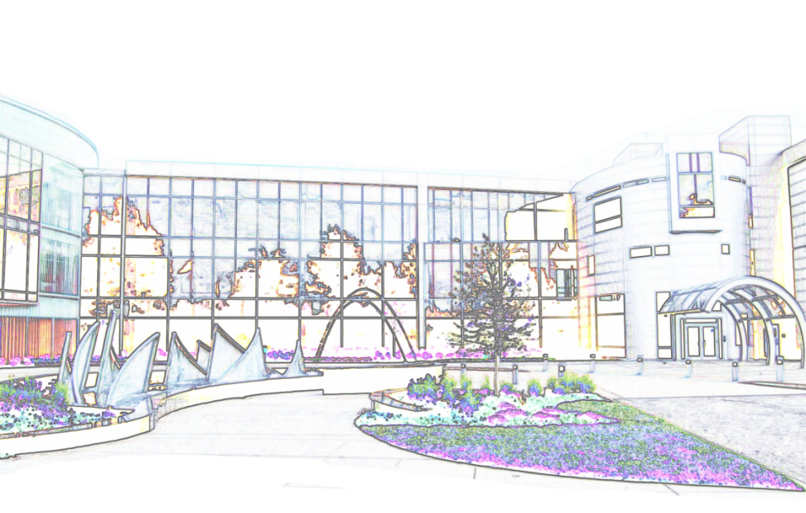
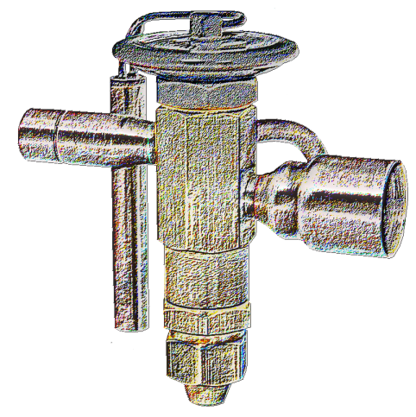
Today’s Topics
Parker Hannifin Corp.
Back to Basics
Thermostatic Expansion Valves

Slide 3
Parker History
Parker acquires Microthermo Technologies
2010
Parker acquires Virginia KMP
2005
Parker acquires Sporlan Valve Co.
2004
Parker acquires Aeroquip AC&R from Eaton
2001
1990’s
Parker launches www.parker.com
1980’s
Parker makes 36 acquisitions.
1970’s
Parker sales reach 500 million.
1964
Parker Hannifin is first traded on the NYSE. Sales reach 200 M.
1957
Parker Appliance acquires the Hannifin Company (industrial fluid power products)
1940’s
Parker sales reach 8 million.
1930’s
Parker grows to 3 million in sales.
1920’s
The Company grows while serving a booming auto industry and fledging aircraft pioneers.
1918
The Parker Appliance Company Founded by Arthur LaRue Parker

Slide 4
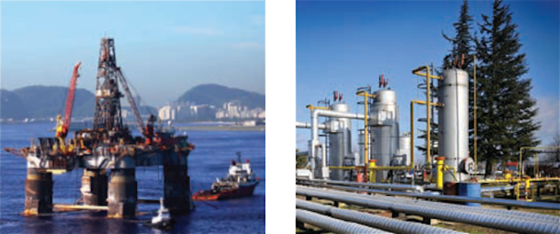
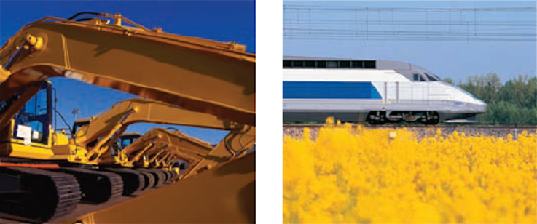
Parker Overview
Parker can be found on and around everything that moves.
Fluid Connectors
Instrumentation
Filtration
Engineered Materials
Aerospace
Hydraulics
Automation

Slide 5
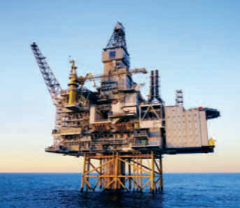
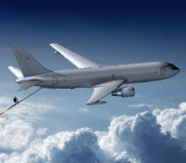
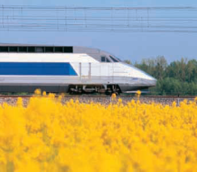
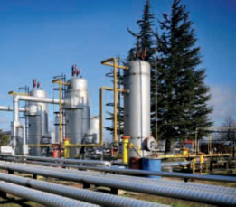
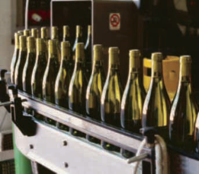
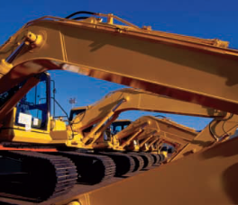
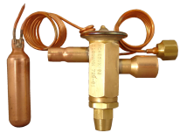
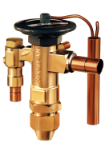
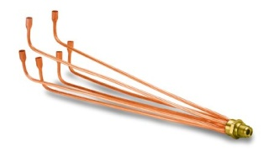
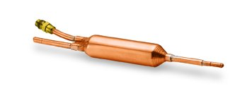
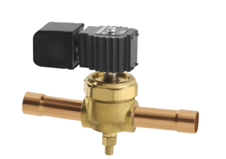
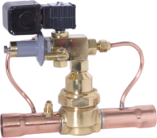
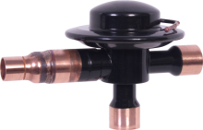
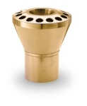
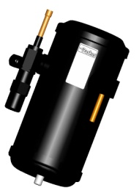
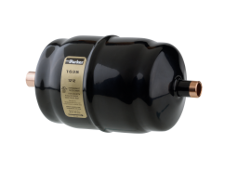
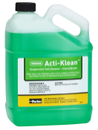
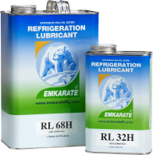
Parker – Sporlan Division
Fluid Connectors
Aerospace
Automation
Instrumentation
Filtration
Seal
Hydraulics
Sporlan
Washington, MO (3) New Haven, IN (1)
Greenfield, TN (1)
Owensville, MO (2)

Slide 6
13 SEER
More energy efficient motors (compressor and/or fans)
Variable Speed components
More surface area (larger equipment size)
Use of Thermostatic Expansion Valves
Adds approx. ½ to 1 SEER

Slide 7
Saturation Chart
What is the Temperature -Pressure Chart ? ?
T
P

Slide 8
Temperature - Pressure Graph
700
Subcooling
Heat removed from the refrigerant that causes its temperature to fall below its saturation point.
Superheat
Heat added to the refrigerant vapor that causes its temperature to rise above its saturation point.
600
500
Liquid
11° Subcool
14° Superheat
400
Pressure (psig)
300
200
Gas
100
Saturation
96°
85
110
-40 -20 0 20 40 60 80 100 120 140 160
R-410A
Temperature °F

Slide 9
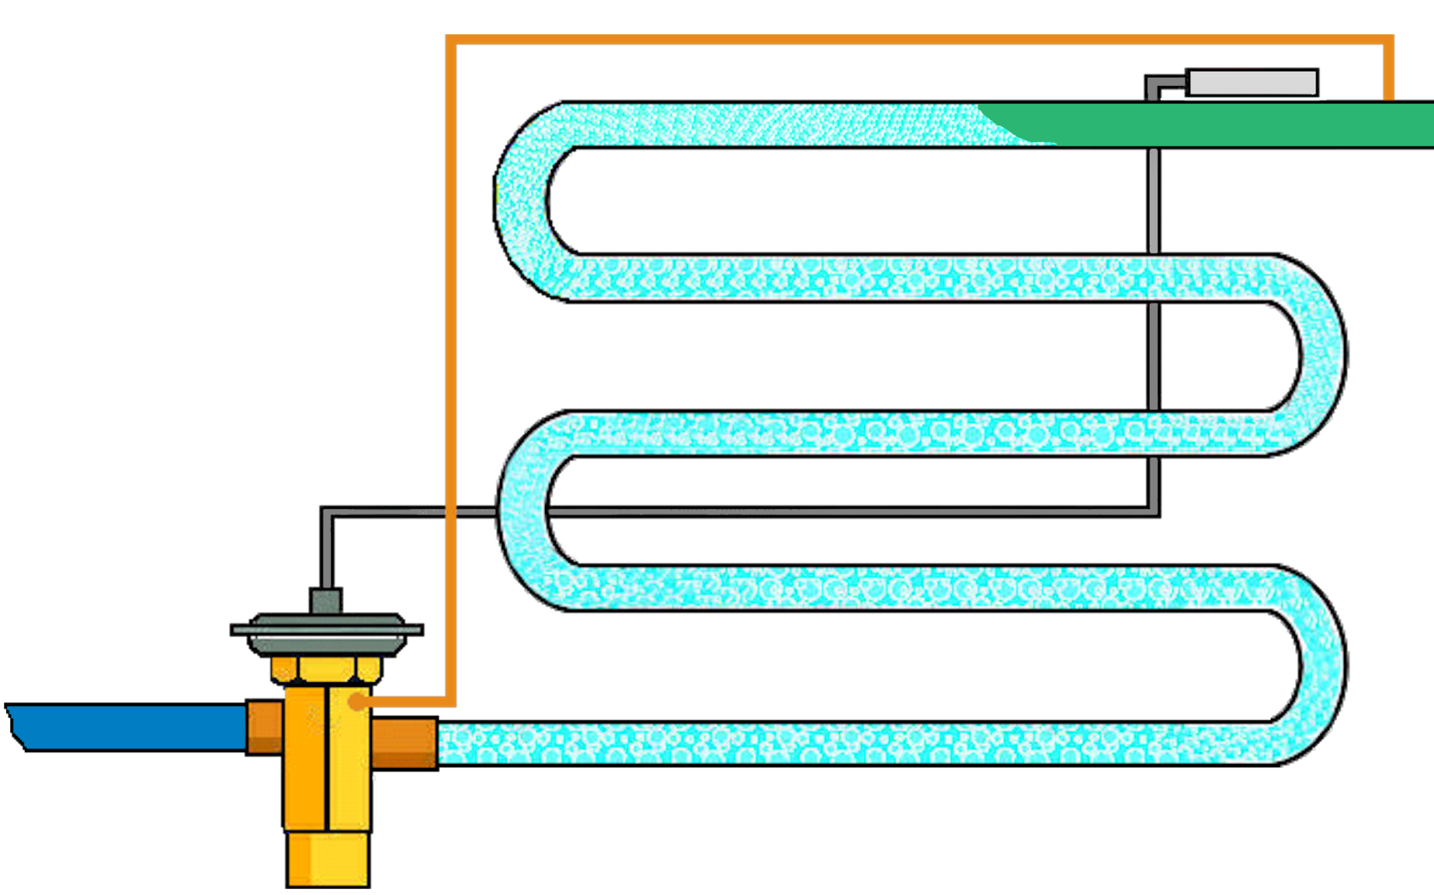
TXV’s control superheat
Point of Complete
Vaporization
Superheated Suction
Vaporization
Liquid Line
Saturated Refrigerant

Slide 10
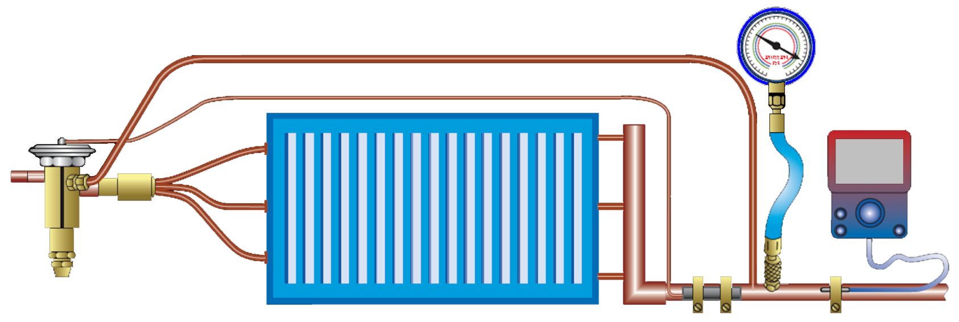
Measuring Superheat
143 psig
R-410A
57
Actual temperature at bulb ……………... 57°F
Saturated temperature
corresponding to 143 psig ……………….. 50°F
Operating superheat …………………… 7°F
Notes:
How do you determine superheat?
Determine suction pressure at the evaporator outlet with a gauge. On close coupled installations, suction pressure may be read at compressor suction connection.
Use pressure temperature chart to determine saturation temperature at observed suction pressure.
Measure suction gas temperature on the line at the expansion valve bulb's remote location.
Subtract saturation temperature (from Step 2) from suction gas temperature (from Step 3).
The difference is the superheat of the suction gas. (Example uses R-410A).

Slide 11
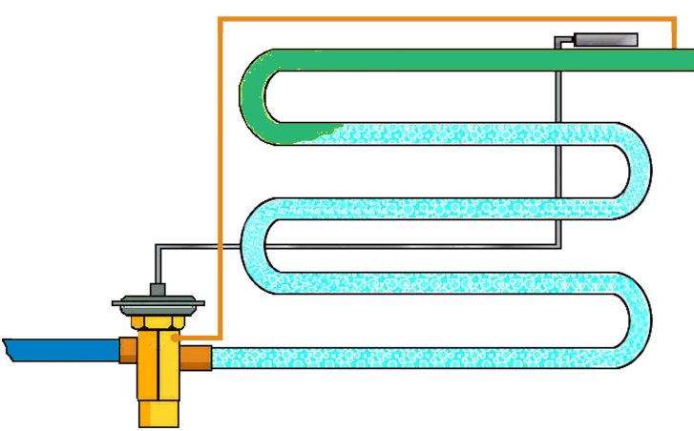
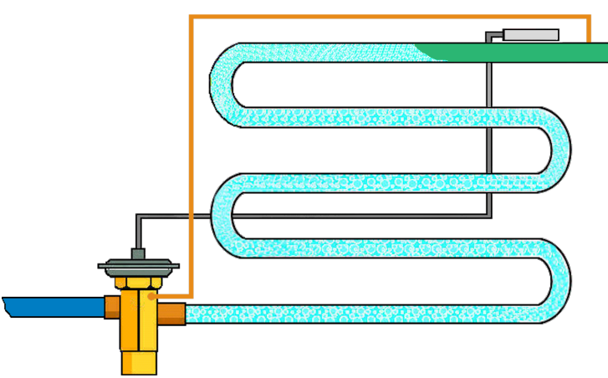
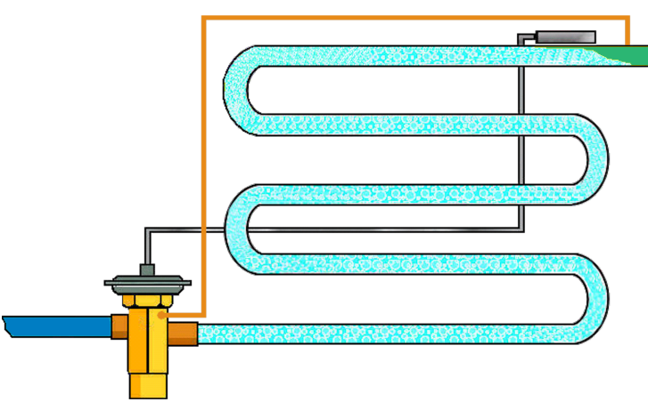
Heat Transfer
High Superheat
Reduced use of Evaporator heat transfer surface
Normal Superheat
Max safe use of Evaporator heat transfer surface
No Superheat
Maximum use of Evaporator heat transfer surface

Slide 12
System Performance
Fixed Restrictor
Evaporator Superheat
TXV
Provides
Improved
Efficiency
Capacity Rating Point
TXV Protects Compressor
TXV
Flood
60°F
95°F
120°F
Outdoor Temperature °F

Slide 13
Thermostatic . . .
A Thermostatic Expansion Valve is …
A Precision Metering Device …
Designed to regulate the flow of liquid refrigerant to an evaporator …
At a rate equal to the evaporation of the liquid in the evaporator …
By responding to the temperature of the vaporized refrigerant exiting the evaporator and the pressure in the evaporator.

Slide 14
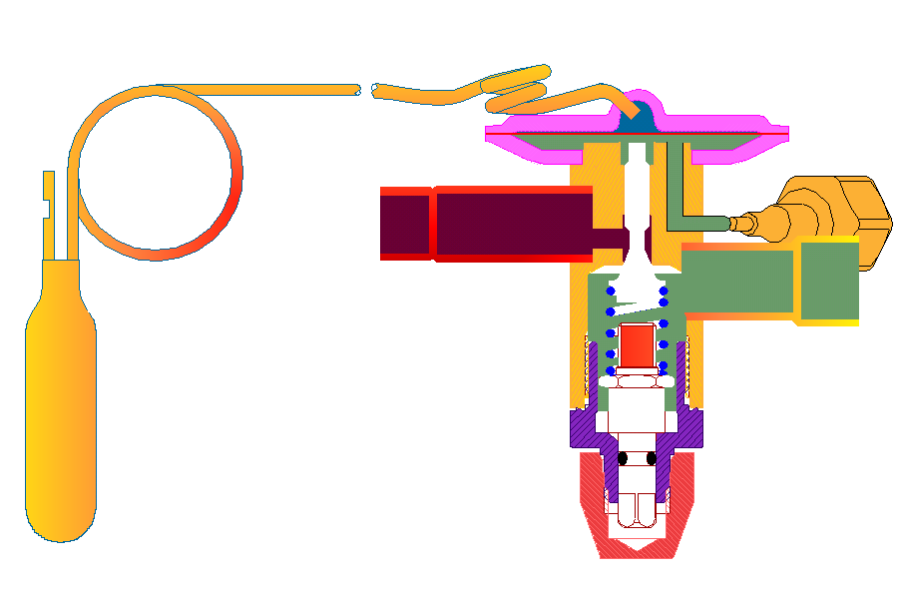
Expansion Valve Anatomy
CAP TUBE
POWER ELEMENT
EXTERNAL EQUALIZER
DIAPHRAGM
PAD
INLET
O-RING SEAL
OUTLET
PISTON
SPRING
BODY
SENSING BULB
SUPERHEAT ADJUSTMENT STEM
CAP

Slide 15
Balancing the Forces
The valve drives to a determined superheat with a specific opening degree and is dependent on the evaporator load.
Bulb Pressure (F1)
Valve driver (opening force)
Responds to refrigerant temperature changes exiting the evaporator
Spring Pressure (F3)
Constant.
Determines what superheat the valve operates at.
Must be physically changed to change the superheat.
Evaporator Pressure (F2)
Represents the evaporator load on the system.
Determines the opening degree of the valve.
F1 = F2 + F3

Slide 16
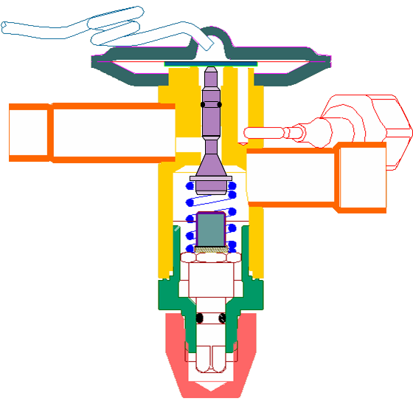
Balance Port Construction
F1 = Thermal Bulb pressure.
Opening force
F1
F2 = Evaporator pressure.
Closing Force
F2
F3 = Superheat Spring Force.
Closing Force
F4 = High & Low side pressure differential times the port area.
Opening force
F3
F4
F4 Force is “Canceled” out in “balance ported” valves due to unique design of piston.
Notes:
Balanced port valves respond to forces (F-1), (F-2) and (F-3) in a manner similar to conventional valves; however, they take a unique approach to the (F-4) force created by high and low side pressure differentials across the ball and valve orifice.
The area of the Parker Power Piston® is equal to the area of the port diameter. This force is cancelled out as the piston force and the force across the port are equal and opposite.
As inlet pressure changes, the (F-4) force changes but always remain equal and opposite and is cancelled out, therefore, variations in valve system pressures do not have any effect on the static superheat setting of the valve.

Slide 17
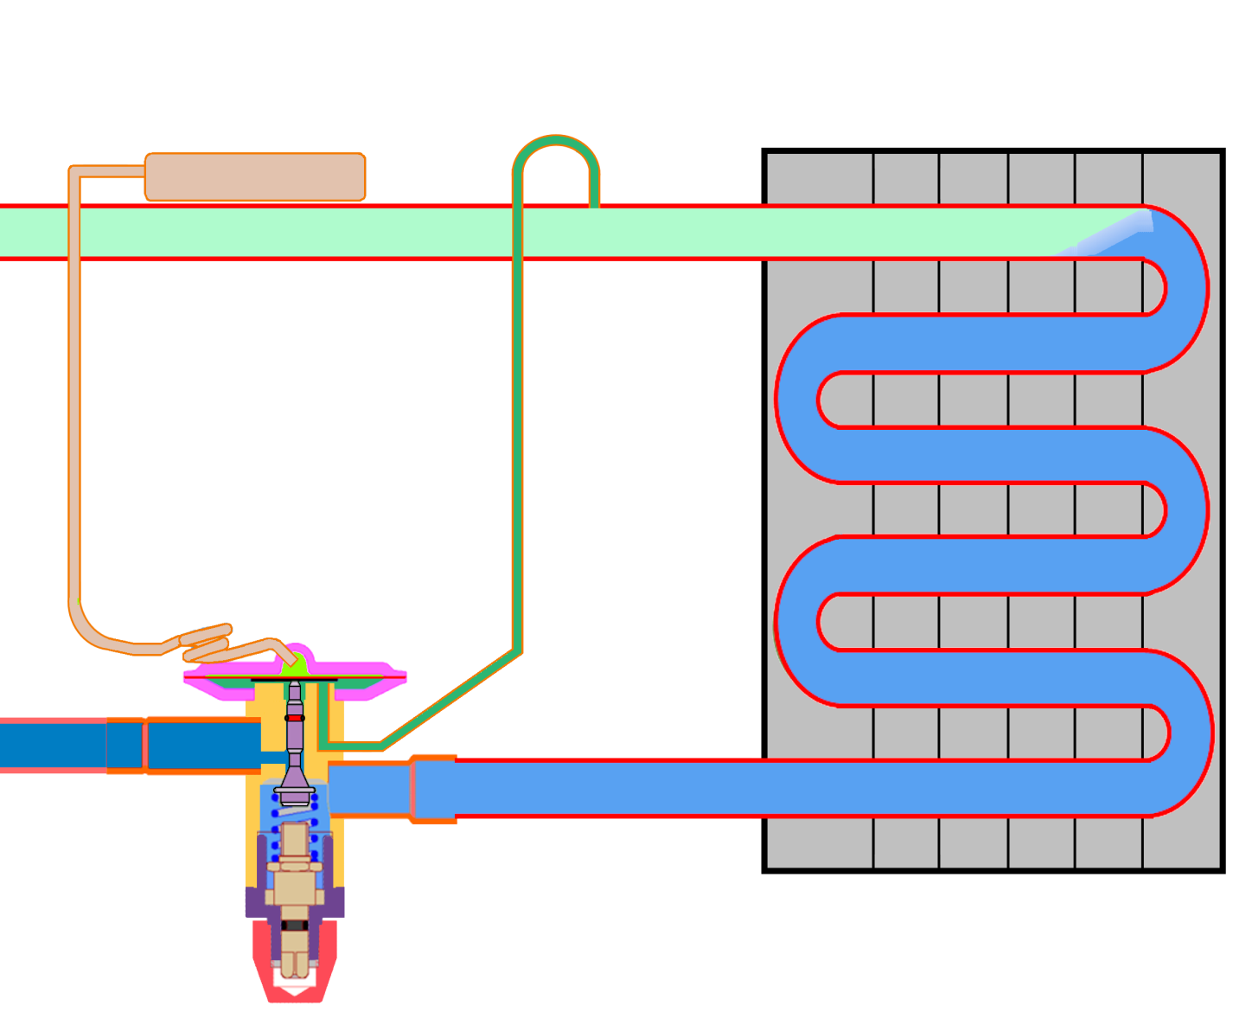
Balanced Port Expansion Valve
F1 = F2 + F3
57°F
143 psig (F2)
50°F SST
162 psig
F1 = 143 + 19
F1 = 162 psig
Evap. Outlet Temp = 57°F
Evap Saturation Temp = 50°F
Superheat = 7°F
Spring (F3)
19 psig
R-410A

Slide 18
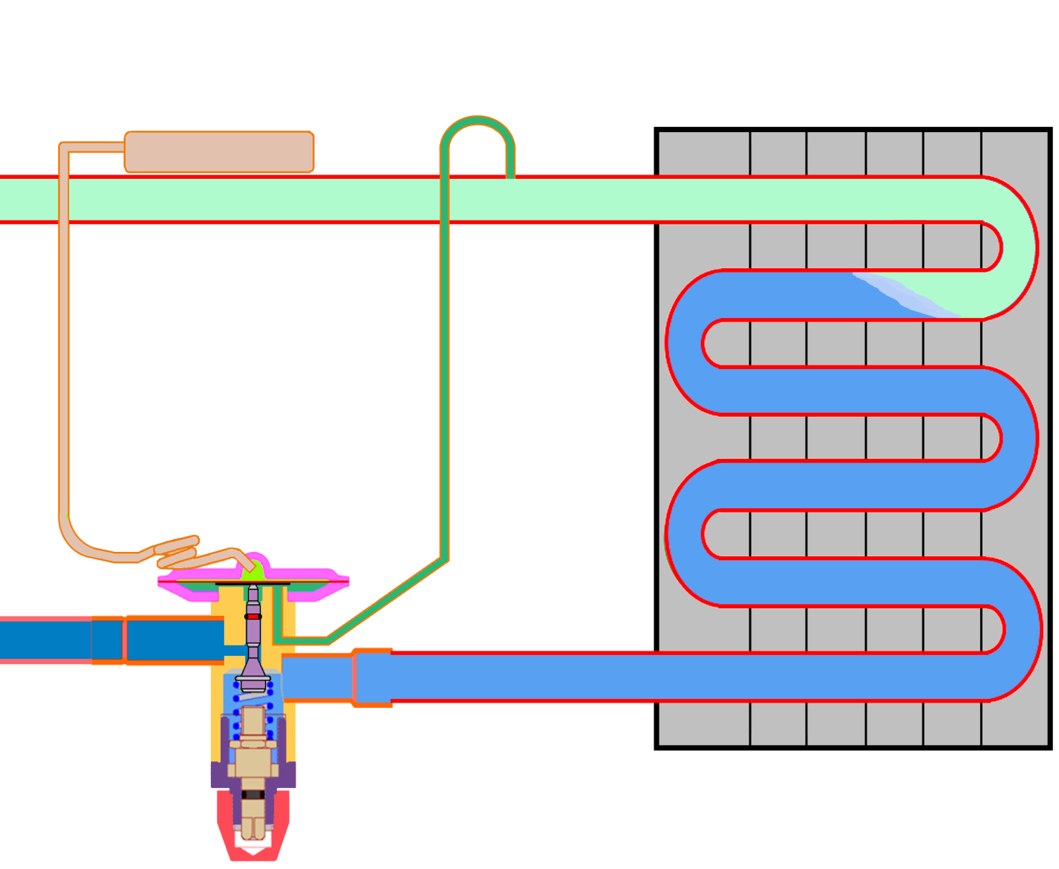
Evaporator Load Increases
Increase in Superheat causes the bulb pressure to increase. . causing the opening force to increase.
60°F
143 psig (F2)
50°F SST
170 psig
Increase in Load causes a temporary imbalance.
F1 = F2 + F3
F1 = 143 + 19
F1 = 162 psig
Evap. Outlet Temp = 60°F
Evap Saturation Temp = 50°F
Superheat = 10°F
Spring (F3)
19 psig
R-410A

Slide 19
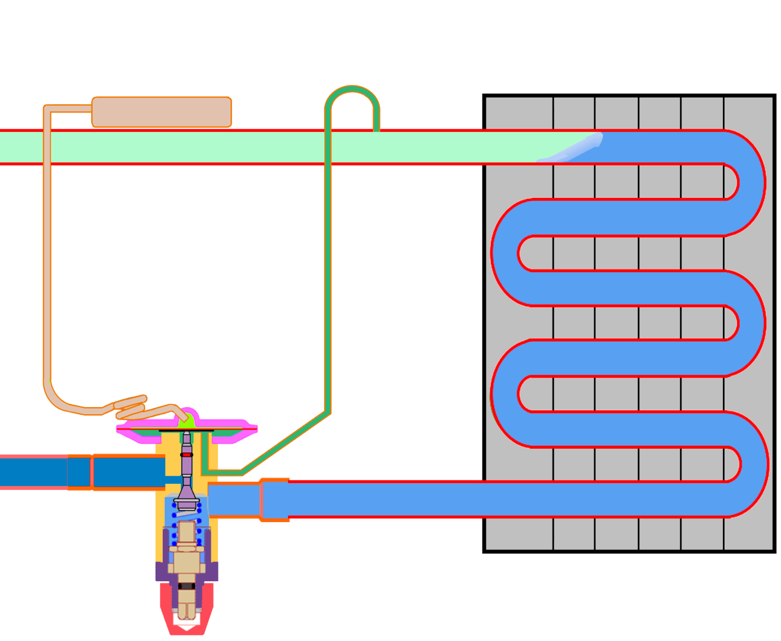
Evaporator Load Decreases
Decrease in Superheat causes the bulb pressure to decrease. . causing the valve to close.
55°F
143 psig (F2)
50°F SST
156 psig
Decrease in Load causes a temporary imbalance.
F1 = F2 + F3
F1 = 143 + 19
F1 = 162 psig
Evap. Outlet Temp = 55°F
Evap Saturation Temp = 50°F
Superheat = 5°F
Spring (F3)
19 psig
R-410A

Slide 20
Thermal Bulb Charge - Type
Universal Charge
Large liquid charge
“Not Sensitive” to migration
MOP Ballast Charge
Cross Section
Very small liquid charge
“Sensitive” to migration
Ballast brick – slows reaction

Slide 21
MOP Operating Function
Pressure limiting charge feature that uses a small amount of charge to limit the TXV for protection.
Positive
Keeps compressors within operating envelope.
Prevents liquid floodback during certain start-up conditions.
Negative
Charge migration
Diaphragm and capillary tube must be warmer than bulb.

Slide 22
MOP “Ballast” Function
Bulb temperature increase
Liquid surface heats quickly
Brick heated slowly
Gas re-condenses on brick surface
Slow opening
Bulb temperature decrease
Quick condensation on bulb inner surface
Condensation rate slows – part of brick remains warmer than surface
Fast closing

Slide 23
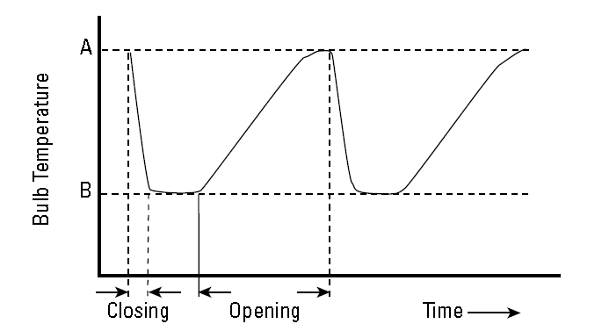
Bulb Response
Bulb response to temperature change
MOP

Slide 24
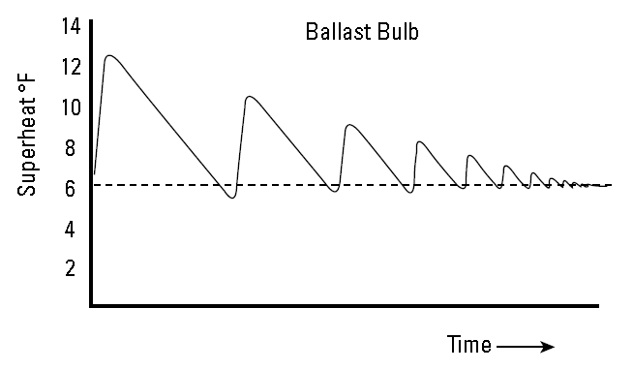
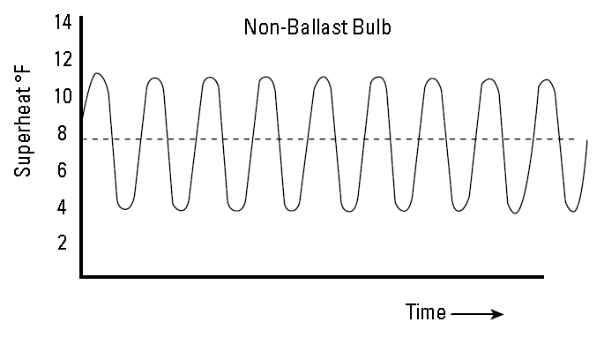
Operating Superheat Variation
Bulb response to temperature change
Anti-Hunt
Standard

Slide 25
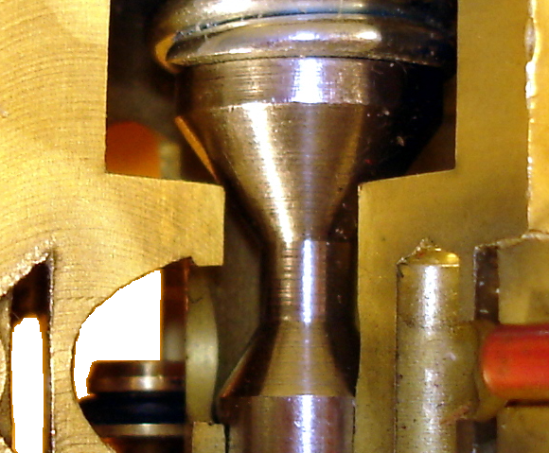
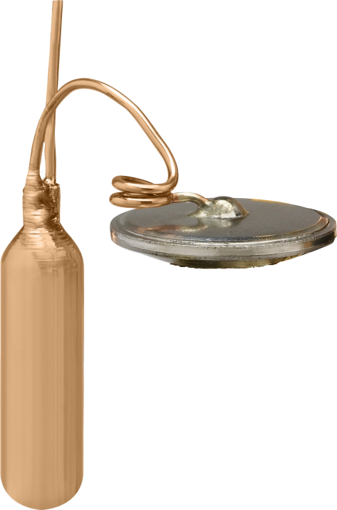
Select a Valve
Capacity
Refrigerant
Application

Slide 26
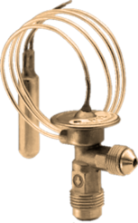
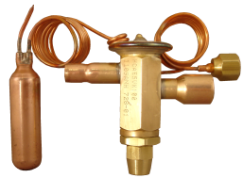
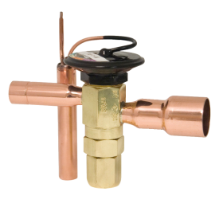
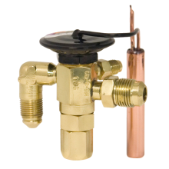
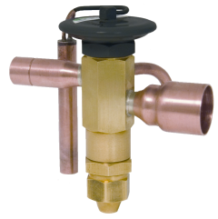
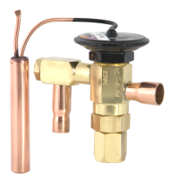
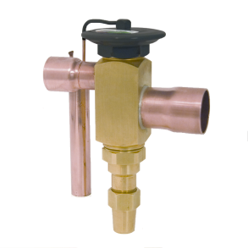
Parker TXV’s
N Series ( 1/4 to 3 tons)
Low Profile coolers, Ice Machines, Beverage Dispensers
H(E) & HC(E) Series ( 3/4 to 5 tons)
Air Conditioning, Heat Pumps
Balanced Port
C(E) Series ( 1/8 to 6 tons)
Refrigeration, Supermarket, AC
Balanced Port
EC(E) Series ( 1/8 to 15 tons)
Refrigeration, Supermarket, AC
Balanced Port
EBSE Series ( 8 to 20 tons)
AC, Chillers, Refrigeration
Balanced Port
SC(E) Series ( 1/8 to 6 tons)
Refrigeration, Supermarket, AC
Balanced Port
OE Series ( 15 to 70 tons)
AC, Chillers, Refrigeration
Balanced Port

Slide 27
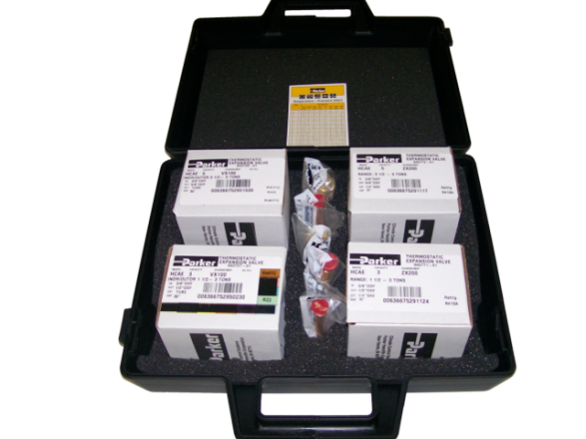
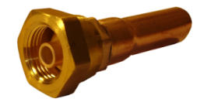
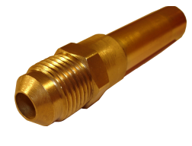
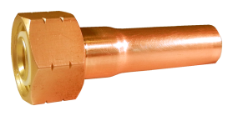
Residential AC TXV Kit Air Conditioning and Heat Pump
Kit covers Residential AC & Heat Pumps from 1½ to 5 Tons
Four Sweat Connection Valves with Adjustable Superheat
Five Adapters (Aeroquip, Chatleff and Flare) *
Fits All OEM brands and replacement coils
Refrigerant R-22, R-407C
Model No. | Part No. | Capacity (T) | Inlet | Outlet | Equalizer
HCAE-3-VX100 | 040727-01 | 1½ - 3 | ⅜” ODF | ½” ODF | ¼” FL. NUT
HCAE-5-VX100 | 040728-01 | 3½ - 5 | ⅜” ODF | ⅝” ODF | ¼” FL. NUT
Refrigerants R-410A
Model No. | Part No. | Capacity (T) | Inlet | Outlet | Equalizer
HCAE-3-ZX200 | 040771-01 | 1½ - 3 | ⅜” ODF | ½” ODF | ¼” FL. NUT
HCAE-5-ZX200 | 040772-01 | 3½ - 5 | ⅜” ODF | ⅝” ODF | ¼” FL. NUT
Outlet Connection Adapters
Model No. |  | Part No. | Model No. |  | Part No.
5/8” ODM x Aeroquip Fitting |  | 183372 | 1/2” ODM x Chatleff Fitting |  | 183375
1/2” ODM x Aeroquip Fitting |  | 183373 | 1/2” ODM x 3/8” SAE |  | 183376
5/8” ODM x Chatleff Fitting |  | 183374
Aero Style
3/8” SAE
Chatleff Style
* (Equipment Manufacturers use either Aeroquip, Chatleff, or direct TXV braze)

Slide 28
Select a Power Element
Refrigerant
Application
Application | Evaporator Range (°F) | R-22 R-407C | R-12 R-134a | R-502 R-404A | R-410A
Low Temp Refrigeration | -40° to 0° | VZ | - | SZ | -
Commercial Refrigeration | -40° to +60° | VW | JW | SW | -
Low Temp Pres. Limit | -40° to 0° | VX35 | - | SX35 | -
Commercial Pres. Limit | -10° to +60° | VX100 | JX60 | SX110 | ZX200
Air Conditioning | +30° to +60° | VX100 | JX60 | SX110 | ZX200
Heat Pump | -15° to +60° | VX100 | - | - | ZX200

Slide 29
TXV Installation Considerations
Thermal Bulb Mounting
GOOD THERMAL CONTACT
Straight Clean Surface to mount the bulb and Clamp Tight.
NEVER mount on Coupling or Joint.
Avoid vertical pipe if possible.
Locate close to evaporator outlet.
FULLY INSULATE the Thermal Bulb.
Notes:
Bulb Location and Installation
Since the control response of the bulb is crucial for satisfactory operation, care should be taken in its mounting and positioning.
· Always make sure the suction line is cleaned before clamping the bulb in place.
· On lines that are 5/8 " O.D. or smaller, the bulb may be installed on top of the line or side mounted (preferably at the 3 o'clock position).
· On lines that are 1 " O.D. or larger, the remote bulb should be installed at 45° or at approximately the 4 or 8 o'clock position.
· Never mount a bulb on the bottom of suction lines because a mixture of refrigerant and oil may be present at that point, especially on smaller lines.
· It is good practice to insulate the bulb regardless of the refrigerant type. This ensures that the bulb will only respond to the suction gas temperature and will not be affected by condensation, ice formation or ambient temperatures.
· Avoid mounting the bulb on vertical lines or close to reversing valves.
· The bulb should always be mounted between the evaporator outlet and the external equalizer connection and should be as close to the evaporator outlet as possible (generally 3 to 6 inches).
· On systems that have multiple evaporators, the bulb must be mounted on the suction line of the evaporator that it controls. Do not mount the bulb on the common suction line.
· Install traps on vertical risers.

Slide 30
TXV Installation Considerations
Thermal Bulb Location
12
Mount on top or sides for 7/8” or smaller
10
2
Bulb
Bulb
Mount on sides just below center for 1” and larger
Bulb
Bulb
8
4
6
Do Not mount Bulb on bottom of Suction line.
Notes:
Bulb Location and Installation
Since the control response of the bulb is crucial for satisfactory operation, care should be taken in its mounting and positioning.
· Always make sure the suction line is cleaned before clamping the bulb in place.
· On lines that are 7/8 " O.D. or smaller, the bulb may be installed on top of the line or side mounted (preferably at the 3 o'clock position).
· On lines that are 1 " O.D. or larger, the remote bulb should be installed at 45° or at approximately the 4 or 8 o'clock position.
· Never mount a bulb on the bottom of suction lines because a mixture of refrigerant and oil may be present at that point, especially on smaller lines.
· It is good practice to insulate the bulb regardless of the refrigerant type. This ensures that the bulb will only respond to the suction gas temperature and will not be affected by condensation, ice formation or ambient temperatures.
· Avoid mounting the bulb on vertical lines or close to reversing valves.
· The bulb should always be mounted between the evaporator outlet and the external equalizer connection and should be as close to the evaporator outlet as possible (generally 3 to 6 inches).
· On systems that have multiple evaporators, the bulb must be mounted on the suction line of the evaporator that it controls. Do not mount the bulb on the common suction line.
· Install traps on vertical risers.

Slide 31
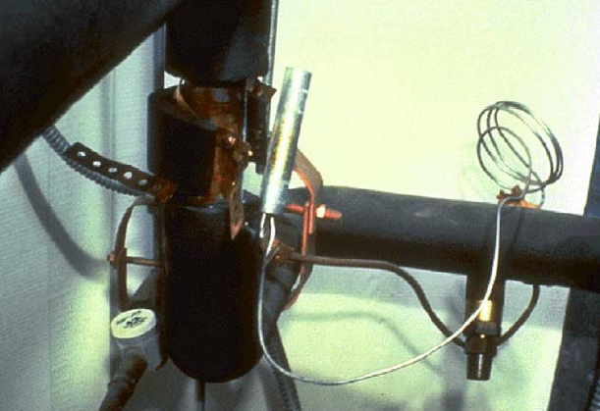
Thermal Bulb
NOT a Proper Installation
Use the metal straps or clamp provided by the valve manufacturer.

Slide 32
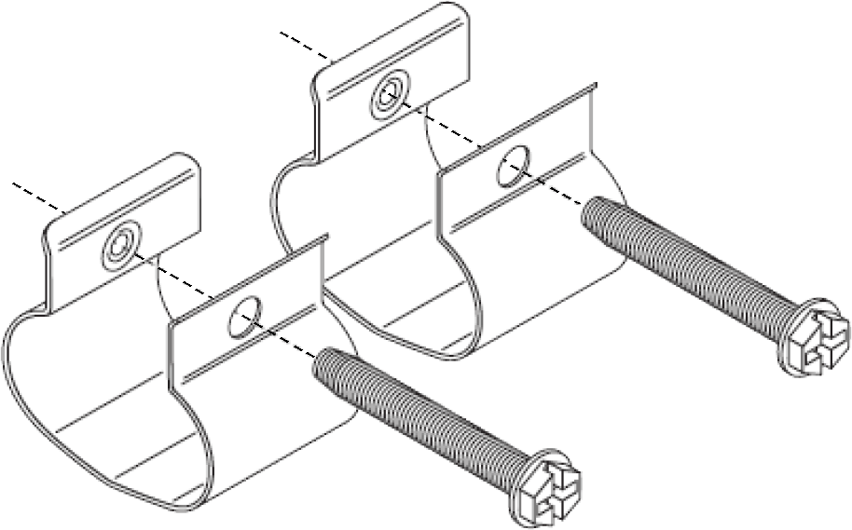
Thermal Bulb Clamps
An example of a metal clamp provided by the equipment manufacturer.
New Style of a metal clamp provided by Parker.

Slide 33
External Equalizer
Some TXV’s have an external pressure equalization line installed in the suction line.
External equalized TXV’s are necessary for proper TXV function when evaporators have a large pressure drop (generally over 3 psi).
Notes:
External Equalizer Use
Use external equalizers for evap / distributor pressure drops over 3 psi.
Can be mounted upstream or downstream of bulb for Parker valves due to balanced port construction - keep toward top of suction line to prevent oil logging.

Slide 34
Equalizer Line
Installation issues
Equalizer Line - bottom
Frost on Equalizer Line

Slide 35
TXV Installation Considerations
Brazing
Limit body temperature to 250°F to prevent internal seals damage.
Do not disassemble valves for installation, WRAP VALVE BODY, or use a Thermal Block.
Remove Thermal Bulb from suction line before brazing
Notes:
Brazing
Limit body temperature to 250°F (120° C) due to internal seals used for balanced port construction.
Do not disassemble valves for installation (WRAP VALVE BODY)

Slide 36
TXV Valve Orientation
Most valves are not position sensitive.
However, optimal operation is achieved with power element UP to avoid oil accumulation near diaphragm.
Notes:
Valve Orientation
Parker valves are not position sensitive; however, optimal operation is achieved with power element UP to avoid oil accumulation near diaphragm cavity.

Slide 37
TXV Superheat Adjustment
Must have Proper system refrigerant charge.
Must have Proper Air Flow across coil.
Must be AT or NEAR design operating conditions.
Clockwise - Higher SH
Counter-Clockwise Lower SH
Clockwise decreases refrigerant flow thus increasing superheat
Counter-clockwise increases refrigerant flow thus decreasing superheat
View of Adjustment Stem
Notes:
Superheat Adjustment
Superheat degrees / turn varies per refrigerant and evaporator temperature
Clockwise increases superheat / Decreases refrigerant flow
Counter clockwise decreases superheat / Increases refrigerant flow

Slide 38
TXV Troubleshooting
Symptom
Look for . . .
Low refrigerant charge.
Insufficient Subcooling
Improperly adjusted TXV.
Excessive pressure drop w/ internally equalized TXV.
Contamination blocking valve.
TXV leaking bulb charge.
High Operating Superheat

Slide 39
TXV Troubleshooting
Symptom
Look for . . .
Poor bulb mounting / contact (bulb senses too high temp.)
Improperly adjusted TXV.
Contamination in valve not allowing it to close fully.
An oversized valve
Oil logging in the evaporator
Low Operating Superheat

Slide 40
TXV Troubleshooting
Symptom
Look for . . .
Oversized expansion valve (valve overcompensates)
Thermal bulb too far from Evap. Outlet.
Incorrect type bulb charge (“X” charges have best stability)
Uneven heat loading in multi-circuit evaporator (flooding circuit(s) affects suction line temperature)
Poor distribution or unequal circuit loading (Oil logging?)
Valve Hunting

Slide 41
Thank You
www.parker.com/coolparts
1-800-742-2681

