Slide 1






Parker Hannifin Corp.
By:

Slide 2





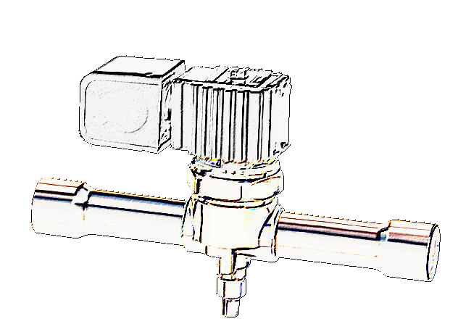
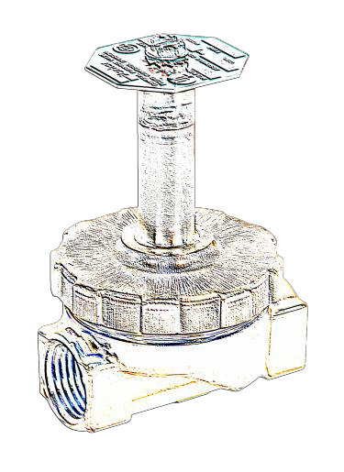



Today’s Topics
Parker Hannifin
- the Company
Solenoid Valves
Steam & Hot
Water Valves
NATE Certified for Continuing Education Credit

Slide 3

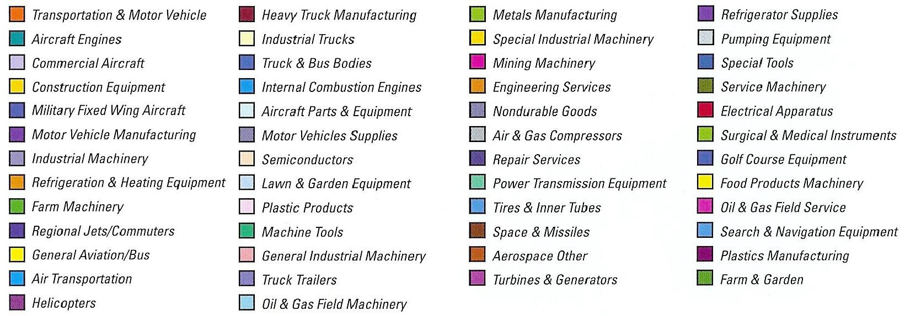
Parker Diversity

Slide 4



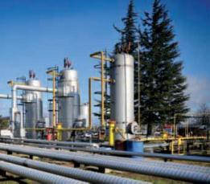



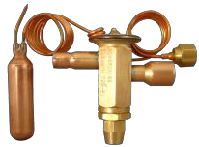

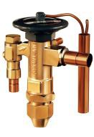
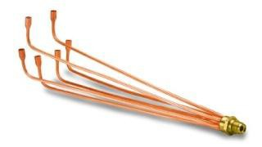


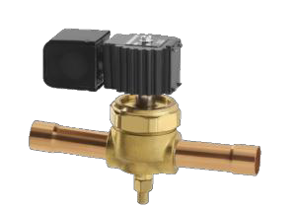
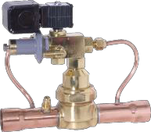
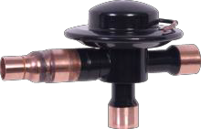
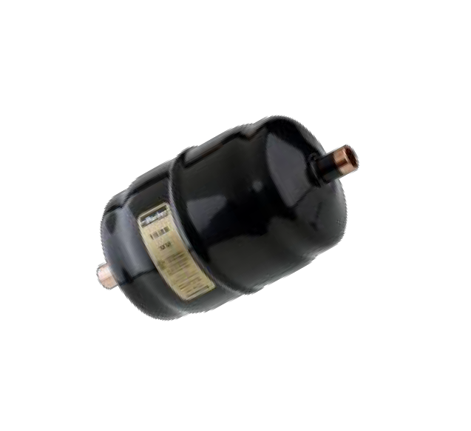
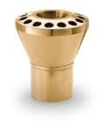
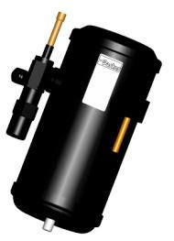


Parker Corporate Overview
Fluid Connectors
Aerospace
Automation Instrumentation
Sporlan
Filtration
Seal
Hydraulics
Washington, MO (3) New Haven, IN (1) Greenfield, TN (1)
Owensville, MO (2)
4

Slide 5
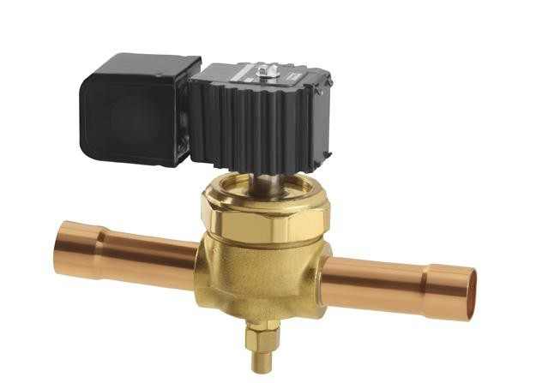
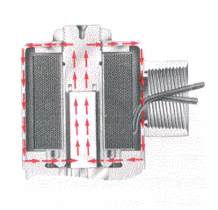
Solenoid Valves
A solenoid valve is...”
An electromechanical control
of flow.
Operated by magnetic flux that moves a magnetic plunger or lever away from or towards an orifice.

Slide 6
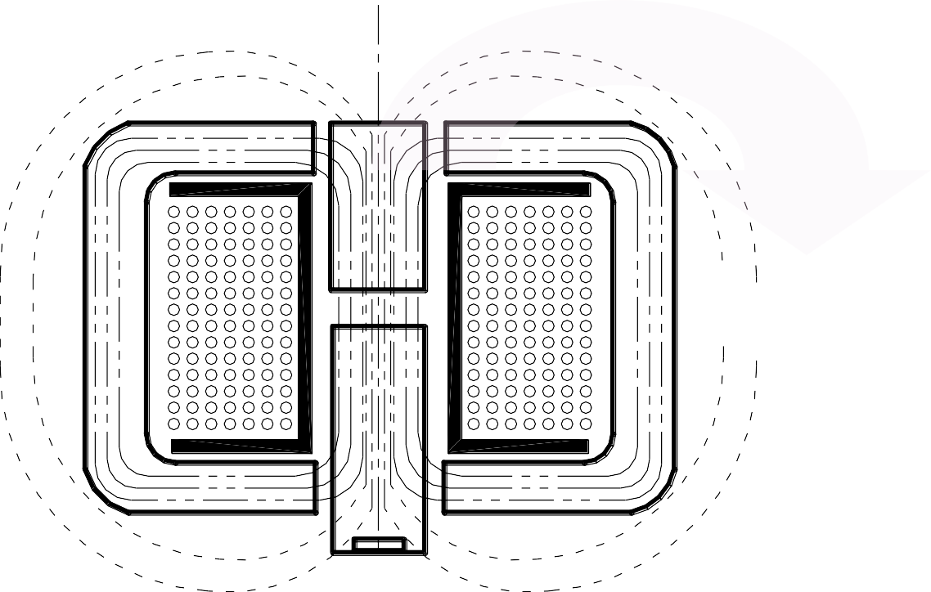
Coils / Magnetic Lines

Slide 7
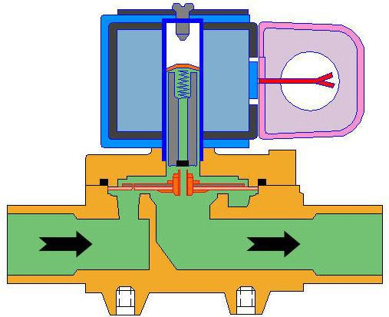
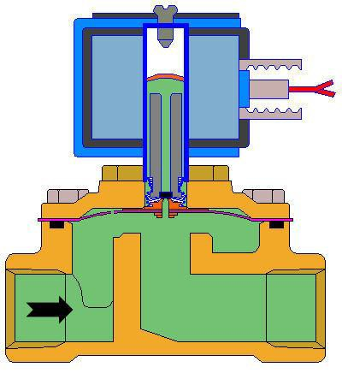
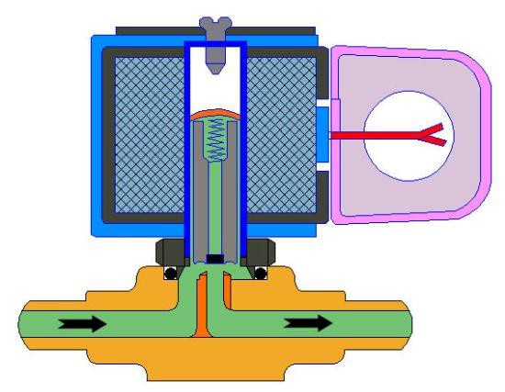
Solenoid Valves Design Type
Direct Acting
Pilot Operated Hung Diaphragm
Direct Acting -
“the main orifice is opened and closed by the plunger”
Pilot Operated -
“differential pressure across the orifice is required to open and close the main orifice”
Hung Diaphragm -
“the main orifice is controlled by a diaphragm assembly that is mechanically connected to the plunger”

Slide 8

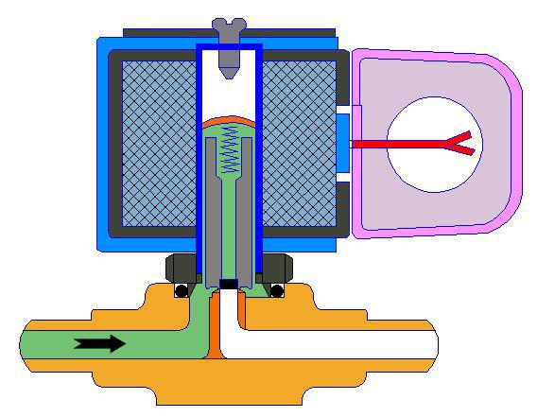
Normally Closed - Direct Acting Not energized / Closed
Coil
Return Spring
Sleeve
flange & stop carry magnetic flux
Plunger Assembly
seal materials
selected for media
compatibility
Orifice / Port
restricts or limits flow through valve
Body materials available in various metals
Body

Slide 9

Normally Closed - Direct Acting Energized / Valve Open

Slide 10
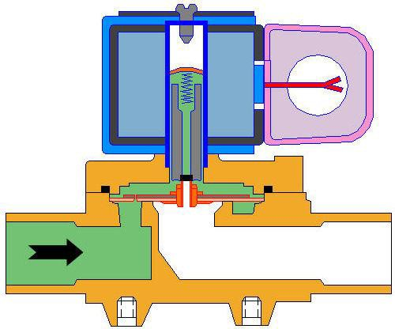
Normally Closed - Pilot Operated Coil Not Energized / Valve Closed
Return
Spring
Sleeve
flange & stop carry magnetic flux
Equalizer Orifice
Coil
Plunger
Diaphragm
Pilot Orifice
Body

Slide 11
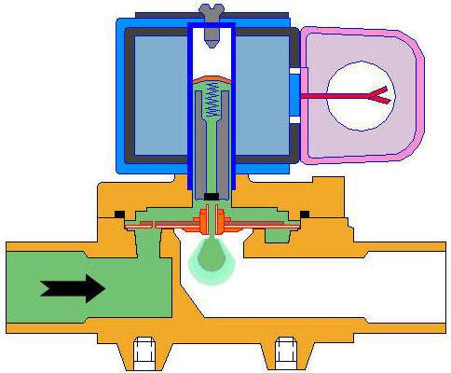
Normally Closed - Pilot Operated Coil Energized / Valve Opening

Slide 12
Normally Closed - Pilot Operated Coil Energized / Valve Open and Operating

Slide 13
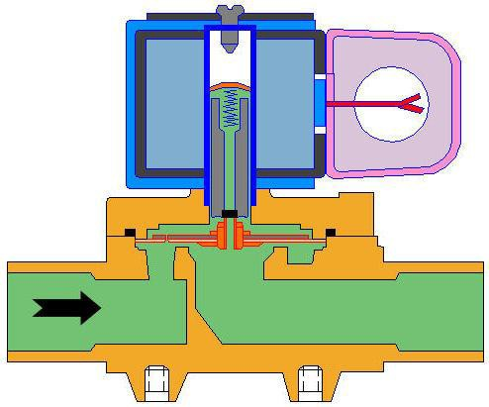
Normally Closed - Pilot Operated Coil Not Energized / Valve starts to Close

Slide 14
Normally Closed - Pilot Operated Coil Not Energized / Valve Closed

Slide 15
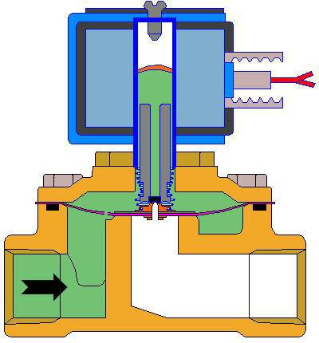
Normally Closed - Hung Diaphragm Coil Not Energized – Valve Closed
Coil
Sleeve
flange & stop carry magnetic flux
Equalizer Orifice
Plunger
Return Spring
Diaphragm
Pilot Orifice
Body

Slide 16
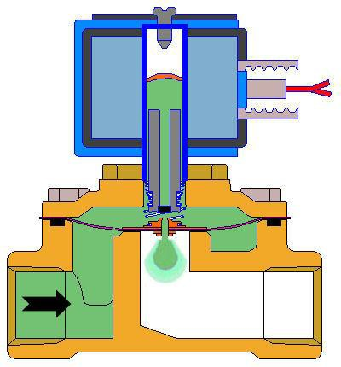
Normally Closed - Hung Diaphragm Coil Energized / Valve starts to Open

Slide 17
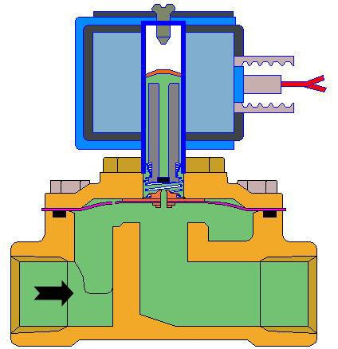
Normally Closed - Hung Diaphragm Coil Energized / Valve Open and Operating

Slide 18

Normally Closed - Hung Diaphragm Coil Not Energized / Valve starts to Close

Slide 19
Normally Closed - Hung Diaphragm Coil Not Energized / Valve Closed

Slide 20
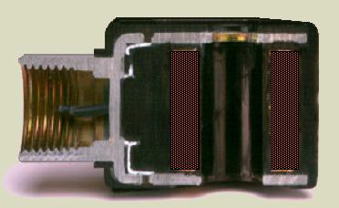
Solenoid Valve - Coils
Uniform layer of copper insulated magnet
wire.
Rated for specific voltage
or range of voltages
Enclosure Carries Magnetic Flux
Coil generates heat when on continuously

Slide 21
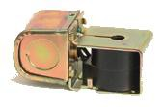

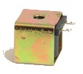
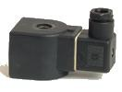

Solenoid Valve - Coils
Junction Box
Leads
Spade
DIN
1/2” Conduit
Standard in HVACR is the Junction Box

Slide 22

Applications
Frozen Beverage Dispensers
Ice Dispensers Chillers Compressors
Mobile Air Conditioning Units Commercial Air Conditioning Units Mobile Refrigeration Systems Supermarket Racks
Supermarket Cases
Refrigeration Reclaim Units

Slide 23

Applications - Refrigeration
Compressor Unloaders
Refrigerant Recovery
General
Refrigeration
Humidifiers

Slide 24
Sizing Valves for HVACR
Refrigerant Phase Matters!
Size Valves independently for:
Liquid Line | Hot Gas Line | Suction Line

Slide 25
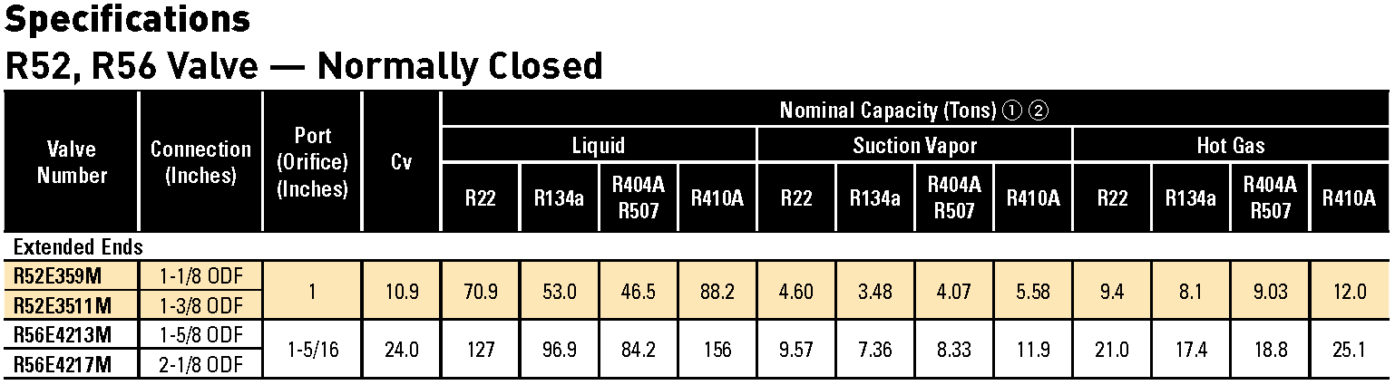
Solenoid Valves – Capacity Table
Nominal Capacity Ratings
Liquid Capacity based on 40°F Evaporator, 10°F superheat temperature, 100°F condenser temperature and PD across valve: 2 psi for R-134a; 3 psi for R-22, 404A, and 507; 5 psi for R-410A
Suction vapor capacity based on 40°F evaporator temp. + 25°F superheat temp., 100°F condenser, 1 psi PD across valve. Hot Gas capacity based on 40°F evaporator temp. + 25°F superheat temp., 100°F condenser, 2 psi PD across valve.

Slide 26



HVACR Solenoid Valve Nomenclature
Family
Optional Manual Stem
Type
Connection
Port Size
Normally Closed
Normally Open
R -
Refrigeration
12
16
22
26
32
36
38
42
46
52
56
-
-
- 27
33
37
39
43
47
53
57
Size of Conn.
measured in 1/8th of inch E - Ext End F - Flare
Size of Port
measured in 1/32 of inch Example:
2 = .075”
3 = .101”
6 = 3/16”
9 = 9/32”
M
Example: To order a 2-way normally closed valve, 1/2 ODF connection, manual bypass option, R22, 5 ton liquid line rating, reference R22 valve catalog page. Select R26E64M.

Slide 27





Electrical Nomenclature – R12 - R57
Electrical Enclosures – R42 thru R57
Lead Wire Color Code
Insulation Type
Coil Type
Voltage
Enclosure
PKC-1 OPKC-1 PKC-2 OPKC-2
24/50-60
120/50-60
120-240/50-60
208-240/50-60
24 VDC
J
J J J J
A A A A A
Q (Orange)
M (Blue) N (Red) K (Black) K (Black)
Coil Wattage – (O)PKC-1 = 10W, (O)PKC-2 = 15W
Example: To order a junction box coil assembly for R52 , Select PKC-1 208-240/50-60 JAN
Order separate or with valve = R52E359 + 208-240/50-60 JAN

Slide 28
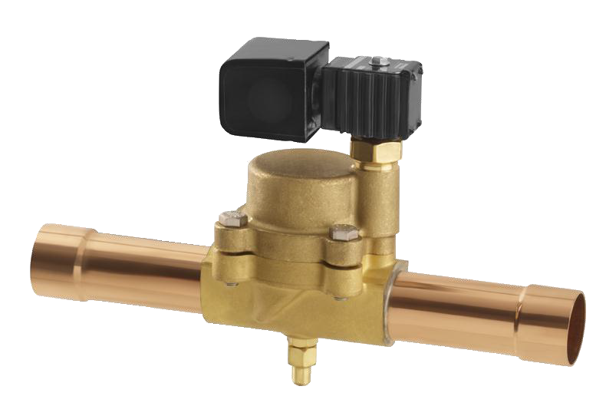
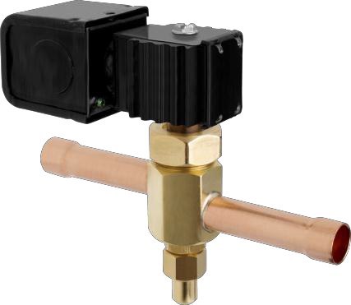
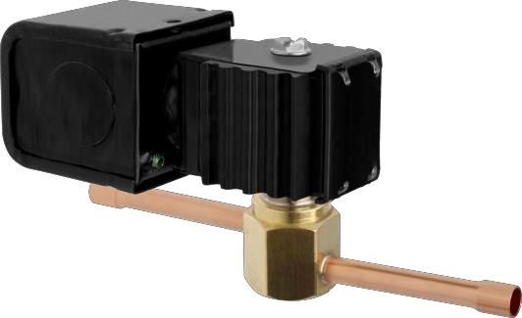
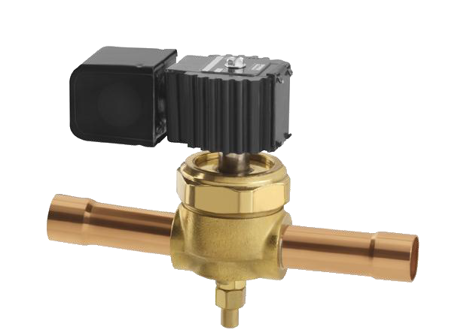
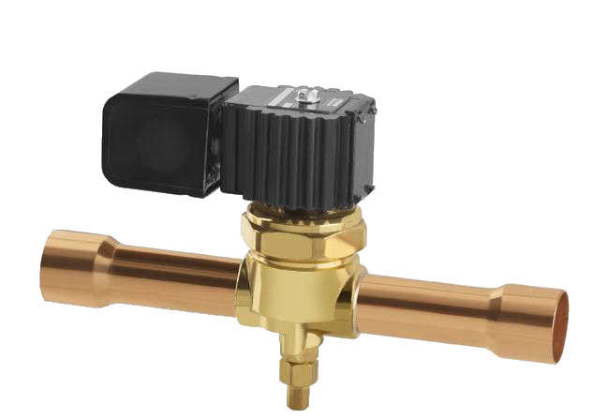
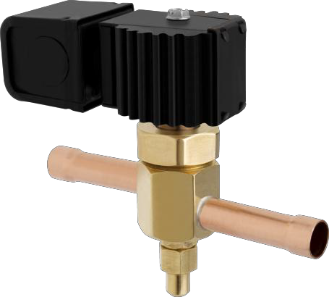
Solenoid Valves
2013
R26E64M w/ PKC-1
R12E22 w/ PKC-1
R52E3511 w/ PKC-1
R42E197M w/ PKC-2
R32E94M w/ PKC-2
R46E259M w/ PKC-2

Slide 29
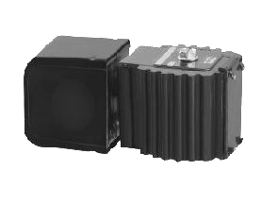
Solenoid Valve Coils 2013
Electrical Enclosures - R12 thru R56
Coil Model N/C | Coil Watts | Coil Model N/O | Coil Watts
PKC-1-24 | 10 | OPKC-1-24 | 10
PKC-1-120 | 10 | OPKC-1-120 | 10
PKC-1-120/240 | 10 | OPKC-1-120/240 | 10
PKC-1-208/240 | 10 | OPKC-1-208/240 | 10
PKC-1-24DC | 15
PKC-2-24 | 15 | OPKC-2-24 | 15
PKC-2-120 | 15 | OPKC-2-120 | 15
PKC-2-120/240 | 15 | OPKC-2-120/240 | 15
PKC-2-208/240 | 15 | OPKC-2-208/240 | 15
PKC-2-24DC | 18

Slide 30
Solenoid Valves 2013
Valve Series * | Nominal Capacity •‚① ② |  |  |  |  |  |  |  | NC Coil Junction Box | NO Coil Junction Box
 | Liquid |  |  |  | Hot Gas
 | R-22 | R-410A | R-134a | R-404A | R-22 | R-410A | R-134a | R-404A
 |  |  |  | R-507 |  |  |  | R-507
R12 E2 | 0.8 | 0.98 |  | 0.53 |  |  |  |  | PKC-1 | xx
R16 E3 | 1.6 | xxx | 1.2 | 1.1 | 0.24 | xxx | 0.20 | 0.22 | PKC-1 | xx
R16 F3 | 1.6 | xxx | 1.2 | 1.1 | 0.24 | xxx | 0.20 | 0.22 | PKC-1 | xx
R22 E5 | 2.8 | 3.45 | 2.1 | 1.9 | 0.45 |  | 0.37 | 0.4 | PKC-1 | xx
R26/27 E6 | 4.9 | 6.02 | 3.8 | 3.3 | 0.84 |  | 0.7 | 0.75 | PKC-1 | OPKC-1
R32/33 E9 | 8.1 | 9.86 | 6.2 | 5.4 | 1.35 |  | 1.12 | 1.21 | PKC-2 | OPKC-2
R36/37 E10 | 11.1 | 13.6 | 8.5 | 7.23 | 1.83 |  | 1.52 | 1.64 | PKC-2 | OPKC-2
R38/39 E14 | 15.8 | 19.2 | 12.0 | 10.4 | 2.62 |  | 2.17 | 2.34 | PKC-2 | OPKC-2
R42/43 E19 | 24.2 | 29.7 | 18.4 | 16.0 | 3.43 | 4.71 | 3.26 | 3.53 | PKC-2 | OPKC-2
R46/47 E25 | 41.4 | 50.6 | 31.5 | 27.4 | 6.74 | 8.07 | 5.60 | 6.04 | PKC-2 | OPKC-2
R52/53 E35 | 57.6 | 57.6 | 53.0 | 38.1 | 9.90 | 12.0 | 8.10 | 9.03 | PKC-1 | OPKC-1
R56/57 E42 | 98.2 | 98.2 | 76.7 | 65.8 | 21.0 | 25.1 | 17.4 | 18.8 | PKC-2 | OPKC-2
* Reference individual catalog pages for specific valve numbers and connection sizes.
① Nominal capacities are based on ARI Standard 760 under the following system conditions:
Liquid line capacities are based on 40°F evaporator, 10°F superheat and 100°F condenser temperatures and pressure drop across valve: 2 psi for R134a - 3 psi for R22, R404A, R507 - 5 psi for R410A
Rated hot gas capacities based on 40°F evaporator temperature plus 25°F superheat and 100°F condenser temperature and 2 psi drop.
②For capacities at other ratings, refer to Extended Capacity tables in Parker Catalog D-1.

Slide 31
Solenoid Valve
Questions?

Slide 32





Parker Hannifin Corp.

Slide 33
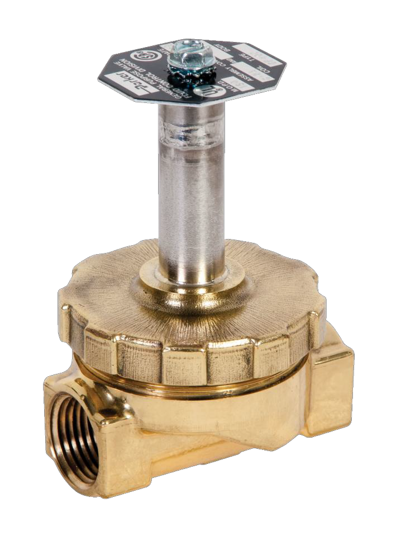
Steam & Hot Water Valves
1/4” Connections to 1-1/2” NPT
Connections
CV’s from .5 to 22.5
Normally Closed or Normally Open
Ethylene Propylene Seals
Available with variety of Coils &
Voltages
Temperature range 353°F Max.
Hung Diaphragm construction
Springs and Plunger are Stainless Steel

Slide 34
Normally Closed – Hung Diaphragm Coil Not Energized – Valve Closed
Coil
Sleeve
flange & stop carry magnetic flux
Equalizer Orifice
Plunger
Return Spring
Diaphragm
Pilot Orifice
Body

Slide 35
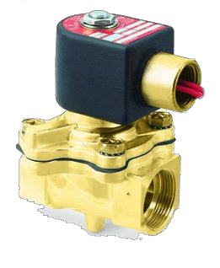
Steam & Hot Water Valves
Parker solenoid valves for hot water and steam are two-way valves with one inlet and one
outlet connection.
  Normally closed valves are open when energized.
  Normally open valves are
closed when energized.

Slide 36

Steam & Hot Water Valves
Wide Variety of Applications
Dry Cleaning
Sterilizers
Steam Irons
Laundry equipment
Steam baths
Moldings
Autoclaves
Steam atomization

Slide 37




Nomenclature for Steam Valves
08
F
S3
C
2
3
40 ACF
Connection Size
Conn. Type
Construc- tion
Operation
Body Material
Trim
Steam Service
Size of end
connection in sixteenths (inches)
Example: 04 = 1/4”
06 = 3/8”
08 = 1/2”
12 = 3/4”
16 = 1”
20 = 1-1/4”
24 = 1-1/2”
F = Female S = Steam
C =
Normally Closed
O =
Normally Open
2 = Brass
3 = EPDM
Ethylene propylene elastomers
40 = Valve
^{Pipe Thread} 3 = Diaphragm
orifice
diameter in
NPT
Hung
1/64”
increments.
Example: 32 = 1/2”
40 = 5/8”
48 = 3/4”
ACF =
Current Design Series
Coils Ordered Separately

Slide 38
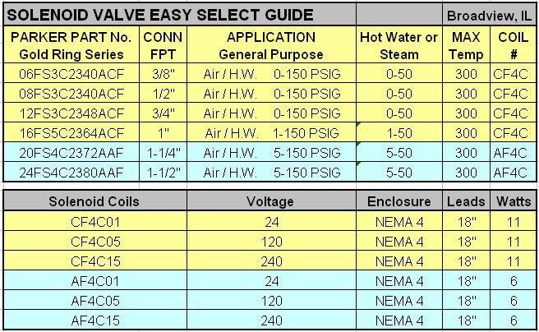
Steam & Hot Water Valve - Selections

Slide 39
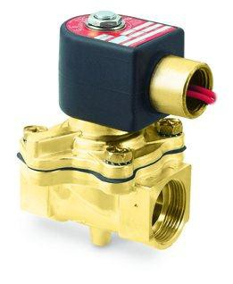

Steam & Hot Water Valve
Questions?

