Slide 1
Title page
Filter-Driers
By: Steve Ward

Slide 2

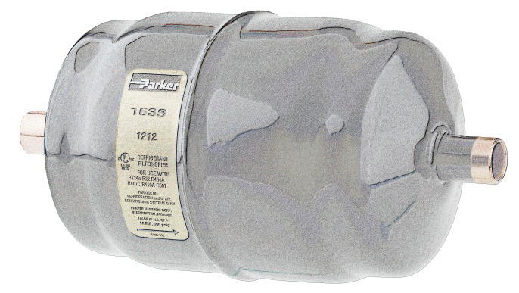
Today’s Topics
Parker Hannifin - the Company
Filter Driers for HVACR Industry

Slide 3
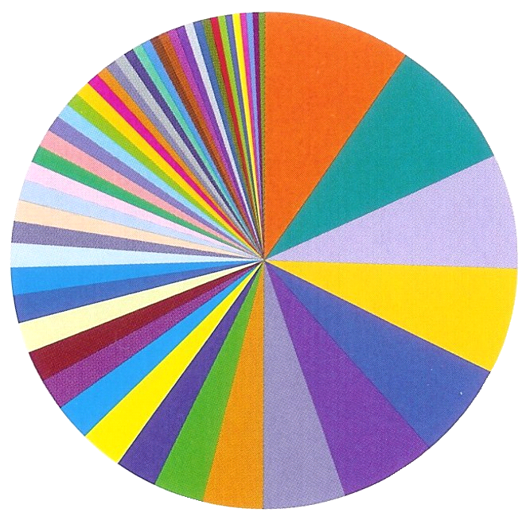
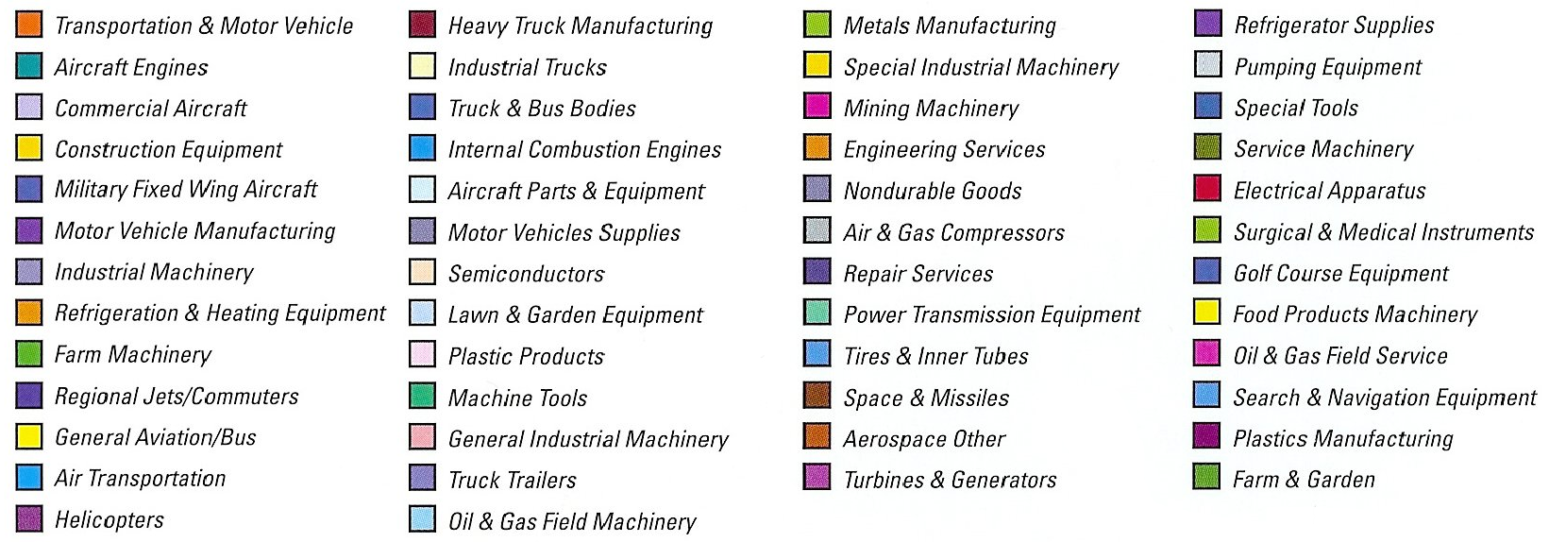
Parker Diversity

Slide 4
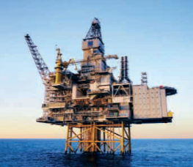

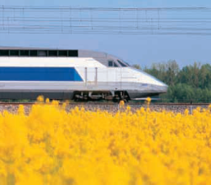
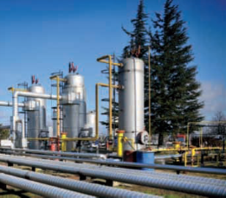
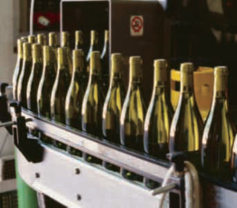

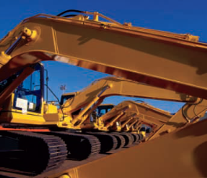
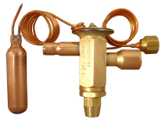

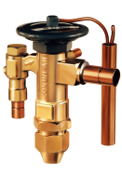
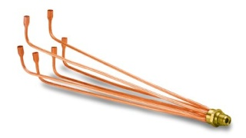
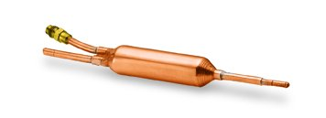

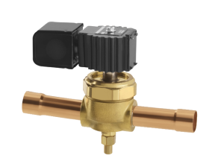
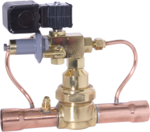
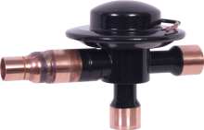
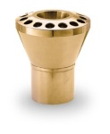
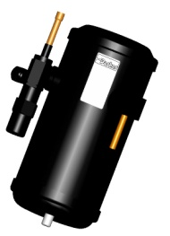
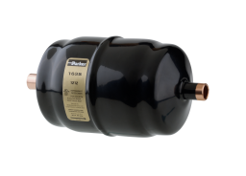
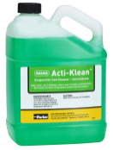
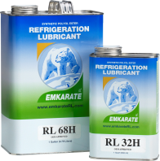
Parker Corporate Overview
Fluid Connectors
Aerospace
Automation
Instrumentation
Filtration
Seal
Hydraulics
Sporlan
Washington, MO (3)
Greenfield, TN (1)
Owensville, MO (2)

Slide 5
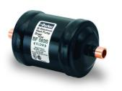
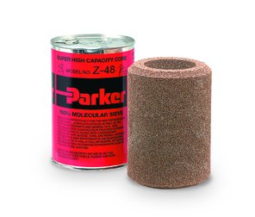
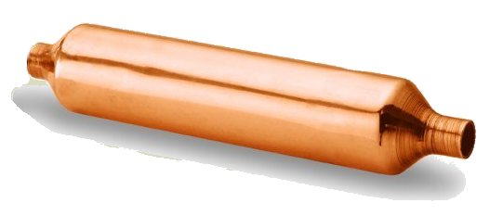
Filter Driers
A Drier in a HVACR system has two Functions:
  To adsorb system contaminants (water & acid).
  To provide physical filtration.

Slide 6
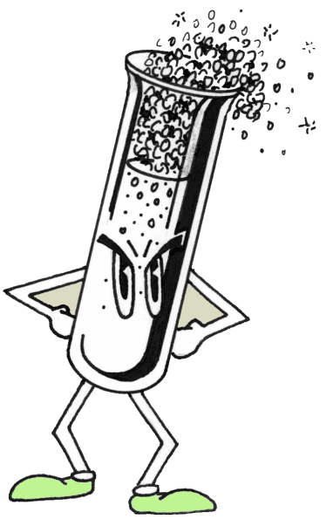
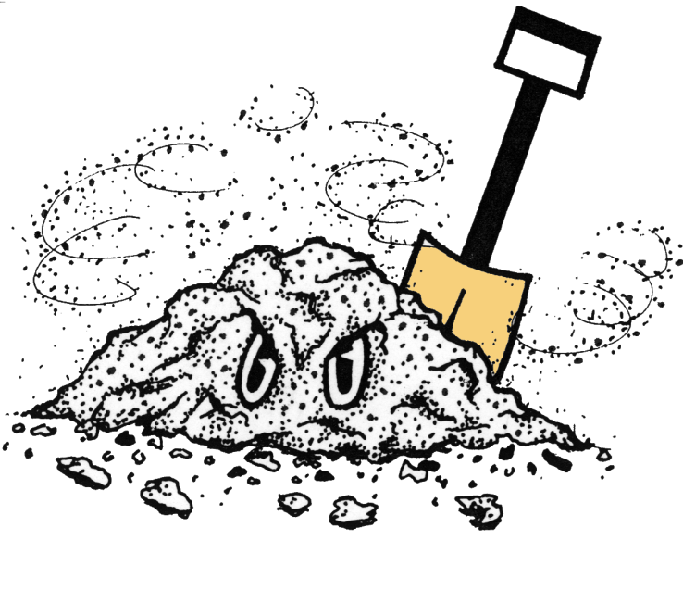
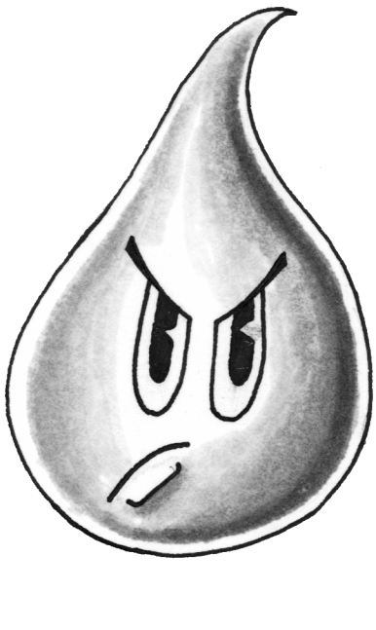
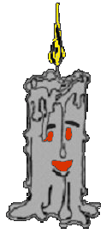
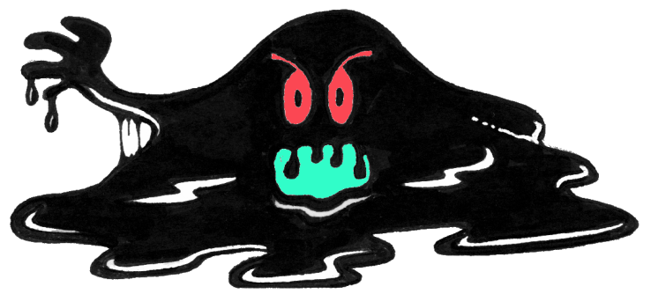
Contaminates
Acid
Foreign Matter
Moisture
Wax
Sludge & Varnish

Slide 7
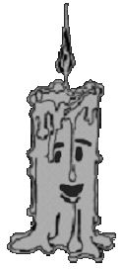
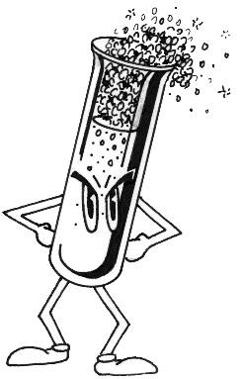

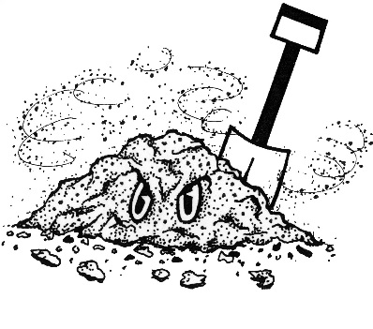
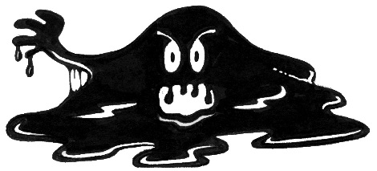
Contaminants
Contaminants introduced or generated in a system:
  From installation or service
  From adverse operating conditions
Contaminant Types
Anything circulating in the system other than refrigerant and oil
Acid Moisture Foreign Matter Wax Sludge & Varnish

Slide 8

Contaminants
Water or Moisture
Lubricant – reacts with moisture to form acid
Refrigerant – reacts with moisture to form acid
Moisture – causes copper plating and corrosion

Slide 9
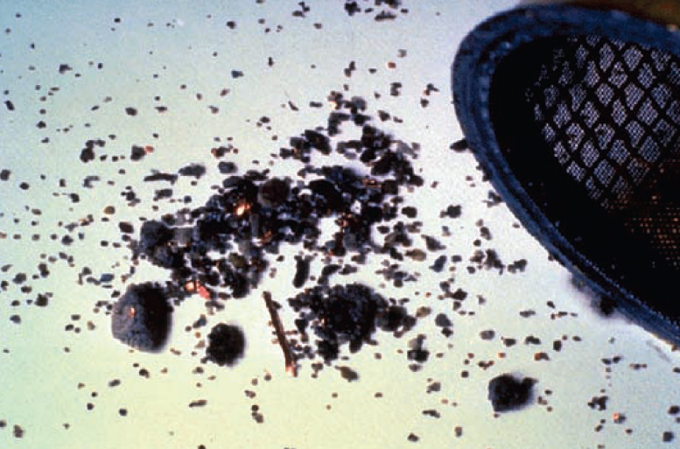
Foreign Matter
Oxide Scale – Dirt – Metallic Particles – Sludge – Flux
Damages compressor components
Affects valve operation
Plugs capillary tubes
POE lubricant suspends and circulates large amounts of debris

Slide 10
Wax
Wax-like substances
Potential sources:
  Excessive brazing paste
  Manufacturing processes
    Cutting lubricants
    Corrosion inhibitors
    Drawing compounds
  Rubber Hoses

Slide 11

Sludge and Varnish
By-product of mineral and alkylbenzene Oil breakdown:
  Varnish – Sludge – Carbonaceous powder
  Ranges from residues at TXV to beige/black/gray solids captured in the filter-Drier
POE lubricant is more thermally stable; but hydrolytic (reacts with water) to form acid.

Slide 12
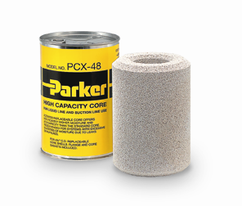
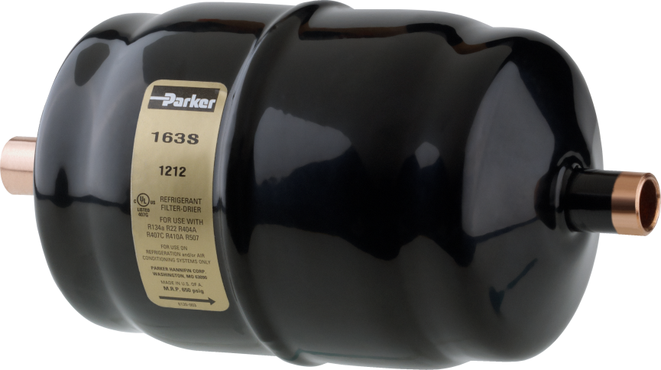
Solution
Install a Filter-Drier
  Must remove a variety of contaminants
  Must be compatible with today’s refrigerants and lubricants

Slide 13
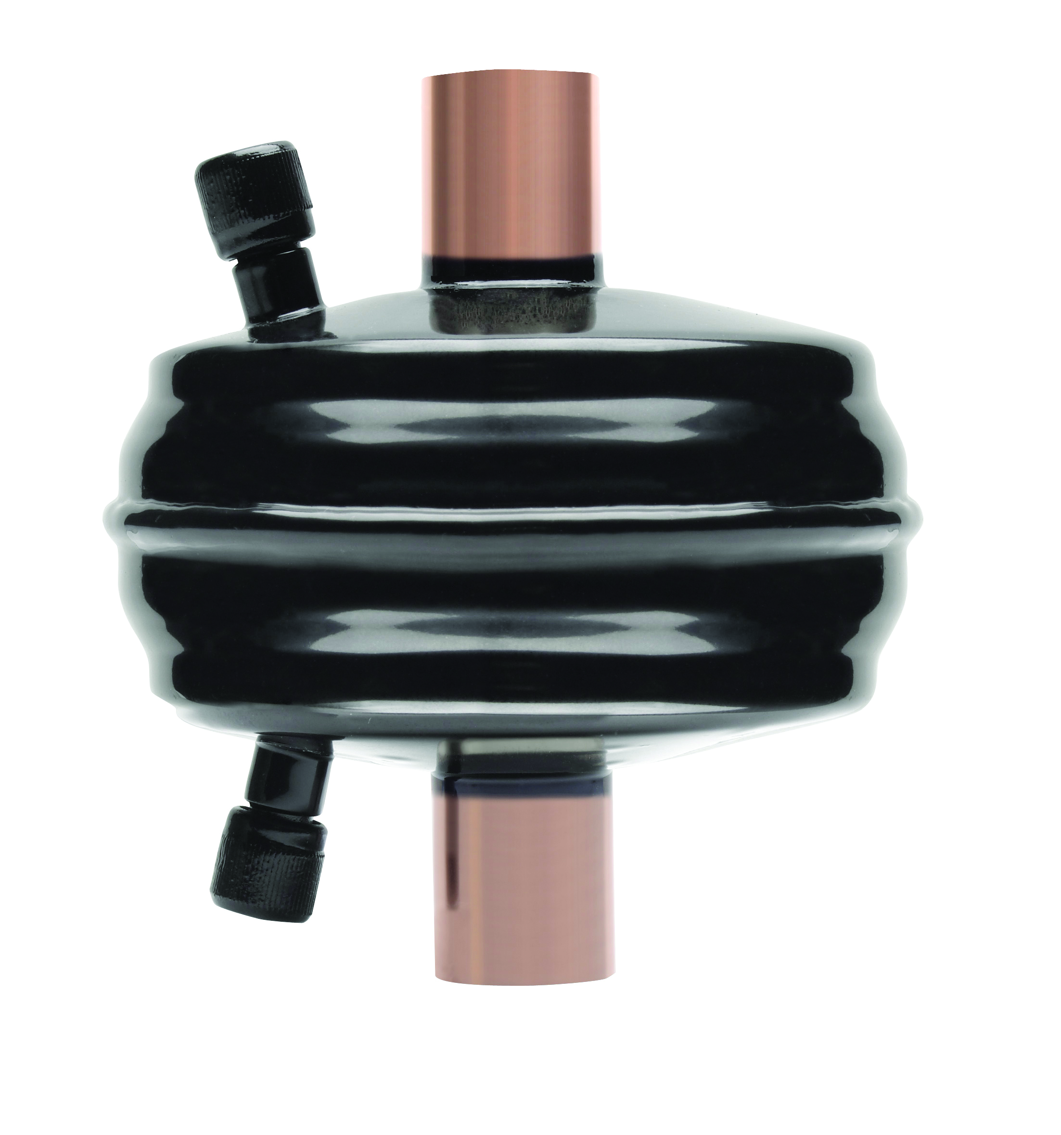
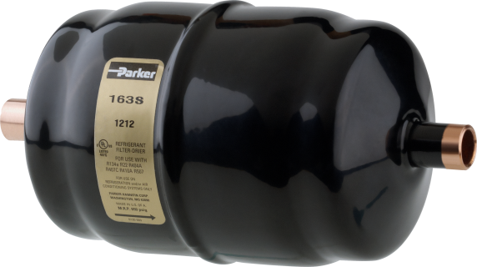
Filter-Driers
Drier Selections:
  Type of System.
  Connections.
  Suction or Liquid Line.
  Flow Capacity (size of system).
  Refrigerant Type.
  Construction Material.
  Safe Working Pressure.

Slide 14
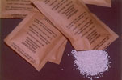
Driers / Desiccants
A Desiccant is a substance that adsorbs water and is used to remove moisture and acid.
  The three most commonly used desiccants are:
Silica Gel
Activated Alumina
Molecular Sieve

Slide 15
Silica Gel
Silica gel is a non-crystalline material with a molecular structure formed by bundles of polymerized silica (SiO₂).
Gel-type desiccants utilize weak bonds formed between water and the desiccant.
Silica gel is not widely used in today’s filter Driers.

Slide 16
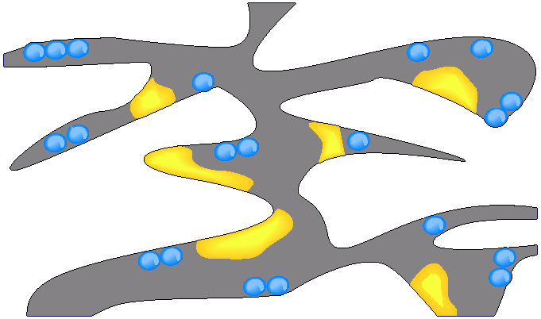
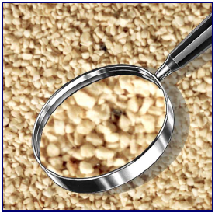
Activated Alumina
Activated alumina is formed from aluminum oxide (Al₂O₃) and is not a highly crystalline material.
Water
Organic Acid

Slide 17
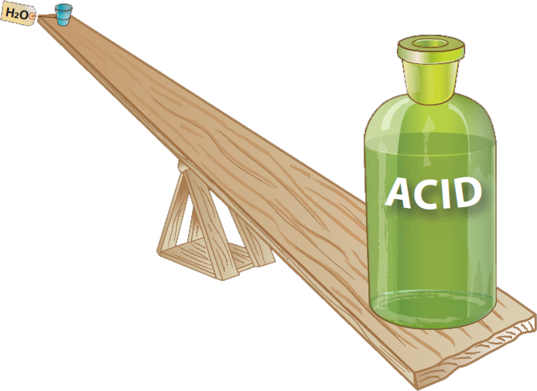
Activated Alumina
Low Water Capacity
High Acid Capacity

Slide 18
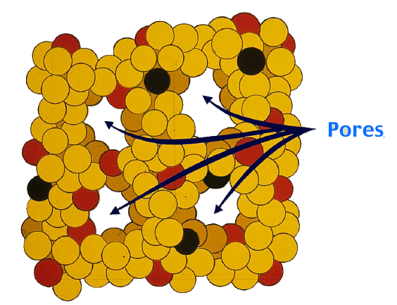
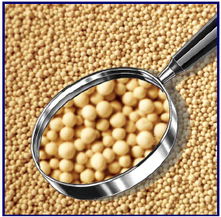
Molecular sieves
These are crystalline sodium alumino-silicates (synthetic zeolites) having cubic crystals, which selectively adsorb molecules based on molecular size and polarity.
One of the keys to molecular sieve is its ability to remove water from refrigerant at low parts per million (ppm) level.

Slide 19
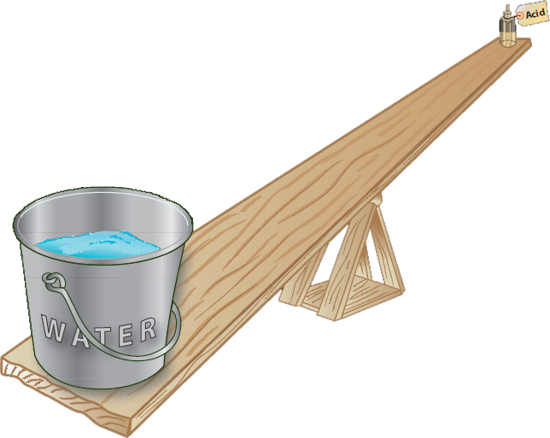
Molecular sieves
Low Acid Capacity
High Water Capacity

Slide 20
Desiccant / Dry Down
20
Molecular Sieve
15
Water capacity, weight %
10
Activated Alumina
5
Silica Gel
0 10 20 30 40
Water in Refrigerant, ppm by weight

Slide 21
Desiccants
Desiccants are available in granular, bead, and block forms. Solid core desiccants, or block forms, consist of desiccant beads, granules, or both, held together by a binder. The binder is usually a non-desiccant material.
Beaded molecular sieve desiccants offer higher water capacity per unit mass than solid core desiccants.
Due to the dense nature of cores, core Driers usually have a higher pressure drop than comparable loose filled Driers.

Slide 22
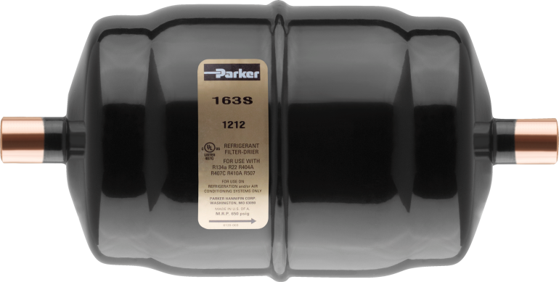
Liquid Line Filter Driers
Gold Label LLD Series
Designed for use in Liquid Lines.
Compatible for use with all commercially available refrigerants including R-410A.
Compatible with Mineral, Alkylbenzene or POE oils.
Spring load molecular sieve and activated alumina.
Solid copper ODF or Nickel plated steel SAE fittings.
Powder coat exterior paint exceeds 500 hrs. salt spray test.
3 Cubic In. through 75 Cubic In. (Flare or ODF)

Slide 23
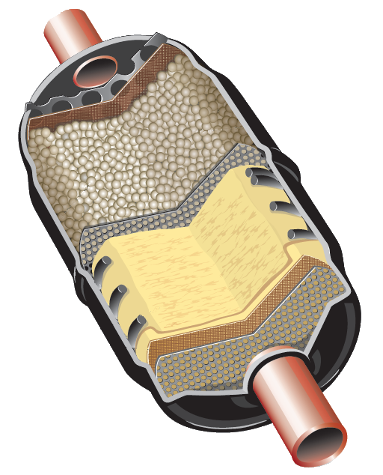
Liquid Line Filter-Drier
FLOW
Steel Shell
Spring Loaded
Compacted Dessicant Bead
Solid Copper fittings
Baffle Plates
Multi-layered filtration

Slide 24
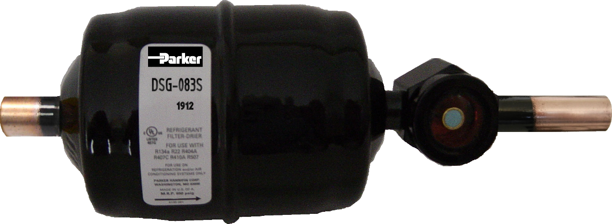
Liquid Line Filter Driers
DSG Filter-Drier Sightglass
Moisture / Liquid indicator combined with Gold Label LLD
Available in popular 083S and 163S sizes
Solid Copper Fittings
Replaceable Indicator Element
Reduce Leaks and Installation Costs

Slide 25
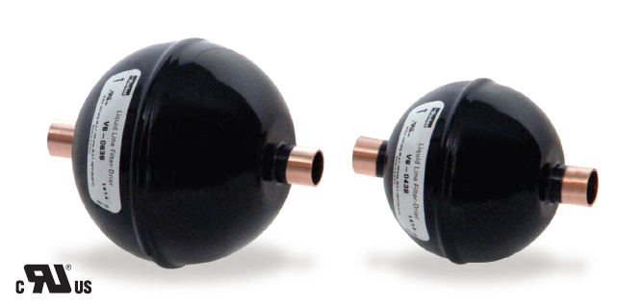
SS Series Overview
Maximum Rated Pressure: 650 psi
R-410A Capable
High Contaminant Capacity
New Design:
Spherical shape reduces shell wall thickness
Core fills shell with similar desiccant load as prior Sahara Series design but in smaller size
Shape reduces pressure drop
Excellent combination of solid debris capture capability and water capacity
Unique Selling Features
Recognized Parker Brand
2
Made in North America
3
Compact Core Style Model
1
Notes:
Really should be titled “hydrocarbon optimized”
Water Capacity
Water capacity at a 50 ppm dryness level for R-290 at 125 deg F is 30 drops
Burst pressure of 2500 psi which at a minimum allows a 500 psig MRP

Slide 26
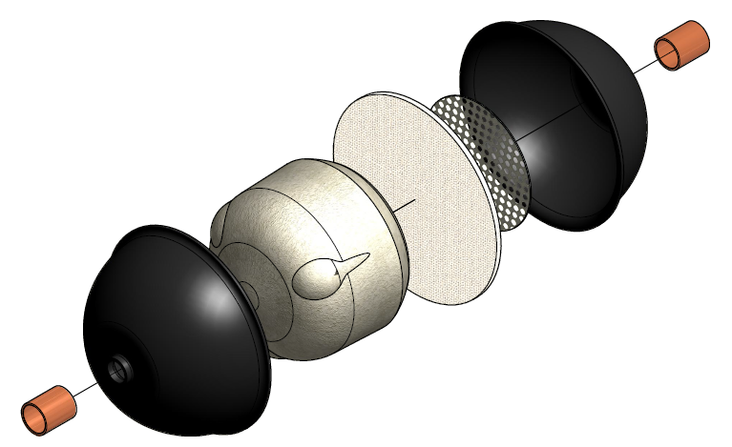
SS Series
Recommended Application
  AC only
  Gold Label LLD for Refrigeration Applications
Literature
  Catalog A-1 (Parker)
    Performance data
    Dimensional information
    Recommended Tonnage Table
Recommended Tonnage | Model | Nominal Size
2 | 2SS3S | 04
3 | 3SS3S | 08
5 | 5SS3S | 16
5SS3S
Connection Size and Type – 3/8” Solder
Series Description
Recommended Tonnage

Slide 27
Suction Line Filter Driers
Gold Label SLD Series
Designed for system clean-up.
Solid Core filter driers for use in the suction line.
The Core material collects and holds a maximum amount of contaminants with a minimum pressure drop.
Contaminants include acids and other harmful particles that may be present after a motor burn-out.
Access valves on both sides of the filter allow easy measurement of pressure drop through the filter.
8 Cubic In. through 54 Cubic In. (Flare or ODF)

Slide 28
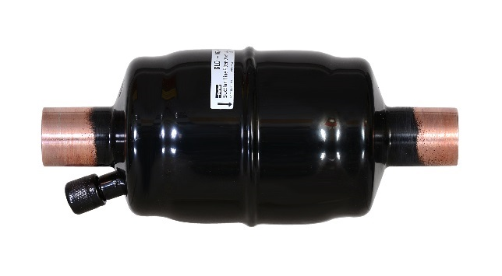
Suction Line Filter Driers
Sahara SLD Series
Designed for A/C system clean-up
Low pressure drop
High acid capacity
Solid copper ODF connections 5/8”, 3/4” or 7/8”
Access valve on the filter allow easy measurement of pressure drop through the filter.
Available in 16 and 30 Cubic In. sizes

Slide 29

Steel Bi-Flow Filter Driers
Gold Label BF Series
The “BF” Series bi-flow Drier is designed specifically for heat pump application.
Desiccant core provides removal of solid contaminants, acid and moisture.
Solid copper ODF or Nickel plated steel SAE fittings
Core is cushioned for protection.
Powder coat exterior paint exceeds 500 hrs. salt spray test.
Available in 8, 16, and 30 Cubic In. (Flare or ODF)

Slide 30

SSBF Series
Recommended Application
  HP only
  Gold Label BF for Refrigeration Applications
Literature
  Catalog A-1 (Parker)
    Performance data
    Dimensional information
    Recommended Tonnage Table
5SSBF3S
Recommended Tonnage | Model | Nominal Size
3 | 3SSBF3S | 08
5 | 5SSBF3S | 16
Connection Size and Type – 3/8” Solder
Series Description
Recommended Tonnage

Slide 31

Bi-directional Flow and Filtration
Bi-Flow Drier

Slide 32
Bi-directional Flow and Filtration
Cooling Mode

Slide 33
Bi-directional Flow and Filtration
Heating Mode

Slide 34

Bi-directional Flow and Filtration

Slide 35
What about the numbers?
The first two numbers indicate the Drier size.
032 is 3 cubic inch
053 is 5 cubic inch
084S is 8 cubic inch
165 is 16 cubic inch
307S is 30 cubic inch
415 is 41 cubic inch
759S is 75 cubic inch
The last number indicates the connection in 8’ths.
032 is a 2/8" or 1/4" SAE flare
053 is a 3/8" SAE flare
084S is a 4/8" or 1/2" Sweat
165 is a 5/8" SAE flare
307S is a 7/8" Sweat
759S is a 9/8" or 1-1/8”Sweat
When an alphabetical letter follows such as 759S it identifies the Drier as having a Sweat Connection (ODS).

Slide 36

Bi-directional Flow and Filtration

Slide 37


Filter Driers
Questions?

