Slide 1


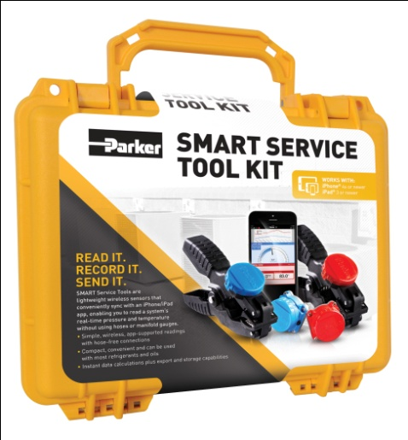
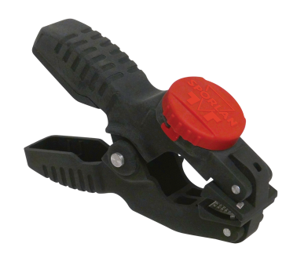
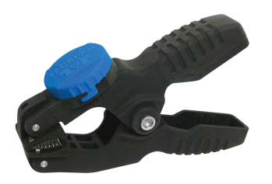
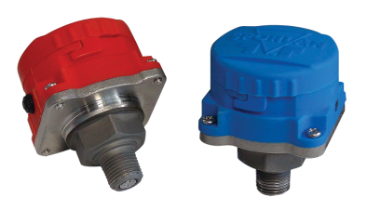
SMART SERVICE TOOL KIT
WORKS AS SMART AS YOU DO.
Matt Wehmeyer
Product Manager
Sporlan Division, Parker Hannifin
SMART Solutions.
Speed and Precision for the Modern Technician.
Notes:
Welcome and thank you for joining us.
Now several of your common diagnostic/service problems for HVAC/R can be solved with one ingenious product: the new SMART Service Tool Kit from Parker, Sporlan.

Slide 2
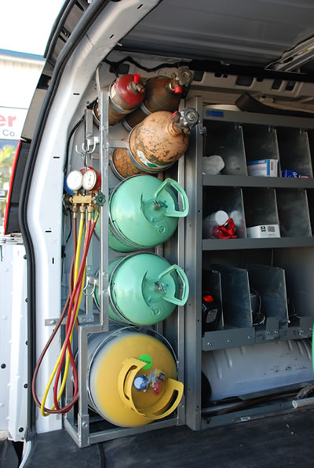
Traditional HVAC/R system diagnostics
EQUIPMENT
Various different refrigerants
Gauge set(s)
P/T charts
Calculator
Temperature sensor(s)
Pen & paper, tablet or laptop for recording data
Notes:
Diagnosing/servicing HVAC/R problems today requires a lot of equipment to be stored in the truck and taken to the job site. This list highlights only a few of these tools.
Multiple trips to the truck are often required to bring all of the necessary tools to the job site. These extra steps use up valuable time and money.

Slide 3
Traditional HVAC/R system diagnostics
Head Pressure Control Valves
Capacity Control Valves
Evaporator Pressure Regulators
TEV’S
Solenoid Valves
Driers
Notes:
Diagnosing/servicing HVAC/R problems today requires a lot of equipment to be stored in the truck and taken to the job site. This list highlights only a few of these tools.
Multiple trips to the truck are often required to bring all of the necessary tools to the job site. These extra steps use up valuable time and money.

Slide 4
Traditional HVAC/R system diagnostics
Head Pressure Control Valves
Air conditioning and refrigeration systems must be able to operate through a wide range of ambient conditions.
Proper refrigerant flow is dependent on a minimum pressure differential between the high side and the low side of a system as defined by and controlled by the expansion devise.
Since the pressure differential across the thermostatic expansion valve port affects the rate of refrigerant flow, low head pressure generally causes insufficient refrigerant to be fed to the evaporator.
Any system using hot gas for compressor capacity control must have a normal head pressure to operate properly. Failure to have sufficient head pressure will result in low suction pressure and/or iced evaporator coils.
Notes:
Diagnosing/servicing HVAC/R problems today requires a lot of equipment to be stored in the truck and taken to the job site. This list highlights only a few of these tools.
Multiple trips to the truck are often required to bring all of the necessary tools to the job site. These extra steps use up valuable time and money.

Slide 5
Traditional HVAC/R system diagnostics
Head Pressure Control Valves
The primary off-cycle problem is refrigerant migration to the outdoor condenser and/or the receiver.
The typical method of maintaining normal head pressure in a refrigeration
system during periods of low ambient temperature is to restrict liquid flow from the condenser to the receiver, and at the same time divert hot gas to the inlet of the receiver.
This results in liquid refrigerant backing up into the condenser which in turn increases the condensing pressure.
At the same time the hot gas raises liquid pressure in the receiver, allowing the system to operate normally.
Notes:
Diagnosing/servicing HVAC/R problems today requires a lot of equipment to be stored in the truck and taken to the job site. This list highlights only a few of these tools.
Multiple trips to the truck are often required to bring all of the necessary tools to the job site. These extra steps use up valuable time and money.

Slide 6
Traditional HVAC/R system diagnostics
Head Pressure Control Valves
Notes:
Diagnosing/servicing HVAC/R problems today requires a lot of equipment to be stored in the truck and taken to the job site. This list highlights only a few of these tools.
Multiple trips to the truck are often required to bring all of the necessary tools to the job site. These extra steps use up valuable time and money.

Slide 7
Traditional HVAC/R system diagnostics
Head Pressure Control Valves
Notes:
Diagnosing/servicing HVAC/R problems today requires a lot of equipment to be stored in the truck and taken to the job site. This list highlights only a few of these tools.
Multiple trips to the truck are often required to bring all of the necessary tools to the job site. These extra steps use up valuable time and money.

Slide 8
Traditional HVAC/R system diagnostics
Head Pressure Control Valves
The LAC-4 is a three way modulating valve that responds to discharge pressure.
the discharge pressure bleeds around the pushrod to the underside of the diaphragm.
When the outdoor ambient falls, the condensing pressure falls. This causes the discharge pressure to fall as well.
When the discharge pressure falls below the dome pressure, the valve modulates open to the discharge port which allows discharge gas to bypass the condenser.
Mixing the discharge gas with the liquid creates a high pressure at the condenser outlet, reducing the flow and causing liquid to back up in the condenser. This reduction in effective condenser surface area results in a rise in condensing pressure.
During summer conditions, the discharge pressure is high thus closing the discharge
Notes:
Diagnosing/servicing HVAC/R problems today requires a lot of equipment to be stored in the truck and taken to the job site. This list highlights only a few of these tools.
Multiple trips to the truck are often required to bring all of the necessary tools to the job site. These extra steps use up valuable time and money.

Slide 9
Traditional HVAC/R system diagnostics
Head Pressure Control Valves
The LAC valves are available with three standard settings which should handle the majority of applications:
100 psig (6.9 bar) for R-134a
295 psig (20.3 bar)for R-410A
180 psig (12.4 bar) for R-404/507, R-407C
Notes:
Diagnosing/servicing HVAC/R problems today requires a lot of equipment to be stored in the truck and taken to the job site. This list highlights only a few of these tools.
Multiple trips to the truck are often required to bring all of the necessary tools to the job site. These extra steps use up valuable time and money.

Slide 10
Traditional HVAC/R system diagnostics
Capacity Control Valves
(Discharge bypass valves)
On many air conditioning and refrigeration systems it is desirable to limit the minimum evaporating pressure during periods of low load either to prevent coil icing or to avoid operating the compressor at a lower suction pressure than it was designed to operate.
Various methods have been used to achieve this result — integral cylinder unloading, variable speed control, or multiple smaller systems or discharge bypass.
A practical and economical solution to the problem, is to bypass a portion of the hot discharge gas directly into the low side
This valve, which opens on a decrease in suction pressure, can be set to automatically maintain a desired minimum evaporating pressure regardless of the decrease in evaporator load.
Notes:
Diagnosing/servicing HVAC/R problems today requires a lot of equipment to be stored in the truck and taken to the job site. This list highlights only a few of these tools.
Multiple trips to the truck are often required to bring all of the necessary tools to the job site. These extra steps use up valuable time and money.

Slide 11
Traditional HVAC/R system diagnostics
Capacity Control Valves
(Discharge bypass valves)
Notes:
Diagnosing/servicing HVAC/R problems today requires a lot of equipment to be stored in the truck and taken to the job site. This list highlights only a few of these tools.
Multiple trips to the truck are often required to bring all of the necessary tools to the job site. These extra steps use up valuable time and money.

Slide 12
Traditional HVAC/R system diagnostics
Capacity Control Valves
(Discharge bypass valves)
Notes:
Diagnosing/servicing HVAC/R problems today requires a lot of equipment to be stored in the truck and taken to the job site. This list highlights only a few of these tools.
Multiple trips to the truck are often required to bring all of the necessary tools to the job site. These extra steps use up valuable time and money.

Slide 13
Traditional HVAC/R system diagnostics
Capacity Control Valves
(Discharge bypass valves)
In refrigeration systems, the minimum allowable evaporating temperature that will avoid coil icing depends on evaporator design and the amount of air passing over the coil. The refrigerant temperature may be below 32°F (0°C), but coil icing will not usually occur with high air velocities since the external surface temperature of the tube will be bove 32°F (0°C). For most air conditioning systems the minimum evaporating temperature is 20°F to 25°F (-6.7 to -3.9°C). However, when air velocities reduced considerably, the minimum evaporating temperature should be 26°F to 28°F (-3.3 to -2.2°C).
Parker Discharge Bypass Valves can be set so they start to open at an evaporating pressure equivalent to 32°F (0°C) saturation temperature. Therefore, they would be at their rated capacity at 26°F (-3.3°C) evaporating temperature.
Notes:
Diagnosing/servicing HVAC/R problems today requires a lot of equipment to be stored in the truck and taken to the job site. This list highlights only a few of these tools.
Multiple trips to the truck are often required to bring all of the necessary tools to the job site. These extra steps use up valuable time and money.

Slide 14
Traditional HVAC/R system diagnostics
Evaporator Pressure Regulators
(EPR Valves)
Evaporator Pressure Regulating valves (EPRs) are
designed to provide an economical means of accurately
maintaining evaporator pressure and temperature under
varying evaporator loads.
The primary function of an EPR is to prevent the evaporator pressure from falling below a predetermined value or setting.
A consistent evaporating temperature is maintained at the valve setting as evaporator loads decrease.
When the evaporator load increases, the valve Opens on a Rise of Inlet pressure above its setting.
Notes:
Diagnosing/servicing HVAC/R problems today requires a lot of equipment to be stored in the truck and taken to the job site. This list highlights only a few of these tools.
Multiple trips to the truck are often required to bring all of the necessary tools to the job site. These extra steps use up valuable time and money.

Slide 15
Traditional HVAC/R system diagnostics
Evaporator Pressure Regulators
(EPR Valves)
Notes:
Diagnosing/servicing HVAC/R problems today requires a lot of equipment to be stored in the truck and taken to the job site. This list highlights only a few of these tools.
Multiple trips to the truck are often required to bring all of the necessary tools to the job site. These extra steps use up valuable time and money.

Slide 16
Traditional HVAC/R system diagnostics
Evaporator Pressure Regulators
(EPR Valves)
Notes:
Diagnosing/servicing HVAC/R problems today requires a lot of equipment to be stored in the truck and taken to the job site. This list highlights only a few of these tools.
Multiple trips to the truck are often required to bring all of the necessary tools to the job site. These extra steps use up valuable time and money.

Slide 17
Traditional HVAC/R system diagnostics
Evaporator Pressure Regulators
(EPR Valves)
Valve setting is defined as the minimum control pressure, or the opening inlet pressure of the valve.
Below the setting the valve will close and stop refrigerant flow until the valve setting is reached.
As inlet pressure increases above the valve setting, the valve will open at the rate of the valve’s gradient, to provide more flow.
Notes:
Diagnosing/servicing HVAC/R problems today requires a lot of equipment to be stored in the truck and taken to the job site. This list highlights only a few of these tools.
Multiple trips to the truck are often required to bring all of the necessary tools to the job site. These extra steps use up valuable time and money.

Slide 18
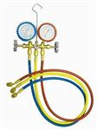
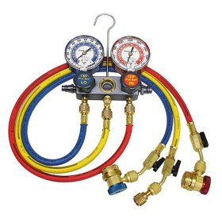
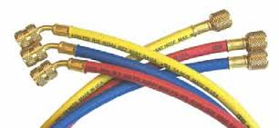
Traditional HVAC/R system diagnostics
REDUNDANCY AND WASTE
One gauge set per refrigerant preferred over cleaning between uses
Different length hoses
Refrigerant is lost in hoses
Refrigerant may need to be added if too much is lost
Notes:
Gauge sets utilize a manifold and several hoses. The internal surface area of the gauge set will contain the remnants of the previous refrigerant and will have to be cleaned on a regular basis in order to use with a different refrigerant.
For convenience, most contractors will carry multiple gauge sets, one for each refrigerant, and multiple lengths of hoses. This requires the contractor to choose the correct gauge set/hose length for each system.
The longer the hose, the more refrigerant is lost/wasted. If enough is lost, more will have to be added to keep the system functioning efficiently.

Slide 19
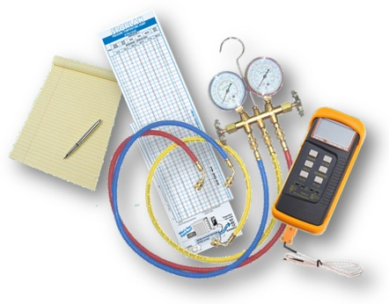
Traditional HVAC/R system diagnostics
LIMITED FLEXIBILITY & MANUAL CALCULATIONS
Suction temperature readings may not always be visible from the manifold/suction pressure tap
P/T charts are used to convert pressure to saturated temperature
Temperatures are subtracted to calculate superheat/subcooling
Notes:
Many times, the temperature readings must be taken far from the pressure readings (gauge set). These locations may even be in different rooms requiring multiple trips between them wasting valuable time.
Once the readings are taken, the pressures must be converted to the saturated temperature of the particular refrigerant. This is done with the use of P/T charts. The temperatures are then subtracted to calculate the superheat or subcooling.
The superheat and/or subcooling can then be used to help troubleshoot system problems.

Slide 20

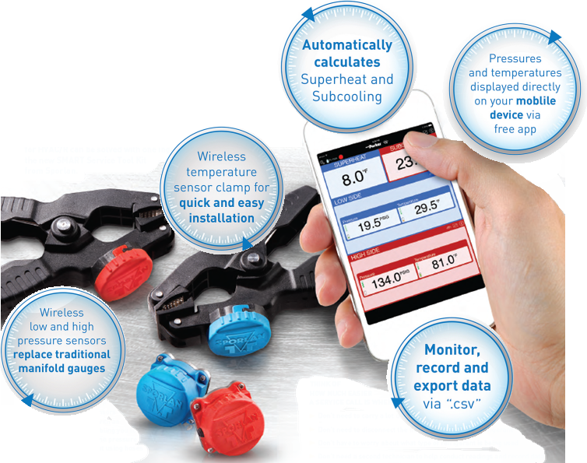
Parker SMART Service Tool Kit
SAVE STEPS, SAVE TIME, SAVE DATA.
Notes:
Now several of your common diagnostic/service problems for HVAC/R can be solved with one ingenious product: the new SMART Service Tool Kit from Parker, Sporlan.
SMART Service Tools are lightweight wireless sensors that conveniently sync with a SMART device, enabling you to read a system’s real-time pressure and temperature without using hoses or manifold gauges.
Think of how much easier a service call is when you:
Don’t need to carry a lot of diagnostic equipment on-site
Don’t need to disconnect the hoses and risk losing refrigerant
Don’t have to worry about what type of refrigerant is being used
Don’t need a second technician to help conduct readings and record data

Slide 21
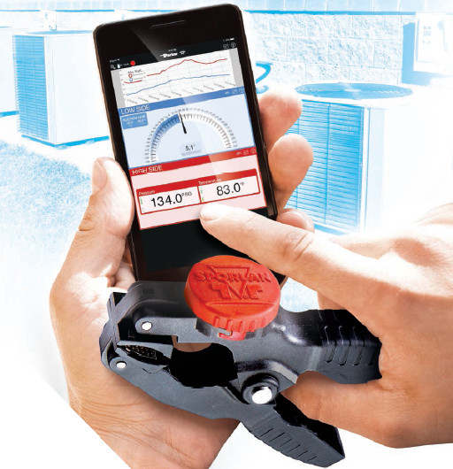
Parker SMART Service Tool Kit
READ IT. RECORD IT. SEND IT.
SMART Service Tools were developed to make diagnostic readings faster and simpler.
But the best part of the products might be the way they calculate and store the recorded data.
And, they are hose-free.
Notes:
With SMART Tools, you no longer have to write down the system data and then manually crunch those numbers yourself.

Slide 22
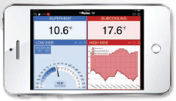
Parker SMART Service Tool Kit
HOW IT WORKS
Turn on the sensors and attach to the system in the appropriate locations
Open the app & connect the sensors
Choose the refrigerant
Temperatures, pressures, superheat and subcooling will be displayed directly on your device
Notes:
The hardware couldn’t be simpler: it’s two wireless sensors (low and high pressure) that replace traditional manifold gauges, plus two wireless temperature sensors mounted on clamps.
Just attach the sensors to the refrigeration unit and activate the app screen. The pressures and temperatures will be displayed right on your smart device.
It’s that quick.

Slide 23
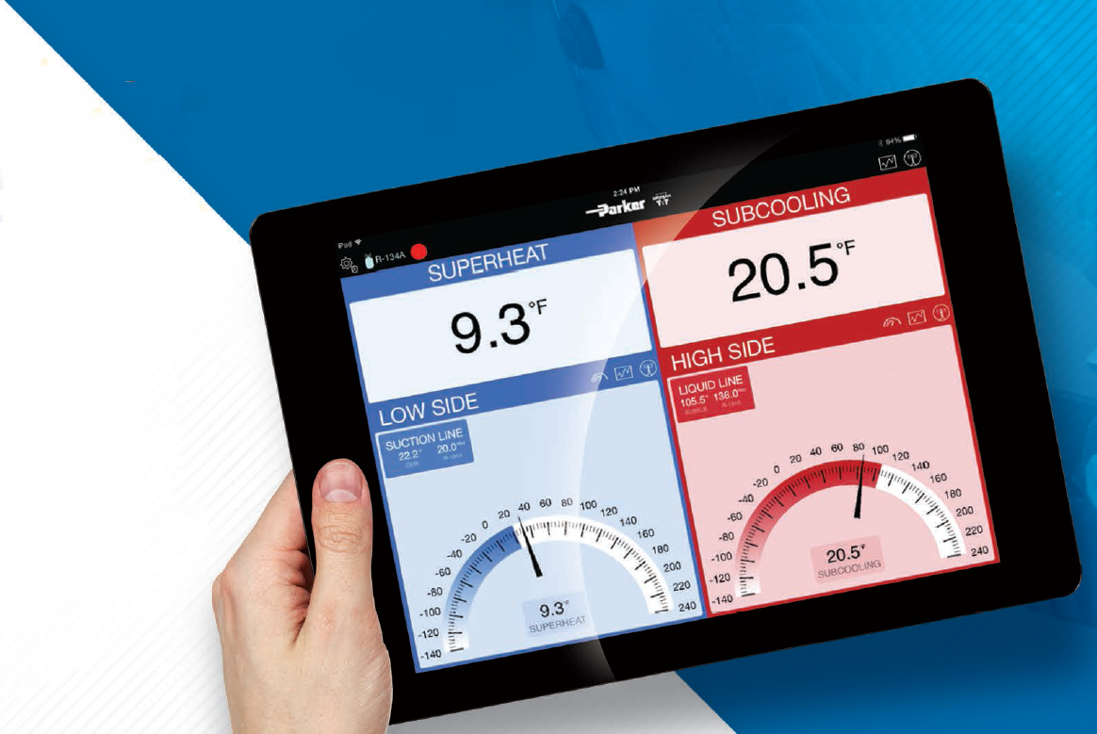
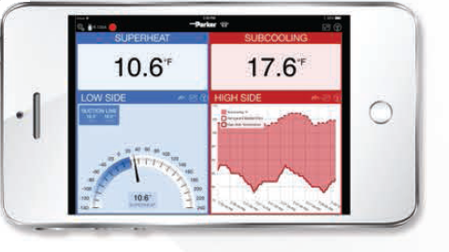
Parker SMART Service Tool Kit
Available now on iPhone 4S or newer, iPad 3 or newer & iPod 5th generation or newer; all with the latest operating system.
Android coming soon!
Notes:
When the pressure and temperature readings appear on your device screen, the calculations are instantly done for you, including the key Superheat and Subcooling parameters.

Slide 24
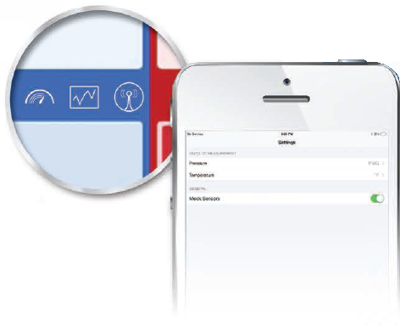
Parker SMART Service Tool Kit
WIRE-FREE SENSORS!
You can select psig or bar for pressure displays and °F or °C for temperature displays.
You can also choose to view each sensor reading section in a different mode: analog, trend or digital.
Notes:
More FREEDOM and FLEXIBILITY.
The app features standard or metric units. The data can be viewed as an analog gauge, trending in chart form, or digitally within the app.
SMART Service Tools even function remotely, allowing you to be in other parts of the building making adjustments (such as with a thermostat) while still measuring pressures and temperatures on the unit itself. Those remote capabilities can save a lot of time and steps, especially in residential applications.

Slide 25
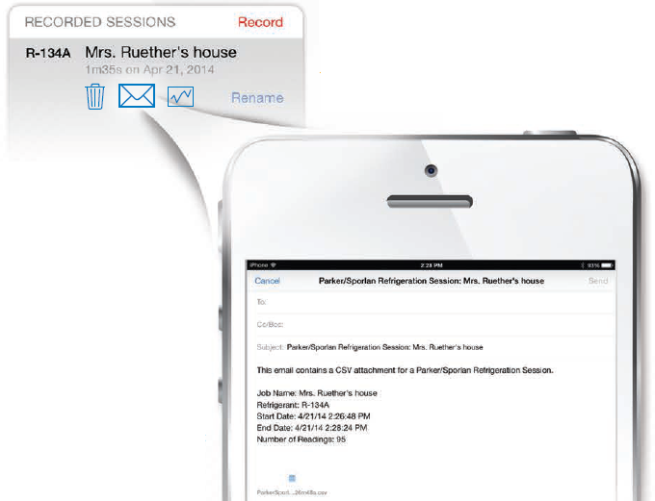
Parker SMART Service Tool Kit
All data can be easily recorded within the app.
One tap converts the information to a “.csv” file, which you can then send to a designated e-mail recipient.
Notes:
Being able to easily compile and access digitized information over time will simplify any analytical processes later, such as monitoring system efficiency, tracking usage trends and much more.
The ability to record and transmit diagnostic data also expedites the need to log verification of the service call or provide proof of work.

Slide 26
Parker SMART Service Tool Kit vs the competition
Feature / Benefit | Parker SMART Service Tool Kit | Yellow jacket Mantooth
Wire Free Sensors | YES | NO-All sensors wired
Battery Life | ≥ 250 hrs | ~ 10 hrs
Battery Type | 1x CR2450 replaceable | 1 x rechargeable lithium polymer
Carrying Case | Pelican® | Plastic
App visibility | FILLS SCREEN | Portrait only
Connectivity | Auto-connect feature | Manually connect
Data Recording | Records > 24 hrs Saves as .csv file Sends via. Email | Screenshots only

Slide 27
Parker SMART Service Tool Kit vs the competition
Feature / Benefit | Parker SMART Service Tool Kit | Yellow jacket Mantooth
Refrigerants | All common refrigerants including ammonia | Not compatible with ammonia
Ingress Protection Rating (IP Code) | IP 65 | IP 50
Ingress Protection Rating (IP Code) Definitions:
1st numeral (Solid Objects) | 5 | Dust-protected
 | 6 | Dust-tight
2nd numeral (Water) | 0 | Not protected
 | 4 | Splashing
 | 5 | Jetting

Slide 28

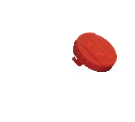
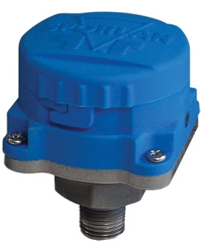
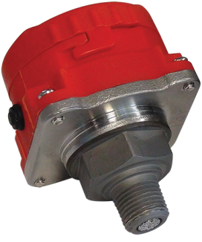
Parker SMART Service Tools
Coming Soon…
Android app. April, 2015
Individual Sensors:
    Temperature Clamp
    Low Pressure Sensor
    High Pressure Sensor

Slide 29
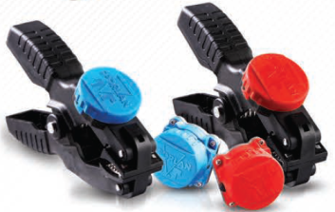
The FUTURE of Parker SMART Service Tools
What does the future hold for you?
Parker will continue to develop new tools for HVAC/R contractors to compliment the SMART Service Tools.
Market focus areas include…
      Supermarket Refrigeration
      Residential A/C
What wireless diagnostic tools would benefit you?

Slide 30
Parker SMART Service Tool Kit
MAKE THE SMART DECISION.
Just contact us at cicaftermarket@parker.com or
800 742-2681 and see how our products work as smart as you do.
Notes:
Talk to Parker, Sporlan today for more information on how SMART Service Tools offer:
Simple, app-supported readings with hose-free connections
Instant data calculations plus export and storage capabilities
The added freedom to read and record data remotely
An easy method for safeguarding system diagnoses
A great way to save time and increase productivity

