Slide 1
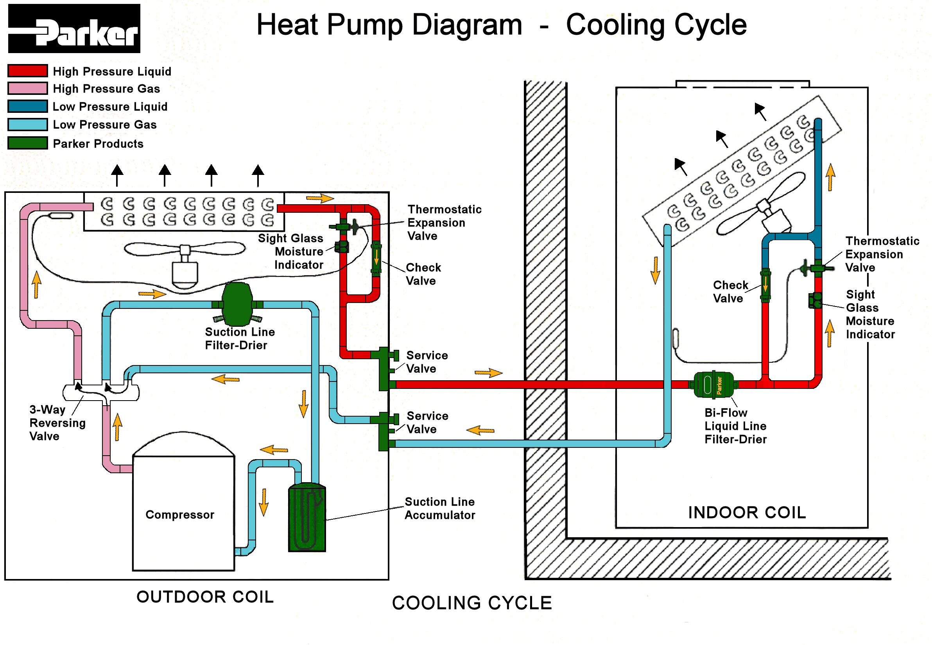
See Page 2 for Heating Cycle
Page 1

Slide 2
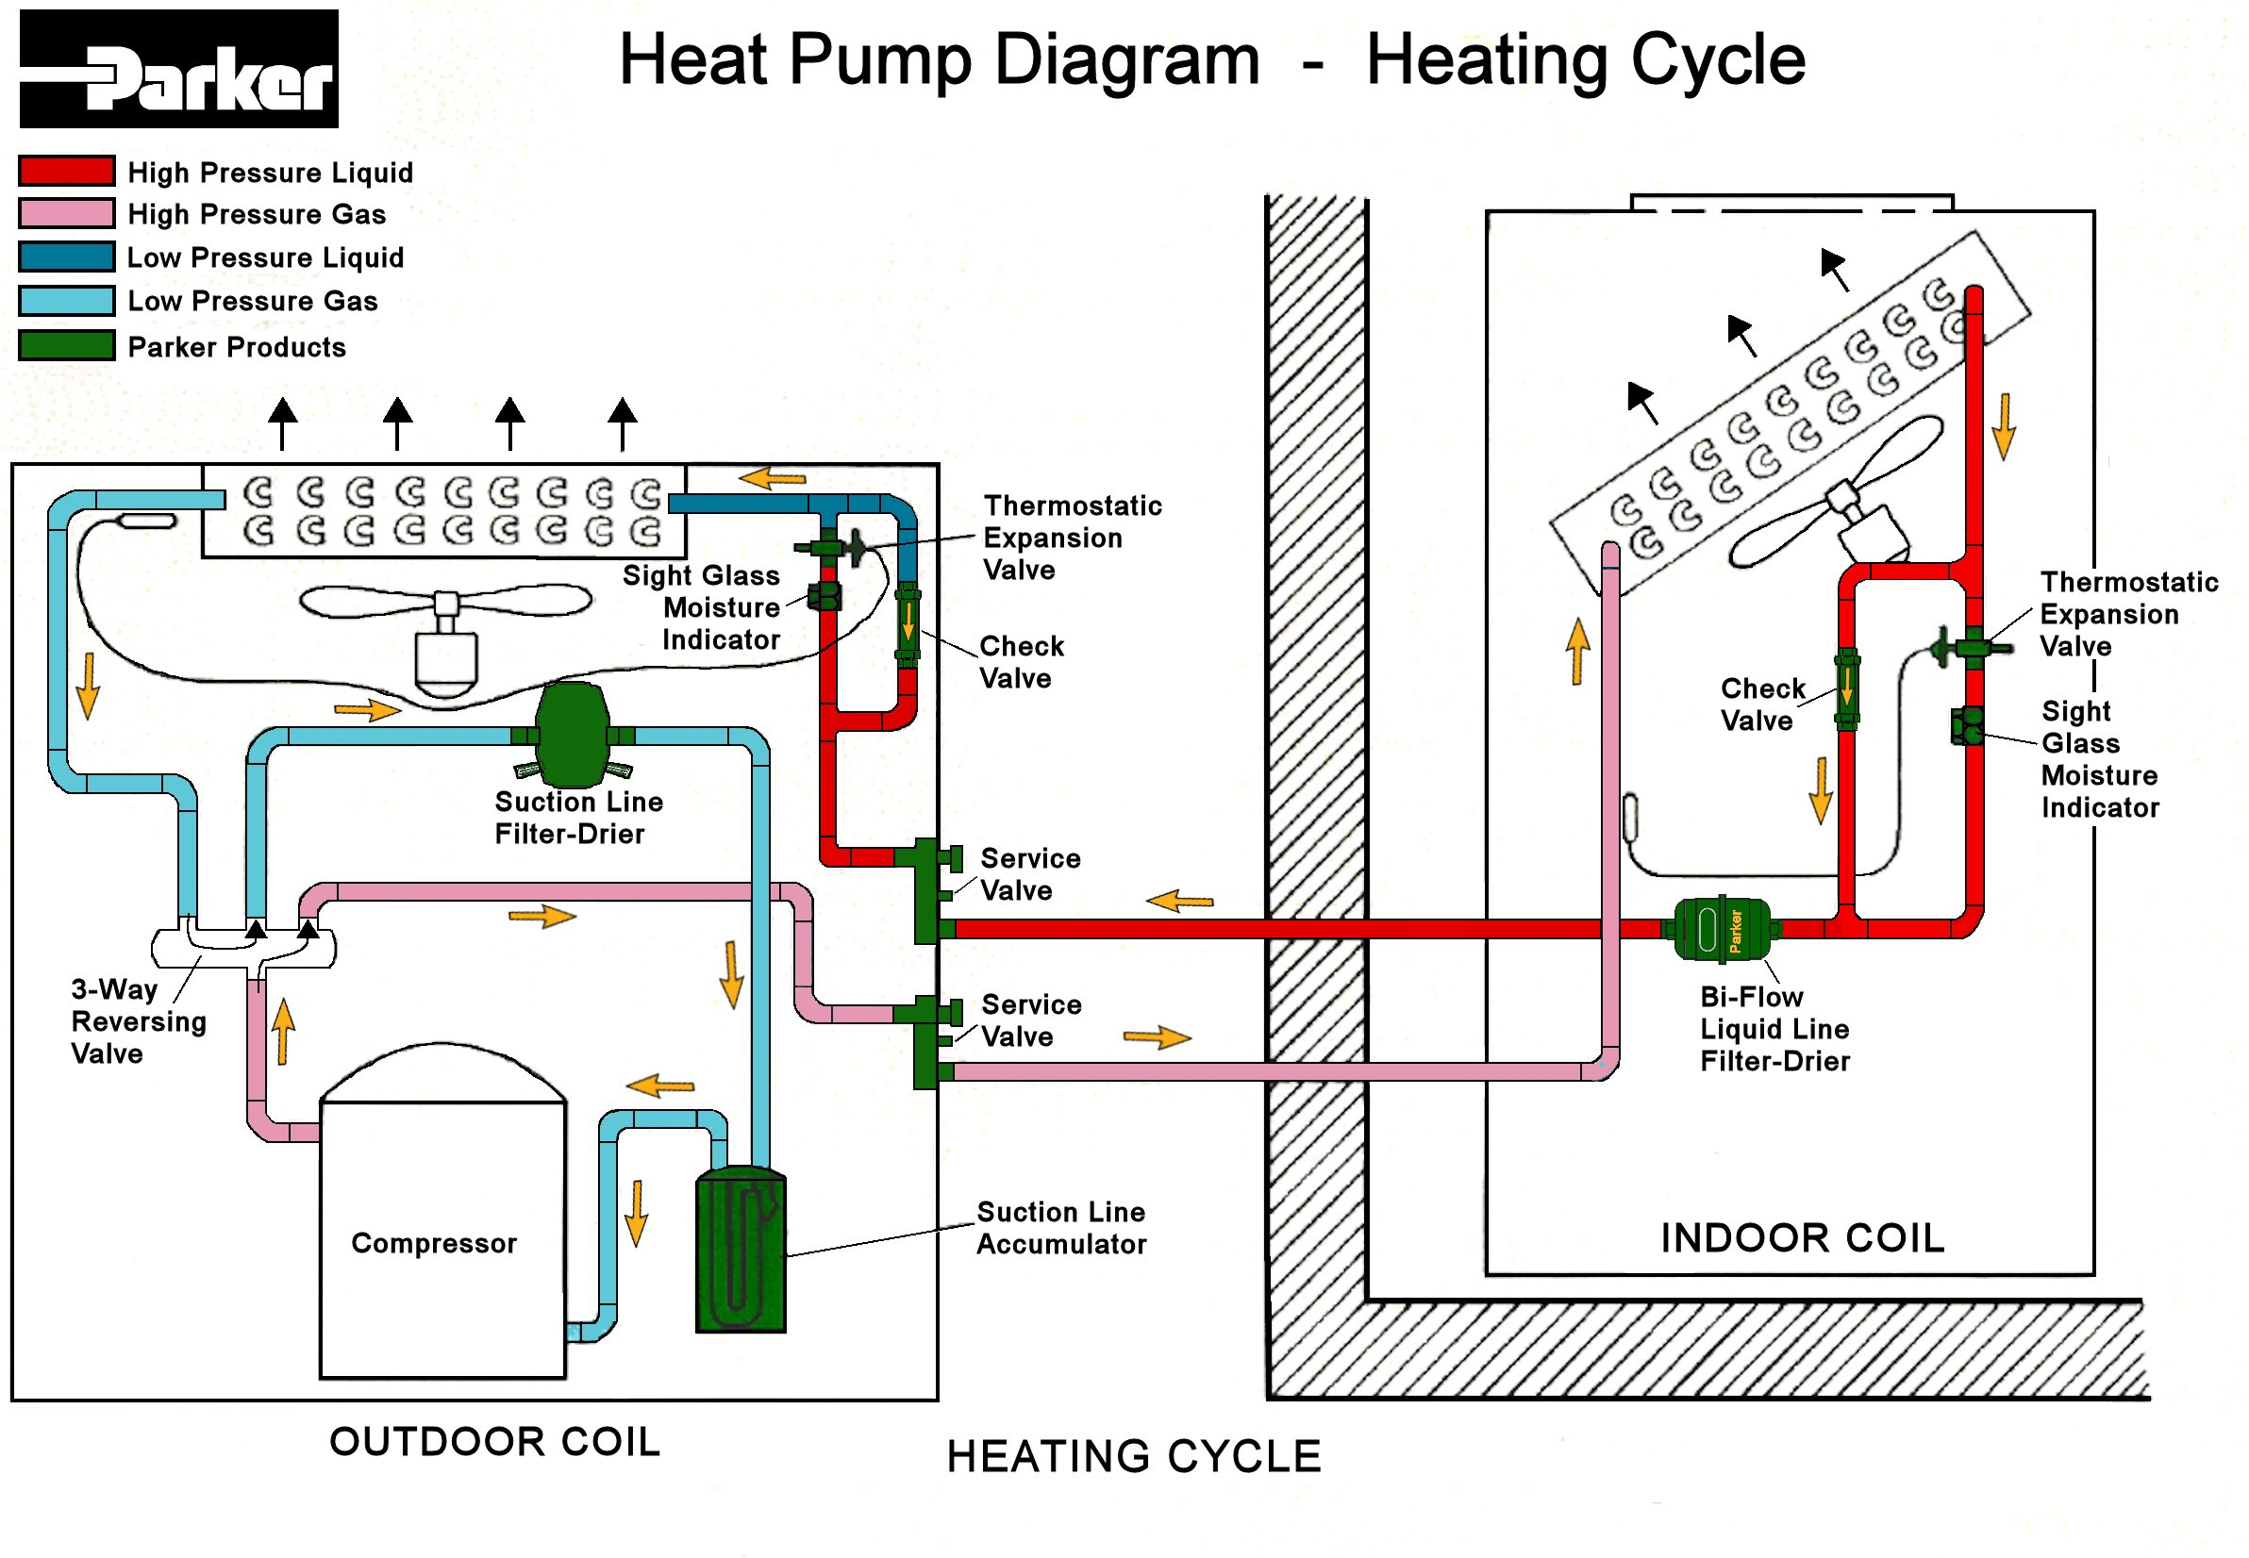
See Page 1 for Cooling Cycle
Page 2

