Slide 1
Presentation Outline
Common Terms / Concepts
HVAC Building Blocks
Plant Level Building Blocks
Description / Application Data
Green opportunities
Selection Criteria
Air Distribution Building Blocks
same
Zone Building Blocks
Same
Links

Slide 2
“Energy”
“Energy” is defined as the ability to do work Units of energy:
BTU (the amt. of heat required to raise the temperature of 1 lb. of water by 1°F)
970 BTU is the latent heat of evaporation of water, or, the amount of heat energy required to evaporate 1 lb of water.
WATT HOUR (= BTU / 3.413)
THERM (= 100,000 BTU)

Slide 3
“Power”
“Power” is the measurement of how much work is accomplished in a specific amount of time.
Units of Power:
BTUH (same as BTUs per Hour)
WATTS = BTUH ÷ 3.413
TON = 12,000 BTUH = the energy it takes to melt 2,000 lbs. of ice @ 32 deg F in 24 hours
HORSEPOWER = 2540 BTUH = 746 WATTS

Slide 4
Heat Transfer Terms

Slide 5
Psychrometrics
air properties and their interrelationships

Slide 6
HVAC System Building Blocks
Refrigeration Plant
Air Distribution System
Zone Control

Slide 7
Refrigeration System Function
Use Energy Input
to
Remove Heat (cooling) from a (Lower Temperature) Space
and
Reject that Heat (heating) to a (Higher Temperature) Space.

Slide 8
Cooling Efficiency
EER = space cooling effect (in BTUH) power input (in Watts)
High Efficiency means more cooling effect for less power input

Slide 9
Efficiency Expressions
EER = BTUH cooling output ÷ Watts input
SEER = BTUH cooling output ÷ Watts input averaged over normal annual usage period
COP = BTUH output ÷ BTUH input
EIR = BTUH input ÷ BTUH output
KW / Ton = KW input ÷ Tons cooling output
IPLV = Integrated Part Load Value = a standard formula that takes part load efficiencies into account

Slide 10
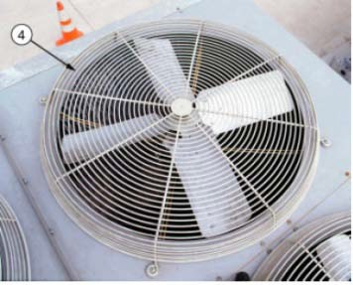
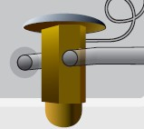
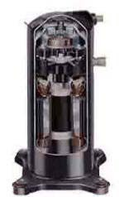
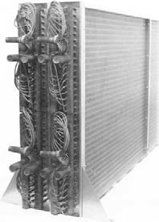
Refrigeration Cycle
Space heat and Compressor Heat to Outside
Low Temp, High Pressure Liquid
High Temp, High Pressure Gas
Condenser
Compressor
Expansion Valve
Evaporator
Energy into the system
High Temp, Low Pressure Gas
Low Temp,
Low Pressure Liquid
Cooling Effect (heat out of the conditioned space)

Slide 11
Refrigeration System Building Blocks
All Refrigerant Systems Have These Pieces in Various Boxes In Various Locations
Condenser:
High Pressure Refrigerant Gas releases heat and condenses and becomes refrigerant liquid (phase change)
Expansion Valve
High pressure liquid refrigerant expands and becomes low pressure liquid
Evaporator
Low pressure refrigerant liquid picks up heat and evaporates and becomes refrigerant gas (phase change)
Compressor
Low pressure refrigerant gas is compressed with power input and and becomes high pressure refrigerant gas

Slide 12
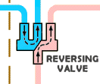
Heat Pump Operation Reversed Refrigerant Flow
Evaporator: Removes Heat from Outdoor Air
Bi-Directional Expansion Valve
Power into the system
Compressor
Condenser: Rejects heat to conditioned space

Slide 13
Refrigeration System Selection Factors
How many tons is my project?
Cost Goals?
EFFICIENCY GOALS
What are my outdoor limitations?
Weight
Roof space
Property line acoustics
What are my indoor limitations?
Floor space
Ceiling space
Access to outdoor air
24/7 Operation?

Slide 14
Refrigeration Plant Green Opportunities
Non-HCFC Refrigerant Types
Ground or Lake as a Heat Source and Sink
Equipment Efficiency Improvement
– Full Load and Part load
Equipment Right Sizing
Pump Energy Reductions
Larger Cooling Tower for Lower Condenser Water Temperatures
Larger heat transfer areas
Optimized operation
Temperature resetting
Heat Recovery Options
Natural Ventilation or Mixed Mode Ventilation
Direct Evaporative Cooling (Swamp Cooling)
Evaporative Condensing

Slide 15
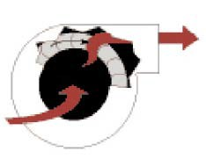
Air Cooled Split System ACU or Heat Pump
Split System Condensing Unit (Outdoor)
Condenser Coil & Fan
High Temp, Low Pressure Gas
Compressor
Low Temp, High Pressure Liquid
Expansion Valve Evaporator Evaporator Fan
Split System DX Fan Coil (Indoor)

Slide 16
Air Cooled Split System
Typical Equipment Designation
Direct Expansion Fan coil & Condensing Unit (DXFC & CU)
Air Distribution via indoor DXFC
Typical Heating Sources
Heat Pump, Electric, Hot Water, Gas Furnace
Typical Applications
Single Family Residences
Retail
24/7 isolated cooling space (server rooms)
Limitations: Typical proximity indoor/outdoor requirement is 75’
Costs: $4,000/ton complete

Slide 17
Air Cooled Split System 10 – 80 Tons
Often called “Air Cooled Vertical Self Contained Units”
Condenser Coil & Fan
Air Cooled Condenser (Roof, Garage, outside)
High Temp, High Pressure Gas
Low Temp, High Pressure Liquid
Expansion Valve Compressor
Evaporator Fan
Evaporator
Indoor Vertical Self Contained ACU or Computer Room ACU

Slide 18
Air Cooled Split System (10 – 80 tons)
Typical Equipment Designation
Vertical Self-Contained Units & Condensing Unit (ACU & CU) or (VSC & CU)
Computer Room Air-Conditioning Unit (CRAC)
Air Distribution via indoor VSC, CRAC, or ACU
Typical Heating Sources
Heat Pump, Electric, Hot Water
Typical Use
Data Center
Office VAV or CAV
Limitations: Typical proximity indoor/outdoor requirement is 75’; floor space required
Costs: $8,000/ton complete

Slide 19
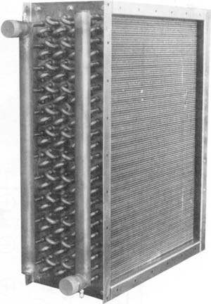
Package Rooftop: Air-Cooled DX ACU or
Air Source Heat Pump
Evaporator Fan
Condenser
Expansion Valve
Evaporator Coil
Compressor
Outdoor Unit

Slide 20
Package Rooftop Air-Cooled DX
Typical Equipment Designation
Air-conditioning Unit (AC)
Rooftop Unit (RTU)
Air Distribution via outdoor AC or RTU
Typical Heating Sources
Heat Pump, Electric, Hot Water, Gas Furnace
Typical Applications
Office VAV or CAV
Retail
Limitations: Standard Units come in 2 – 130 tons; Air is shafted down to floors.
Costs: Equipment only $1,000/ton installed; total system S&C $10/sf.

Slide 21
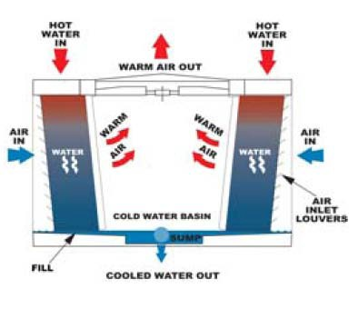
Water Cooled Air-Conditioning Unit
Condenser Water Return 86°F
Cooling Tower
Condenser Water Supply 76°F
Condenser Barrel
Expansion Valve
Evaporator Fan
Evaporator Compressor
Water Cooled DX ACU (Indoors typically)

Slide 22
Water Cooled Air-Conditioning Unit
Typical Equipment Designation
Air-conditioning Unit & Fluid Cooler (ACU & FC)
Vertical Self-Contained & Fluid Cooler (VSC & FC)
Air Distribution via indoor ACU or VSC
Typical Heating Sources
Electric, Hot Water
Typical Applications
Office VAV or CAV
Retail
Limitations: Standard Units come in 30 – 80 tons; Mechanical Room required
Costs: Equipment only $2,500/ton installed; total system S&C
$12/sf.

Slide 23
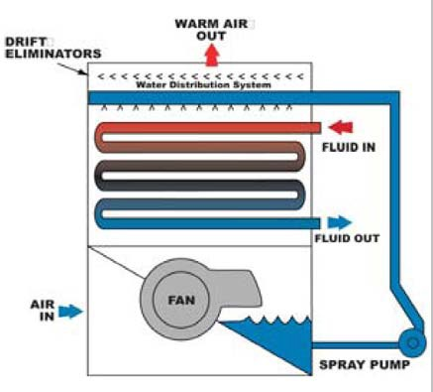
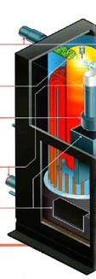
Water Source Heat Pumps “2 Pipe System”
Closed Circuit Fluid Cooler Outdoor
Condenser Water Return 86°F Max
Condenser Water Supply 60°F Min
Boiler
Condenser or Evaporator Barrel
Bi Directional Expansion Valve
Evaporator or Condenser Fan
Evaporator or Condenser Coil
Compressor
Water Source Heat Pump Indoor

Slide 24
Water Source Heat Pump
Typical Equipment Designation
Water Source Heat Pump & Fluid Cooler (WSHP & FC)
Heat Pump & Fluid Cooler (HP & FC)
Air Distribution via indoor WSHP or HP
Typical Heating Sources
Gas boiler
Typical Applications
Residential
Retail
24/7 isolated cooling areas less than 5 tons
Limitations: Non – Residential Energy Codes limit usage by requiring air side economizer
Costs: $13,000/WSHP

Slide 25
Air Cooled Chiller
Expansion Valve
Condenser Coil & Fan
Evaporator Barrel
Compressor
Air Cooled Chiller (outdoor)
Chilled Water Supply
Chilled Water Return 56°F
42°F
Evaporator Fan
Chilled Water Air Handler or Fan Coil (indoor)

Slide 26
How Many Pipes?
“2 Pipe System”
Water Source Heat Pumps
Condenser Water Supply
Condenser Water Return
Gas Boiler at the Roof
“2 Pipe System”
Chilled Water Fan Coils
Chilled Water Supply
Chilled Water Return
Electric Heat at each Fan Coil
“4 Pipe System”
Chilled Water / Hot Water Fan Coils
Chilled Water Supply
Chilled Water Return
Hot Water Supply
Hot Water Return

Slide 27
Air Cooled (Water) Chiller
Typical Equipment Designation
Air-cooled Water Chiller (ACWC)
Air-cooled chiller (ACC)
Air Distribution via indoor or outdoor chilled water air-handling unit (AHU) or fan coil (FC)
Typical Heating Sources
Hot water, electric
Limitations: Tonnage from 30 – 500; takes up a lot of space outdoors and is heavy.
Costs: Equipment only installed $600/ton; Total S&C $14/SF

Slide 28
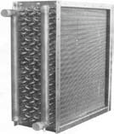
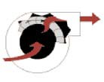
Water Cooled Chiller Plant with AHU
Water Cooled Chiller
Condenser Barrel
Expansion Valve
Evaporator Barrel
Compressor
Condenser Water
Return 86°F
Chilled Water Supply 42°F
Chilled Water
Return 56°F
Chilled Water Air Handler or Fan Coil
Cooling Tower
Condenser Water Supply 76°F

Slide 29
Water Cooled Chiller
Typical Equipment Designation
Chiller (CH) and Cooling Tower (CT)
Air Distribution via indoor or outdoor chilled water air-handling unit (AHU) or fan coil (FC)
Typical Heating Sources
Hot water, electric
Typical Applications
Office VAV or CAV
High Rise
Biotech, Hospital
24/7 isolated cooling areas less than 5 tons
Limitations: CH Needs to be indoor; they are noisy
Refrigeration Machinery Room needed
Costs: Equipment only installed $1000/ton; Total S&C $15/SF

Slide 30
Ground Source Heat Pump
Condenser Water Return 86°F Max
Wells, direct buried loops, lake loops
Auxiliary boiler or fluid cooler could be needed
Condenser Water Supply 60°F Min
Condenser or Evaporator Barrel
Bi Directional Expansion Valve
Evaporator or Condenser Fan
Evaporator or Condenser Coil
Compressor
Water Cooled Heat Pump

Slide 31
Ground Source Heat Pump
Typical Equipment Designation
Water Source Heat Pump (WSHP)
Heat Pump (HP)
Air Distribution via indoor WSHP or HP
Typical Heating Sources
Hot Water
Typical Applications
Residential
Retail
24/7 isolated cooling areas less than 5 tons
Limitations: Energy Codes limit usage
Costs: $17,000/WSHP

Slide 32
Air Distribution Building Blocks
Outdoor Air Intake Location
AHU or ACU Location(s)
Return Air Path (Ducted or plenum)
Return Fans or Barometric Relief or Relief Fan
Relief Air Location

Slide 33
Air Distribution Green Opportunities
Underfloor Air Distribution
VAV or fans with VFDs
Low Supply Air Temperature Delivery
Temperature reset to maximize economizer hours
CO2 Control Ventilation
Watts/cfm Strategies
Low VOC Duct Sealant
Natural Ventilation
Heat Recovery
Mixed Mode or Natural Ventilation

Slide 34
Air Distribution Selection Criteria
How much air (cubic feet/minute (CFM)) is required?
How many Zones?
Cost Goals?
Outdoor limitations?
Weight
Roof space
What are my indoor limitations?
Floor space
Ceiling space
Access to outdoor air
Are there spaces with different operating hours (Office, Retail, 24/7 Operation)?
Are there air streams from spaces that should not be recirculated into other spaces?

Slide 35
Central Air Handlers or ACU’s
(air cooled DX, water cooled DX, chilled water, direct evaporative cooling, etc.)
Coordinate Shaft Area
Attenuate noise large central unit
No louvers required
Coordinate GC built 4’ tall roof curb

Slide 36
Floor by Floor Air Handlers or ACU’s (water cooled or chilled water)
Coordinate Floor area for mechanical rooms
Attenuate noise from mechanical room
No vertical shafts required
Intake louvers required
Exhaust louvers required

Slide 37
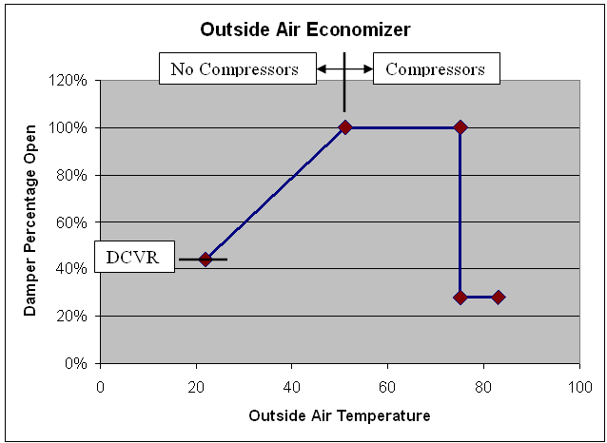
Airside Economizer
Outside Air Percentage
Supply air is a mix of two sources:
Return Air
Outside Air
Outside air economizer operation in a nutshell:
Use the coolest source air to maximize cooling without the use of refrigeration

Slide 38
Airside Economizer Code Rules of The Road
Baseline code requires airside economizer on all air systems
Exceptions:
Seattle
Efficiency 10% better than code
4.5 ton max size and a total max capacity of 5% of airside economizer capacity
Efficiency 15% better than code (server rooms only)
No size or quantity limit
WA State
Efficiency 10% better than code
No size limit
Total max capacity of 20% of airside economizer capacity

Slide 39
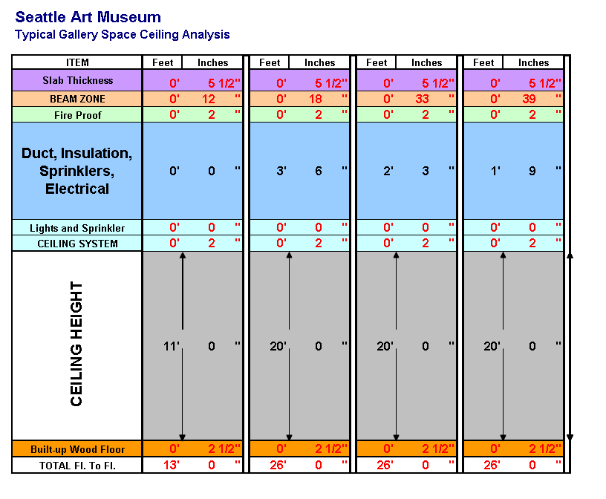
Ceiling Space Coordination

Slide 40
Zone Building Blocks
Temperature Sensors
Supply Air Diffusers
Return Air Grilles
Manual Volume Dampers
VAV Boxes
Zone Heating or Cooling Coils

Slide 41
Zone Green Opportunities
Underfloor Air Distribution
VAV boxes with ECM motors
CO2 Control Ventilation
Watts/CFM Strategies
Fan boxes using return air as first stage of heat
Hot Water heating coils?
Radiant Heating
Natural Ventilation

Slide 42
Zone Selection Criteria
What occupancies do I have?
How many different occupancies or ZONES do I have?
What level of control is appropriate?
Cost Goals?
What is my heating source?
Is this system exposed?
Areas with special HVAC needs? Temp, Humidity, filtration, hours of operation?

Slide 43
VAV Systems
Variable Air Volume (VAV)
Series boxes (VAV)
Parallel Boxes (VAV)
Pinch Boxes (VAV)

Slide 44
VAV Terminal Type: Pinch Box
Also known as “Single Duct boxes”, “Squeeze boxes”, “Reheat boxes”
Maximum allowed air quantity in heating is the amount req’d for ventilation purposes (except for labs or hospitals)
Electric heaters: max delta T is approximately 40°F
Diffusers rule of thumb; do not reduce airflow to less than ½ of design during heating.

Slide 45
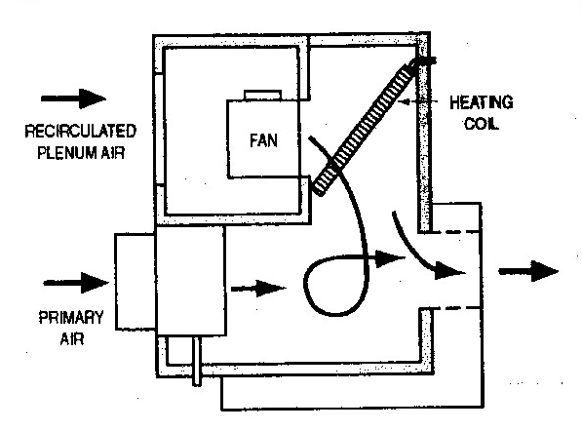
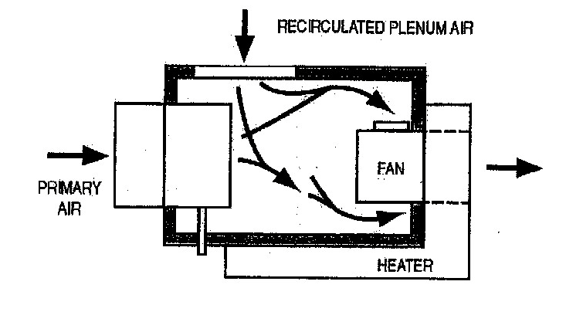
VAV Terminal Types: Fan Boxes
Series Fan VAV Box
Fan in series with air valve
Runs continuously
Allows low temperature primary air
Parallel Fan VAV Box
Fan in parallel with air valve
Runs during heating only

Slide 46
Indoor Air Quality
Human Effluent
CO2
Materials Effluent
VOC’s
Etc
ASHRAE 62.1 Ventilation
(# people x _cfm/ person) +
(area x _cfm / square foot)

Slide 47
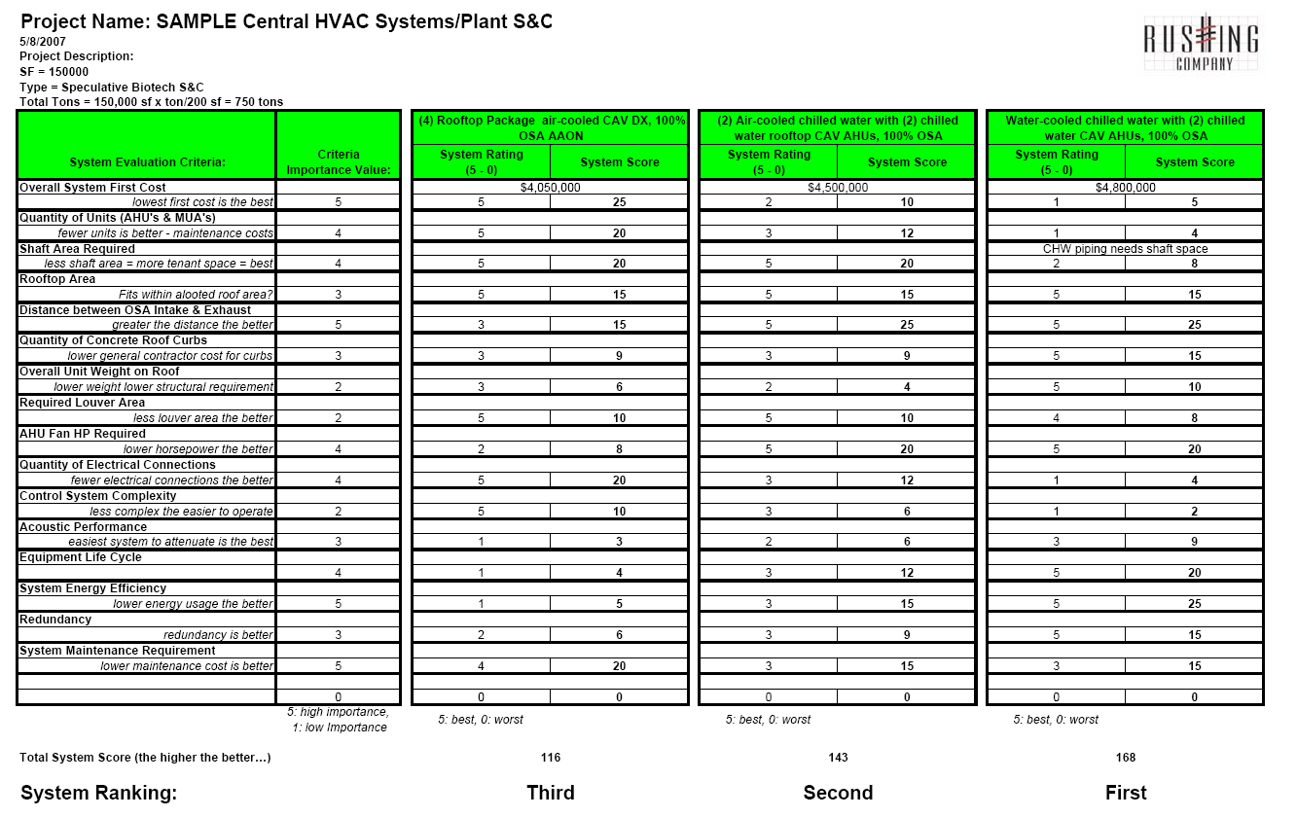
Selection Scorecard

Slide 48
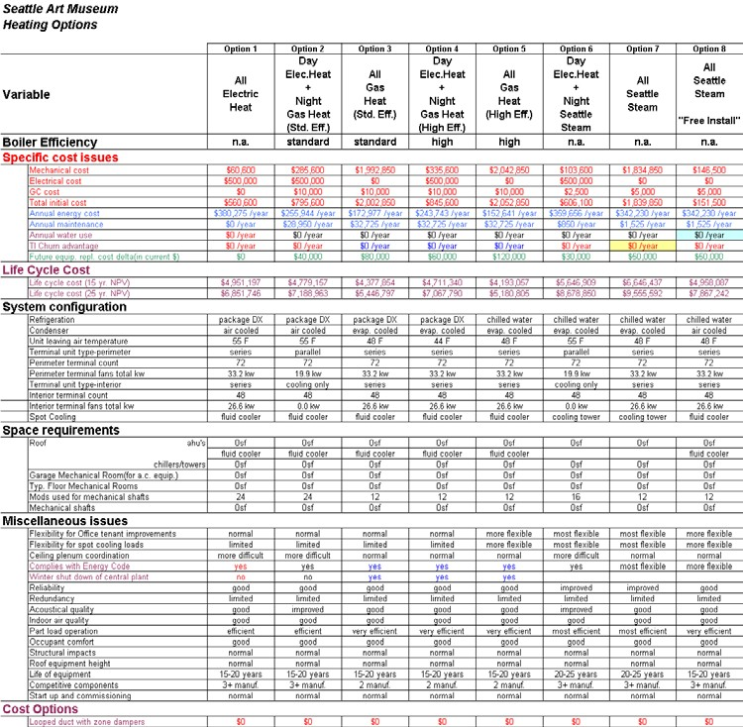
Life Cycle Costing – Buying the Best Value
First Cost Constraints
Operational Costs Energy Maintenance Repairs
Flexibility to Avoid Future Change Costs (TI)
Replacement Horizon
Equipment Life – Planned & Engineered Replacement Strategies

Slide 49
Links for HVAC Basics
http://www.hpac.com/
http://www.esmagazine.com/
http://www.ashrae.org/
http://www.usgbc.org/
http://www.air-conditioner-selection.com/air- conditioning-articles.html
http://www.seattle.gov/dpd/
http://www.sbcc.wa.gov/sbccindx.html

Slide 50
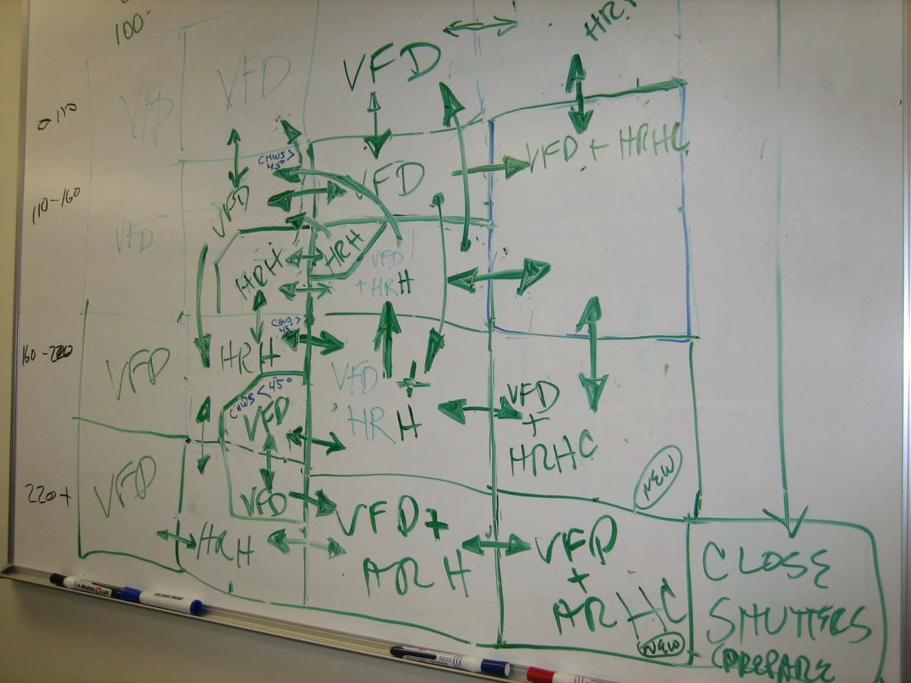
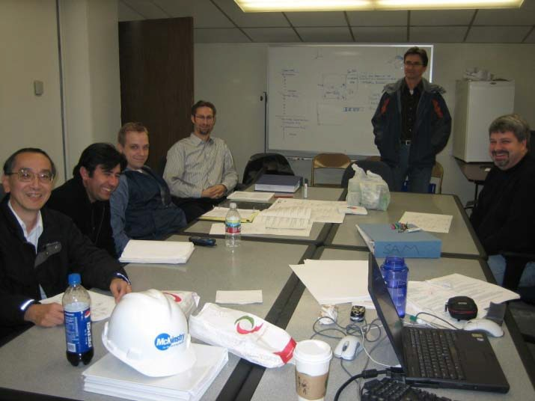
Teamwork = Results
Go team

Slide 51
Thank You

